Slide 1



Project Management
Delivering Value Through Projects

Slide 2

Why Project Management?
“You don’t see yourself being a project manager, so why take this course?”
Develops different types of critical thinking skills.
Most careers will have you engage in project work.
You ask better questions as a project stakeholder.
You understand where to look for signs of problems.
You know what to expect when engaged in project work.
“Not many projects are to send someone into space, so we start small and work our way up the complexity ladder.”

Slide 3

“It Depends”
The most used answer in project management

Slide 4
Course Review
Course Outline
13 Sections, 60-90 Minutes Each
Team Case Study
  Short & Progressive Presentations
Referencing the Project Management Body of Knowledge(PMBOK®) 6th and 7th Editions
Slides are Background for Conversations
Sections
Introduction to Project Management
Waterfall(Standard) vs. Agile
Project Initiation
Project Planning
Resource/People Management
Communications Management
Scope Management
Schedule/Time Management
Cost Management
Risk Management
Project Transition
Strategic Implementations
Project Mgt. Careers & Tool Chest Review

Slide 5
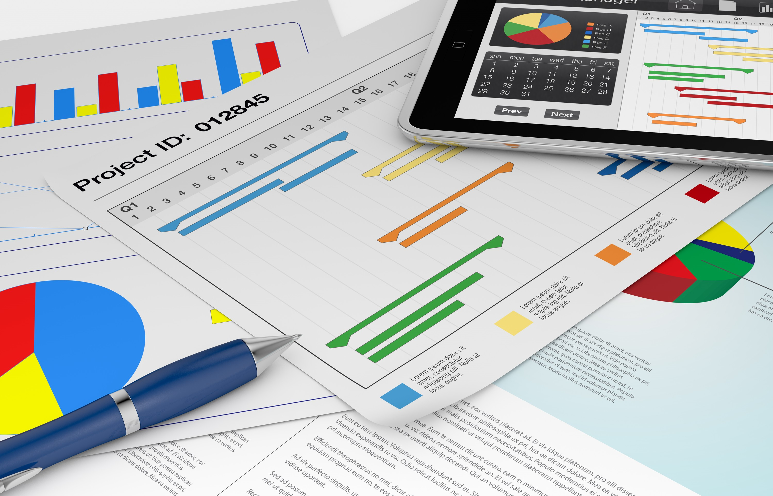
Team
Project
Teams of 3-5
Short Presentations
Progressive Content
Plan for a Minium Viable Product
Build a Pipeline of Added Value
New Project Management Application
Implementation

Slide 6
Introduction to Project Management
What is Project Management and Why is it Important?
Section 1

Slide 7

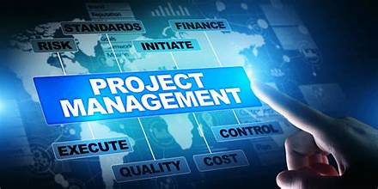

What is Project Management?
Definitions: Project, Project Management, and Program Management
Temporary: There is a definable beginning and end
Unique: Creation of something new (Product, Service, Capability)
Changes: Takes something existing and adds additional value
Progressive: Broken down into steps and methodically implemented
Application of knowledge, skills, tools & techniques used in the execution of projects and programs
Integrating different teams, resources, and organizations
Herding the cats and pulling-off the wedding
Integrated projects that are dependent on each other
Projects that may not be connected but drive a higher-level strategy
Application of project, program, and portfolio management skills
Section 1

Slide 8


Portfolio Management
Grouping of Projects & Programs Under Single Owner
Individual Projects or Programs of Multiple Projects.
Representing Strategic Projects, Customer Projects, Continuous Improvement Projects, etc.
Supporting Resources can be Direct Reporting or Matrix
REPORT
PRIORITIZE
Portfolio
MGT
VALIDATE
EXECUTE
Prioritization of Projects, Programs, and Resources.
Status Reporting of Projects, Programs, and Portfolio.
Leadership & Development of Project Managers.
Monitoring and Controlling the Implementation of Portfolio Projects & Programs.
CONTROL
Section 1

Slide 9





Portfolio Structure
Portfolio Structure isn’t a Leadership Structure
Strategic Portfolio
Owner 1
Sub-Portfolio or Domain 1
Owner 2
Domain 1a
Projects & Programs
Resources
Budgets & Measurements
Domain 1b
Projects & Programs
Resources
Budgets & Measurements
Domain 1c
Projects & Programs
Resources
Budgets & Measurements
Owner 3
Owner 4
Owner 5
Sub-Portfolio or Domain 2
Projects & Programs
Resources
Budgets & Measurements
Sub-Portfolio or Domain 3
Domain Examples
Human Resources
Technology
  Hardware
  Software
  Security
Operations
Finance
  Payroll
  Tax
Domain 3a
Projects & Programs
Resources
Budgets & Measurements
Domain 3b
Projects & Programs
Resources
Budgets & Measurements
Note: Every Organization Structures Domains and Resources Differently
Section 1

Slide 10

Why Project Management?
Project Management Helps
  Deliver objectives
  Meet expectations
  Increase chances of success
  Resolve problems & issues
  Respond to risks more timely
  Optimize resources
  Manage constraints
  Manage change
Tendencies of Projects Not Managed
  Missed deadlines
  Cost overruns
  Poor fitness of use
  Rework
  Uncontrolled scope
  Loss of organization reputation
  Unsatisfied stakeholders
Projects Deliver Value, Solve Problems, and Create Opportunities
Section 1

Slide 11

Attributes of a Project Manager
“The project manager isn’t the smartest person in the room in all areas, but being a generalist sure helps.”
SKILLS
Attributes
Project Management
Facilitation
Leadership
Communications
Analytics
Team Building
Attention to Details
Active Listening
Curiosity
Seeks Input
Pragmatic & Methodical
Sets an Example
Section 1

Slide 12


Blending Skills and Experiences
Project Management
Leadership
Industry Knowledge
Section 1

Slide 13





Leadership Powers
Formal
Power Based on Position
Reward
Giving Incentives/Rewards
Penalty
Able to Penalize Team
Expert
Subject Matter Expertise
Referent
Referencing Higher Positions
Section 1

Slide 14




Project Success
What Defines Success?
SCOPE
COST
SCHEDULE
VALUE
Section 1

Slide 15




Tripple Constraints
They are Real
Scope Drives
Cost + Time
Time Drives
Scope + Budgets
Budget Drives
Time + Scope
Impacts to Fitness of Use
Time + Scope + Budget
Section 1

Slide 16
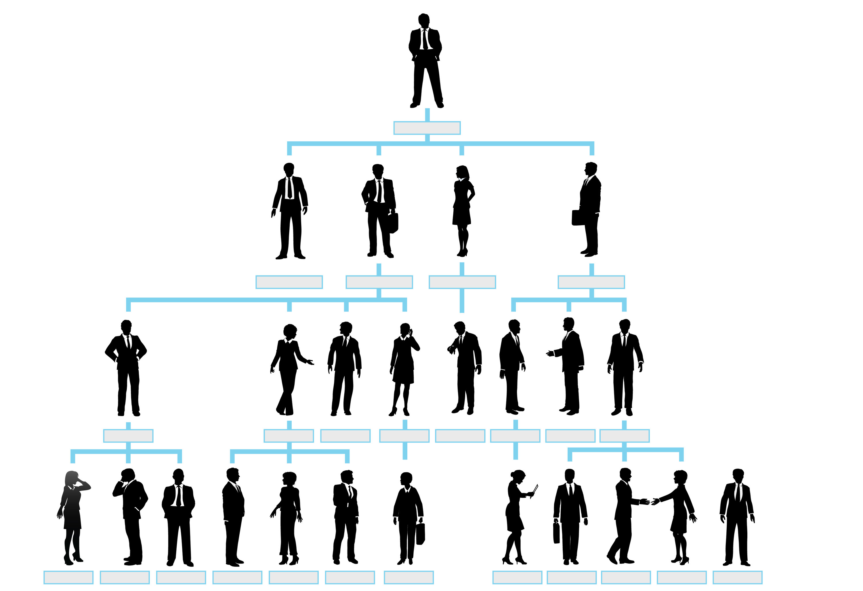
Organizationally Deep Strategy, Culture, Mission, Vision, & Values
Highest-Level Organizational Strategy
Highest-Level Mission, Vision, and Values
Highest
Culture
Business Units / Regional Area Strategy
Mission, Vision, and Values
Alignment
Culture
Culture
Culture
Culture
Functional Area Strategy
Mission, Vision, and Values
Lowest
Culture
Culture
Culture
Culture
Culture
Culture
Culture
Culture
Personal Strategy
Mission, Vision, and Values
Culture
Culture
Culture
Culture
Culture
Culture
Culture
Culture
Culture
Culture
Culture
Culture
Section 1

Slide 17
Project Management Areas of Focus
Knowledge, Skills, and Experience
Project Life Cycle
Starting
Organizing/Plan
Doing the Work / Implementation
Ending
Process Groups
PMBOK® 6th Edition
7th Edition Changed
6th Still Relevant
Initiation
Planning
Executing
Monitor & Control
Closing
Knowledge Areas
Integration
Scope
Schedule
Cost
Quality
Resource
Communications
Risk
Procurement
Stakeholder
Key:
Section 1
Gate / Milestone
Project Phase
Potential Use
Timeline

Slide 18
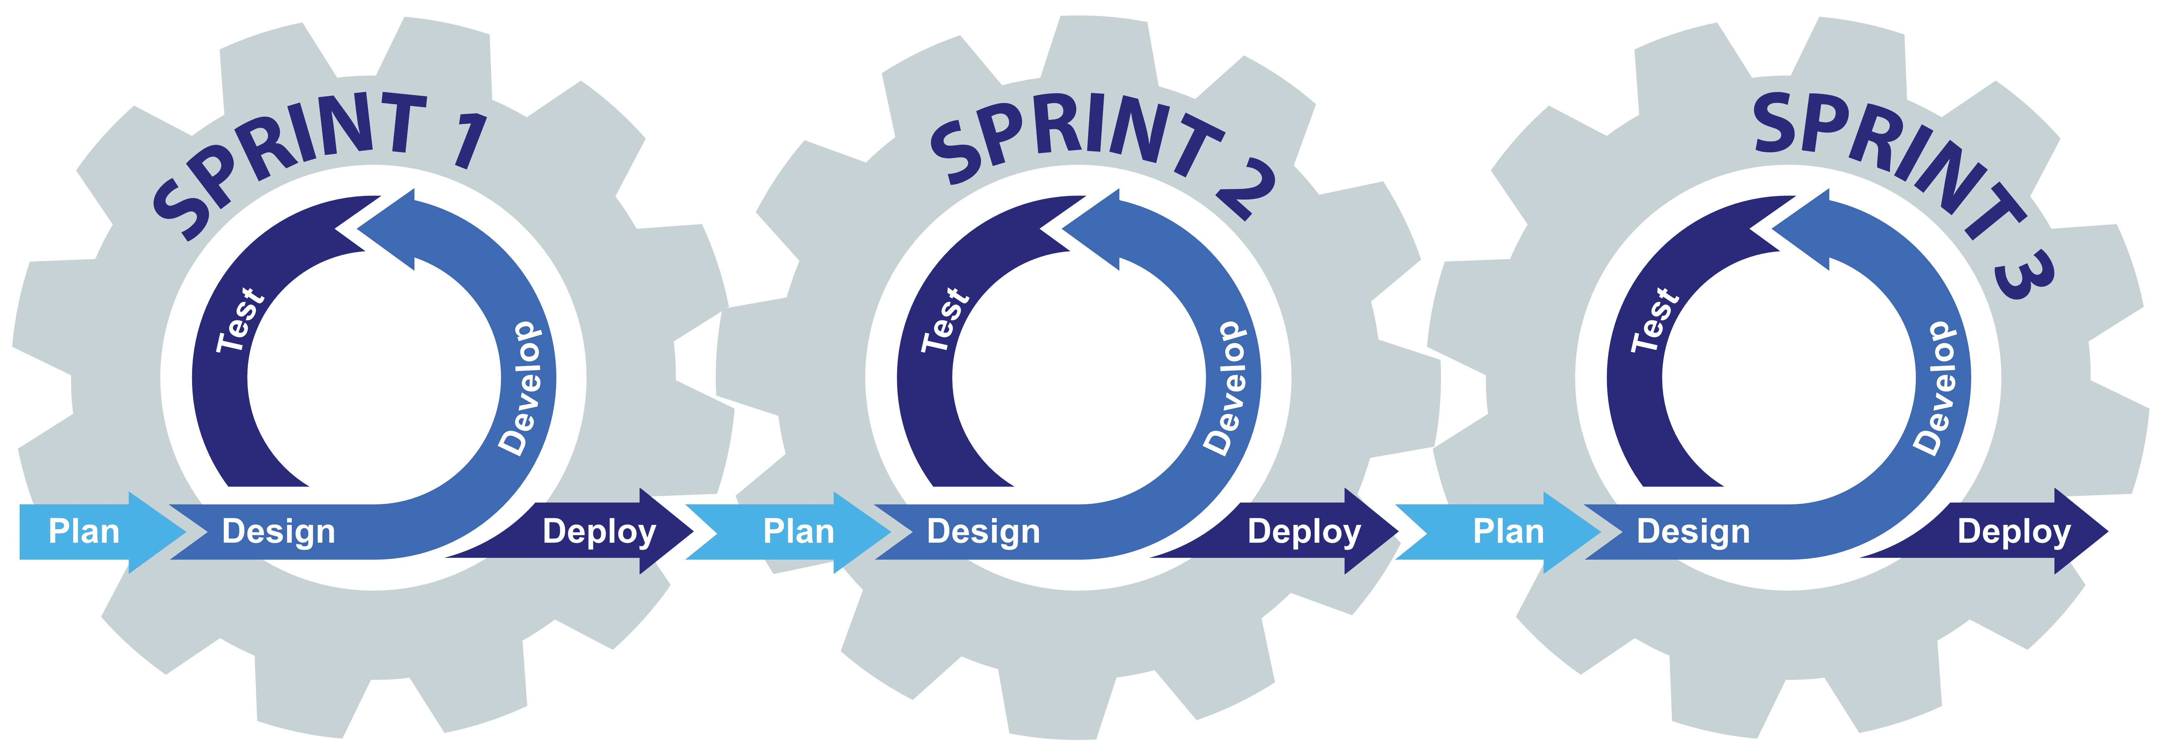

Two Methodologies with Different Approach's
Standard/Waterfall Project or Agile
Standard Project Method
Agile Method
Hybrid
Starts from Nothing
Delivers a Minimum Viable Product (MVP)
Clearly Defined Objectives
Experienced Resources
Longer Durations
Larger Project Teams
Dispersed Resources (Possible Time Zones)
Agile comes from Lean Methodologies
Minimum Viable Product (MVP) Exists
Short Iterations to Deliver Value
A Pipeline of Ideas Ready to Go
  User Stories
Smaller Consistently Changing Teams
Teams Closer, if not Collocated
Section 1

Slide 19






Complexity
Understanding It and Accounting For It
Technology
Geography
Organizations
Goals/Objectives
Skilled Positions
???????
The List Goes On, and On
People Deliver Projects
Understanding complexity is understanding how many people are needed to support.
People represent functions, skills, locations, languages, etc.
Lower Complexity
Higher Complexity
Section 1

Slide 20
Information Flow
Strategy, Desired Outcomes, Deliverables, and Progress
Desired Outcomes, Benefits, & Value
Deliverables with Support & Maintenance Information
Strategy
Senior Leadership
Portfolios
Programs and Projects
Operations
Portfolio Performance Information
Performance Information & Progress
Information for Updates, Fixes, & Adjustments
Outcomes, Benefits, Value Performance Analysis
PMI® PMBOK® 7th Edition “A System for Value Delivery”
Section 1

Slide 21






Project Management Tools
Mid-High Complexity Projects
Desktop Application / Central is Cloud Based
≈ $500 One-Time Licensing Fee per User
Low to Medium Complexity Projects
Cloud Based Application
≈ $110 - $230 per User, Annually
Tool Complexity
Lower Complexity Projects
Cloud Based Application
≈ $250 per User, Annually
Lower Complexity Projects
Cloud Based Application
≈ $500 - $1,200 for 5 Seats, Annually
Lower Complexity Projects
Cloud Based Application
≈ $7 - $19 per User, per Month

Slide 22

Project Management Professional (PMP®)
Requirements
  High school diploma or GED
    60 Months/5 Years Experience within Past 8 Years
  ≥ 4 Year Degree
    36 Months/3 Years Experience within Past 8 Years
  ≥35 hours of project management education/training
  60 Professional Development Units (PDU) every three years
Certification Exam
  180 Questions in 3:50 Hours
  Price: $425 PMI Member/$675 nonmembers
PMP Stats
  Average U.S. Median Salary ≈ $120k
  Current Holders ≈ 1.5m Worldwide
    >500,000 in North America (November 2024)
  Top Countries: U.S., Canada, China
Section 1

Slide 23
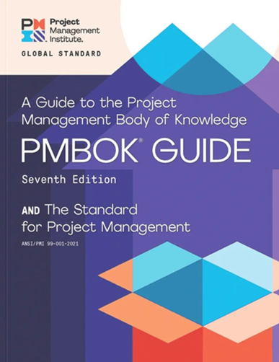

Project Management Body of Knowledge (PMBOK®) Guide 7th Edition
“Shift to a Principle-based standard, focused on intended outcomes rather than deliverables.”
The Project Management Institute (PMI®)
PMBOK® Guide 7th Edition
7th Edition Radically Changed from Previous Editions
The Standard for Project Management
  A System for Value Delivery
  Project Management Principles
Project Performance Domains
  Stakeholder Performance
  Team Performance
  Development Approach & Lifecycle Performance
  Planning Performance
  Project Work Performance
  Planning Performance
  Measurement Performance
  Uncertainty Performance
Tailoring
Models, Methods, and Artifacts
Section 1

Slide 24

Certified Associate in Project Management (CAPM®)
Requirements
  High school diploma or GED
  No experience requirements
  ≥23 hours of project management education/training
  15 Professional Development Units (PDU) every three years
Certification Exam
  150 Questions in 3:00 Hours
  Price: $225 PMI Member/$300 nonmembers
CAPM Stats
Average U.S. Median Salary ≈ $72k
Current Holders ≈ 1.7m Worldwide
Types of Positions
  Assistant Project Manager
  Project Administrator
  Project Analyst
  Project Coordinator
  Project Manager
  Technical Project Manager
Section 1

Slide 25

















Other Project Management Credentials
Undergraduate, Graduate, or University Certifications/Degrees
Program Management Professional (PgMP®)
Disciplined Agile Scrum Master (DASM®)
Portfolio Management Professional (PfMP®)
Disciplined Agile Senior Scrum Master (DASSM®)
PMI Agile Certified Practitioner (PMI-ACP®)
Prince2 Foundation
PMI Professional in Business Analysis (PMI-PBA®)
Prince2 Practitioner
PMI Risk Management Professional (PMI-RMP®)
Prince2 Agile Foundation
PMI Scheduling Professional (PMI-SP®)
Prince2 Agile Practitioner
https://www.pmi.org
https://www.prince2.com
Section 1

Slide 26

Team Exercise: Getting the Band Together
Start Forming Teams & Prepare for Introductions
Team Organization
Separate into Teams
Preferably Different Skills
Pick an Application
Team Exercise

Slide 27
Standard Approach vs. Agile
Two Methods with Different Structures
Which to Use & Why Both are Needed
Section 2

Slide 28
Two Methodologies with Different Approaches
Standard/Waterfall Project or Agile
Centralized Structure
Decentralized Structure
Standard Project Method
Agile Method
Starts from Nothing
Delivers a Minimum Viable Product (MVP)
Clearly Defined Objectives
Experienced Resources
Longer Durations
Larger Project Teams
Dispersed Resources (Possible Time Zones)
Agile comes from Lean Methodologies
Minimum Viable Product (MVP) Exists
Short Iterations to Deliver Value
A Pipeline of Ideas Ready to Go
  User Stories
Smaller Consistently Changing Teams
Teams Closer, if not Collocated
Predictable
Hybrid
Adaptive
Section 2

Slide 29

Minimum Viable Product (MVP)
Delivering Initial Value
Foundational Project Deliverables
Decreases Time to Initial Delivery
Solves Immediate Needs/Problem
Includes Multiple Integrated Pieces
Established Base Solution
Stakeholders Evaluate Performance
Identify Future Needs/Value Iterations
Prioritize Needs, and Short-Term Sequence
Allocate Resources for Adaptive Approach
Section 2

Slide 30
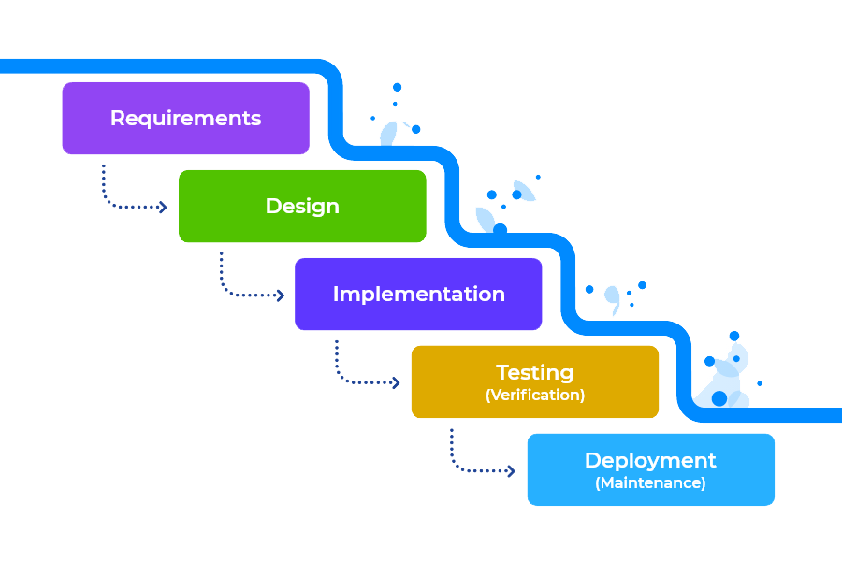
Regular, Standard, Waterfall Project Management
Predictive Approach
Solution Design / Core Development / Unit Testing
User Acceptance Testing, End User Training
1st Level Cost Estimates, Schedule, Scope, Resourcing, Risk
Integration & End-to-End Testing / Training Data Setup
Go-Live Support / Hypercare
Requirements / Discovery / Revised Cost / Updated Timelines
Steady State
Knowledge Gap
Acceptance of Baseline Schedule, Cost, Scope, Risk, Etc.
Project Team Engagement
Ideation / Commercial Notification
Project Approved & kick-off Sessions
Transition to
Run the Business
Scope, Schedule, Cost Controls
Ideation & Approvals
Initiation & Planning
Design/ Develop / Test / Train
Support
Close
Time
Lifecycle
Section 2

Slide 31
Standard Team Structure Example
Different Projects = Different Resources
Core Business
Centralized
PROJECT
External Org.
Project
Manager
Sponsor(s)
Project Manager(s)
Legal
Lead
Finance
Lead
Compliance Lead
Technology
Project Manager
Operations
Lead
Human Resource Lead
Marketing Lead
Integration
Lead(s)
Application Lead(s)
Hardware Lead(s)
Tech Security Lead(s)
Section 2

Slide 32




What is Value?
“Something of worth, importance, or usefulness.”
User Experience
Market Expansion
Cost Reduction
Quality Gains
What does an incremental gain do in these areas?
What other categories define value?
Section 2

Slide 33






Adaptive/Agile Structure
Different Value Iterations = Different Resources
Decentralized
OWNER
ARCHITECT
PROJECT LEAD
TEAM MEMBERS
Product/Service
Tech/Ops
Project Specific
Project Specific
Ensures the Right Capability is Built
Ensures the Capability is Built Right
Coordinates the Capability Build
Builds the Capability
Executives
Operations
Technology
External Orgs
Functional Experts
Operational Experts
Technology Experts
External Experts
STAKEHOLDERS
SPECIALISTS
Section 2

Slide 34
Agile Team Roles & Responsibilities
OWNER
ARCHITECT
PROJECT LEAD
TEAM MEMBERS
Ensures the Right Capability is Built
Ensures the Capability is Built Right
Coordinates the Capability Build
Builds the Capability
Defines capabilities to be built
Prioritizes iterations.
Updates Sr. Stakeholders
Consolidates input from Architect & Project Lead
Brings technical expertise
Oversees solution testing
Validates design
Provides input to Owner for approvals
Coordinates activities
Integrates functional teams
Plans & controls the iteration
Provides status to Owner.
Facilitates team meetings.
Provides Lead with activities, durations, and dependencies
Performs the work
Provides updates to Lead
Coordinates change of scope
Performs testing and deployment of solution.
Section 2

Slide 35
First a Minimum Viable Product (MVP)
Start with Basics & Grow
Minium Viable Product
VALUE ITERATIONS
VALUE
VALUE
VALUE
VALUE
VALUE
VALUE
Market Growth / Sustainable Products & Services
VALUE
VALUE
VALUE
VALUE
VALUE
VALUE
VALUE
VALUE
VALUE
VALUE
VALUE
VALUE
VALUE
VALUE
VALUE
VALUE
VALUE
VALUE
VALUE
VALUE
VALUE
VALUE
VALUE
VALUE
VALUE
VALUE
Section 2

Slide 36
Predictive into Adaptive
YEAR - 1
YEAR - 2
ITERATIONS
Mth1
Mth2
Mth3
Mth4
Mth5
Mth6
Mth7
Mth8
Mth9
Mth10
Mth11
Mth12
Mth1
Mth2
Mth3
Mth4
Mth5
Mth6
Mth7
Mth8
Mth9
Mth10
Mth11
Mth12
MVP
Iteration A
Iteration B
Iteration C
Iteration D
Iteration E
Iteration F
Planning
Building/Testing
Review/Feedback
Approve
Adjust/Track
Predictive
Adaptive
Hybrid
Section 2

Slide 37
Generating a Pipeline (Backlog) of Value Iterations/Sprints
Call Them Whatever You Like
What is the Market/Community/Customer Saying?
Internal Controls
External Controls
Community Access
Cost of Service
Mission Alignment
Staff Engagement
Use of Service
Community Feedback
Communications
Technology
Funding
Paid Staffing
Investment in Growth
Transparency
Facilities/Locations
Tracking/Report Outcomes
Impact Analysis
Service Planning & Design
Leadership Support
Learning & Adjusting
Partner Relationships
Equipment
Volunteers
Sustainable Solution
Backup Support
Service Needs
Government Policies
Local 501 c3 Organizations
Volunteer Engagement
Funding Sources
Community Perception
Charity Rating Platforms
Partner Access/Support
Political Affiliations
Section 2

Slide 38
Strengths-Weaknesses-Threats-Opportunities
External Forces
Value Propositions from a SWOT
Opportunities
Forces that can be capitalized
Factors
Political, Economic, Social-Cultural, Technological, Environmental, Legal, etc…
Threats
Forces that can cause disruptions
Factors
Political, Economic, Social-Cultural, Technological, Environmental, Legal, etc…
Strengths
Forces that are unique to the organization
Core competencies: Skills, operating capabilities & differentiators
Resources: People & Capital
Opportunities-Strengths (OS)
Strategic Thyme(s)
Using strengths to exploit opportunities
Strategy
(O1, S2, S3)
Threats-Strengths (TS)
Strategic Thyme(s)
Using strengths to combat threats
Strategy
(T3, S1, S3)
Internal Forces
Weaknesses
Forces that limit an organizations value proposition
Capabilities, skills, capital investments, etc.
Opportunities-Weaknesses (OW)
Strategic Thyme(s)
Correcting weaknesses to exploit opportunities
Strategy
(O2, W1)
Threats-Weaknesses (TW)
Strategic Thyme(s)
Correcting weaknesses to combat threats
Strategy
(T4, W3)
Section 2

Slide 39


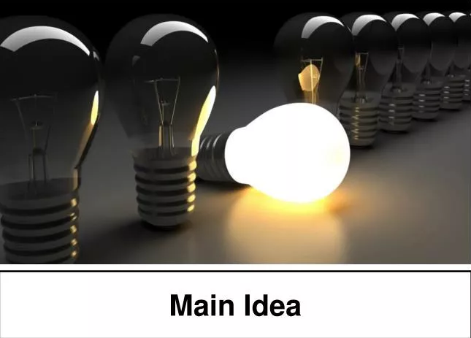
Start the Pipeline at Project Initiation
Value Iteration
1 Piece of Added Value
Value Iteration
The Big Idea
1 Piece of Added Value
Minimum Viable Product
100 Pieces of Value to Create
Value Iteration
60 Pieces for Base Solution
1 Piece of Added Value
Value Iteration
Value Iteration
1 Piece of Added Value
1 Piece of Added Value
Section 2

Slide 40


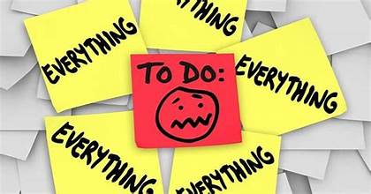

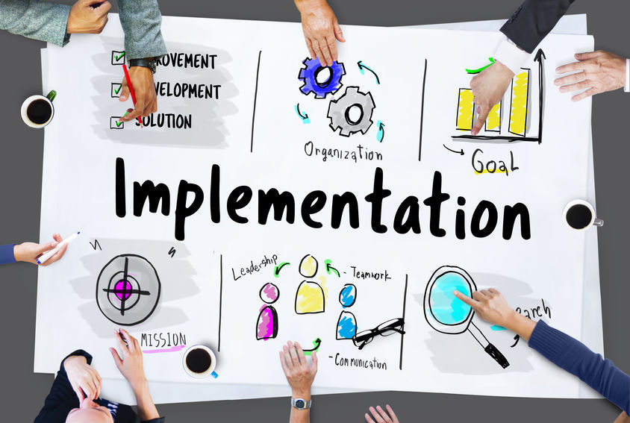

Managing a Pipeline of Value Driven Ideas
Develop Initial list of Value Propositions
Review How the Implementation Went
Prioritize the Top 3-5 Initiatives
Reprioritize the Pipeline and Rethink Approach
Implementation of first Value Iteration
Get in A Rhythm
Section 2

Slide 41
Value Iteration/Sprint Management
#
Prioritized Iteration/Sprint
Service/Area
Resources Needed
Expected Outcome
1
Iteration/Sprint
Service/Area
Resources
Outcome
2
Iteration/Sprint
Service/Area
Resources
Outcome
3
Iteration/Sprint
Service/Area
Resources
Outcome
Pipeline/Backlog of Iterations/Sprints
Iteration/Sprint
Iteration/Sprint
Iteration/Sprint
Iteration/Sprint
Iteration/Sprint
Iteration/Sprint
Iteration/Sprint
Iteration/Sprint
Iteration/Sprint
Iteration/Sprint
Iteration/Sprint
Iteration/Sprint
Iteration/Sprint
Iteration/Sprint
Iteration/Sprint
Section 2

Slide 42
Project Initiation
Getting Things Going
Getting the Band Together
Section 3

Slide 43



A Journey in Project Management
Adjust It
Let’s Take it Together
Close It
I need you to lead a project.
Do It
No problem.
Plan it
Start it
Section 3

Slide 44

Project Assignment
Project Managers Are Normally Assigned
Okay, now what?
What’s the scope?
What are the expectations?
  money, time, deliverables
What skills are needed?
Who to engage first?
What’s the exposure?
Who are the key stakeholders?
What are the constraints?
What are the assumptions?
Section 3

Slide 45
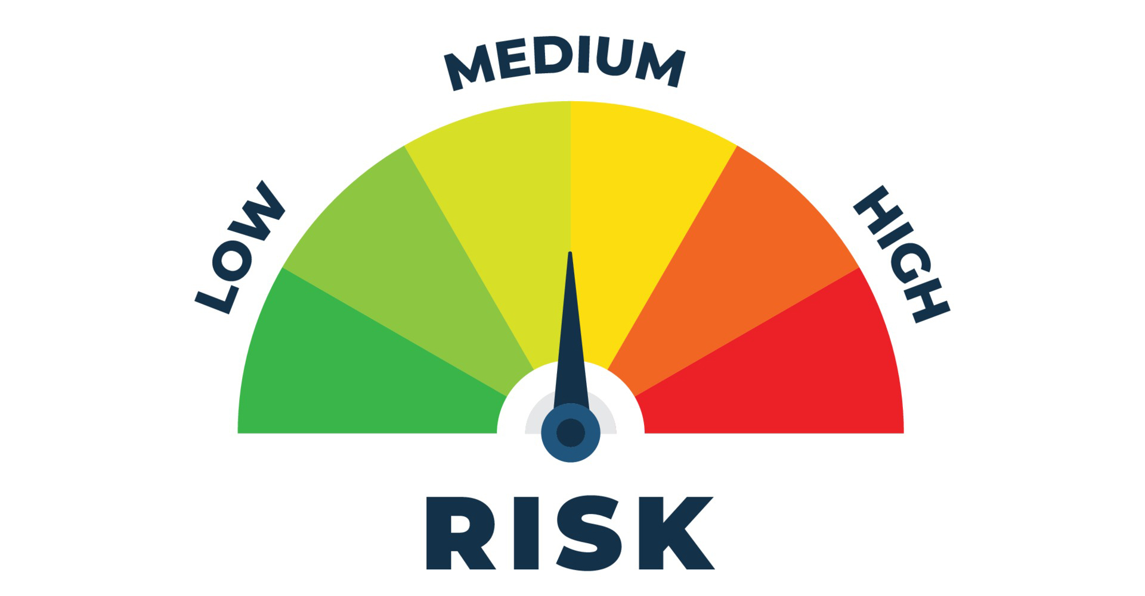

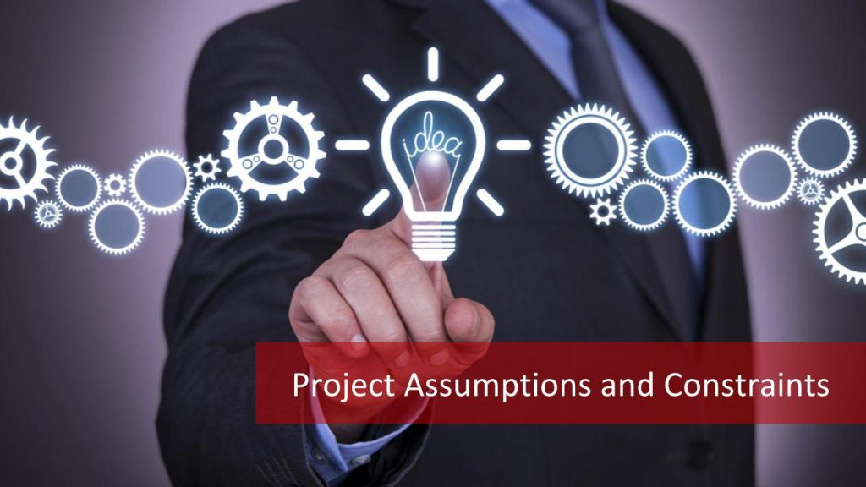


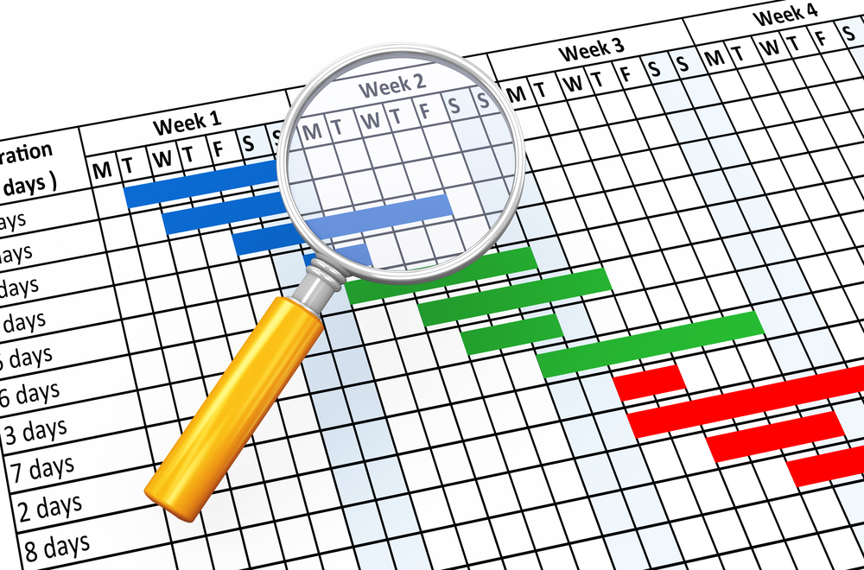

Getting it Going
Project Initiation: Putting the Band Together and Creating the Playlist
Why this project, what are the expected outcomes?
What are the potential risks?
What’s the initial understanding of scope, what’s in, and what’s out?
What are the current assumptions and constraints?
Who are the resources needed and where do they sit?
How are communications managed
What are the schedule expectations?
Who are the initial stakeholders?
Schedule
Section 3

Slide 46
What Style of Project
Depends on What We Know or Think We Know
Predictive
Longer View of Expected Results or Needs
Hybrid
Understand Midrange Needs, Future Needs Unpredictable
Adaptive
Short View of Results or Needs, Uncertainty of Future
Section 3

Slide 47
Project Environmental Factors
Internal Environmental Factors
External Environmental Factors
Process Assets
Governance Documentation
Data Assets
Knowledge Assets
Security & Safety
Culture, Structure, & Governance
Geographic Distribution
Infrastructure
Technology & Software
Resource Availability
Employee Capabilities
Marketplace Conditions
Social & Cultural Conditions
Regulatory Environment
Commercial Databases
Academic Research
Industry Standards
Financial Considerations
Physical Environment
Section 3

Slide 48
Project Performance Domains
Stakeholders
Project Work
Team
Delivery
Integrated
Interdependent
Concurrent
Development Approach & Life Cycle
Measurement
Planning
Uncertainty
Section 3

Slide 49
Narrowing the Knowledge Gap
When do Project Managers Engage?
Prj. Approvals
Getting it Going
Solution Design / Core Development / Unit Testing
User Acceptance Testing, End User Training
1st Level Cost Estimates, Schedule, Scope, Resourcing, Risk
Integration & End-to-End Testing / Training Data Setup
Go-Live Support / Hypercare
Requirements / Discovery / Revised Cost / Updated Timelines
Steady State
Knowledge Gap
Acceptance of Baseline Schedule, Cost, Scope, Risk, Etc.
Project Team Engagement
Ideation / Commercial Notification
Project Approved & kick-off Sessions
Transition to
Run the Business
Scope, Schedule, Cost Controls
Ideation & Approvals
Initiation & Planning
Design/ Develop / Test / Train
Support
Close
Time
Earlier the Better
Lifecycle
Section 3

Slide 50








Project Charter
Formal Initiation Document
Charter
Project Charter
Executive Summary
Formalizes the Project
Used at Initiation
Not a Living Document
Guides the Project Start
Communications Tool
Can be Contract Appendix
Sets Initial Scope Baseline
Not all Charters are Equal
Scope
People
Time
Money
Communicate
Risks
Constraints
Section 3

Slide 51
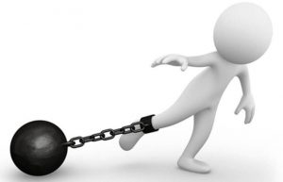
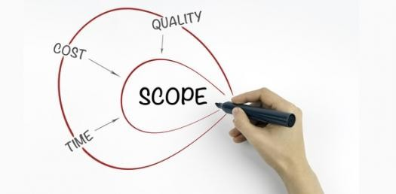
Constraints and Assumptions
Constraints
Assumptions
Must be completed by.
An agreement ends on this date.
System is being sunset on this date.
We only have this amount approved to spend.
There’s a holiday weekend where we should go live.
We need to have all agreed to functionality on day one.
A key resource is out of pocket during a specific period.
When we want to go live there will be a low impact on stakeholders.
The project will deliver an expected value within a short time.
If we deliver this project the demand will be there.
The cost we estimated in the approvals will be all that’s needed.
We have the skill and abilities to implement this.
Section 3

Slide 52

Team Exercise: Kick Starting the Project
What’s the project all about?
Project Initiation
What’s the project about?
Who needs to be involved?
When is it expected to be ready?
Constraints and assumptions?
How will the project team communicate?
How is the project funded?
Any big risks?
Team Exercise

Slide 53
Project Planning
Who, What, When, How
Baselining Expectations
Section 4

Slide 54






Planning for What?
What Tools/Processes/Methodologies Planned to Use
Project Plan
Communications
Work Breakdown Structures
Activity Dependencies and Durations
Baselined Scope of Work Demonstrated
Subject Mater Experts Input and Buy-in
Activities with Ownership
Executive Sponsor Status Reporting
External Communications
Project Team Communications
Frequency/Methods/Content/Audience
Resource Plan
Cost Control
Sponsors, Stakeholders, Decision Makers
Internal & External
Functional Leads & Work Product Owners
Available Contact Information
Connected to Project Plan
Baselined Budgets
Estimated Dates of Spend
Approval Processes for Changes
Cost Reporting
Scope Control
Risk Control
Baselined Scope Document
Scope Change Process & Approvals
Connected to Project Plan & Cost Control
Future Looking Threats and Opportunities
Probabilities and Impact Responses
Connected to Project Plan
Issues Lists are Separate and Immediate
Section 4
*Others Not Shown and Not Every Project Requires Everything

Slide 55
The Hardest Thing to See
Think About the Dots As
Scope
Schedules
Cost
Resources
Risks
Communications
What’s Missing?
1.1
1.3
10.1
2.1
2.3
1
2
10
8.1
8.3
1.2
1.4
8
2.2
10.2
8.4
8.2
7.5
7.2
5.5
7
5.2
5.3
3.1
7.4
5
3
9.1
7.1
5.4
5.6
7.3
9.4
9.3
5.1
9
4.3
6.1
6.4
4
6
4.2
4.1
9.2
9.5
6.2
6.3
Section 4

Slide 56

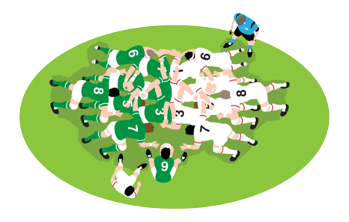
Project Management is a Team Sport
Treat it That Way
Section 4

Slide 57
Narrowing the Knowledge Gap
Building Structure with Flexibility
Prj. Approvals
Getting it Going
Solution Design / Core Development / Unit Testing
User Acceptance Testing, End User Training
1st Level Cost Estimates, Schedule, Scope, Resourcing, Risk
Integration & End-to-End Testing / Training Data Setup
Go-Live Support / Hypercare
Requirements / Discovery / Revised Cost / Updated Timelines
Steady State
Knowledge Gap
Acceptance of Baseline Schedule, Cost, Scope, Risk, Etc.
Project Team Engagement
Ideation / Commercial Notification
Project Approved & kick-off Sessions
Transition to
Run the Business
Scope, Schedule, Cost Controls
Ideation & Approvals
Initiation & Planning
Design/ Develop / Test / Train
Support
Close
Time
Lifecycle
Section 4

Slide 58
Estimating
Levels of Accuracy
75%
50%
Accuracy
Range
25%
0%
-25%
Time
Section 4

Slide 59




Resource Planning
Identify Needed Skills & the People With Them
Identify Other Needed Resources
Leadership
Sponsors
Project Manager
Stakeholders
External Organizations
Technology
Functional Area
Functional Area
Functional Area
Skills
Skills
Skills
Skills
Skills
Skills
Specialized Equipment
Facilities / Buildings
Section 4

Slide 60
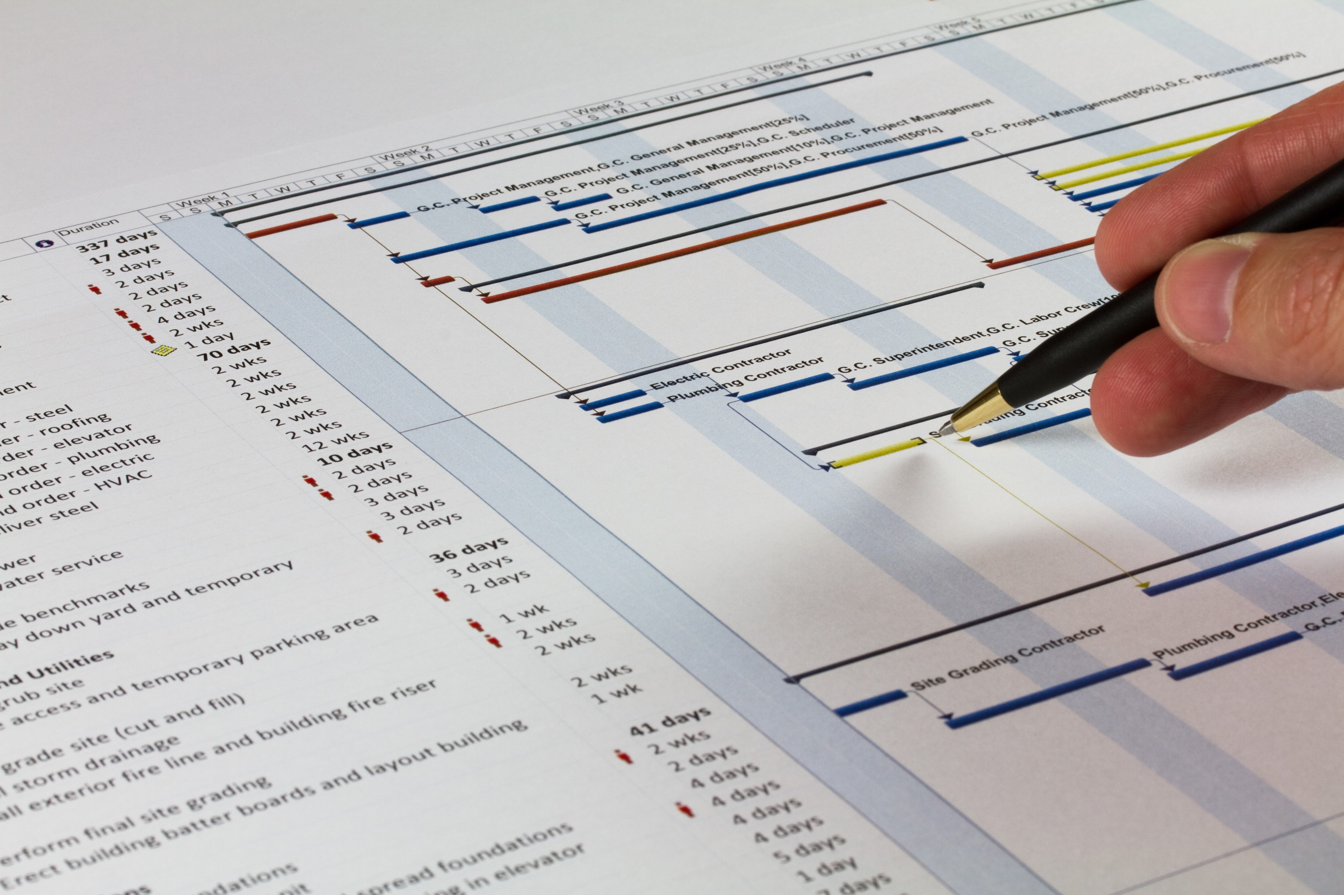
Schedule Planning
Tool(s) to use
Defining the work
Linking work with dependencies
Applying durations to the work
Allocating resources
A critical path that makes logical sense
Getting a schedule to baseline
Section 4

Slide 61


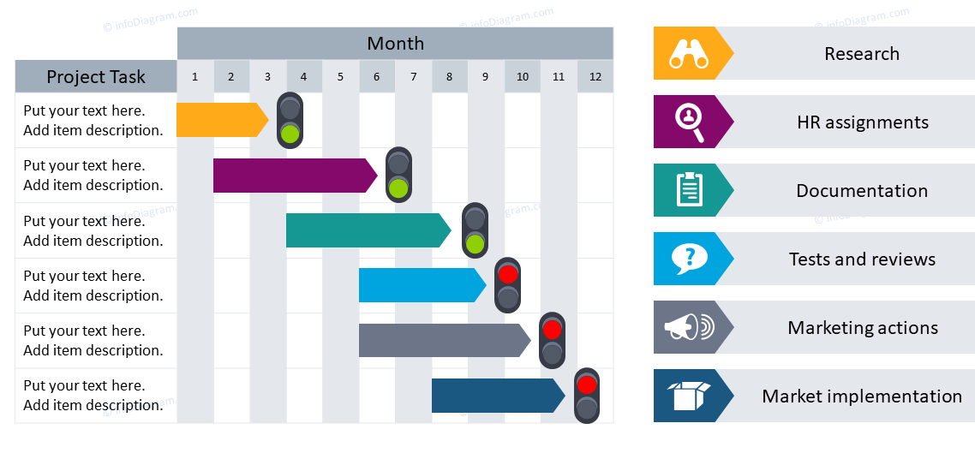
Communications Planning
HOW
WHO
WHAT
E-mail
Video Calls
Face-to-Face
Push Status Reports
Pull Status Reports
Stand-Up Meetings
Internal/External
Stakeholders
Project Team
Executive Leadership
Functional Leaders
Organizational Wide
Project Status
Challenges / Risks
Scope Changes
Cost Performance
Timeline Updates
Roadblocks
Section 4

Slide 62
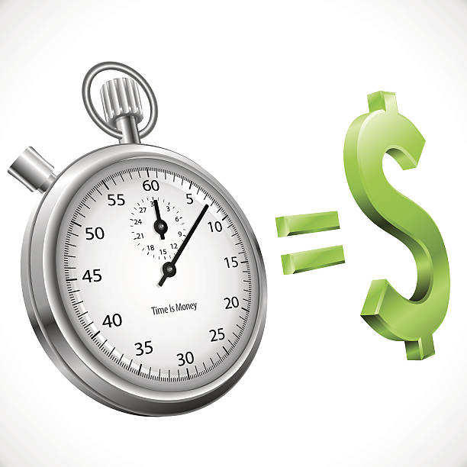

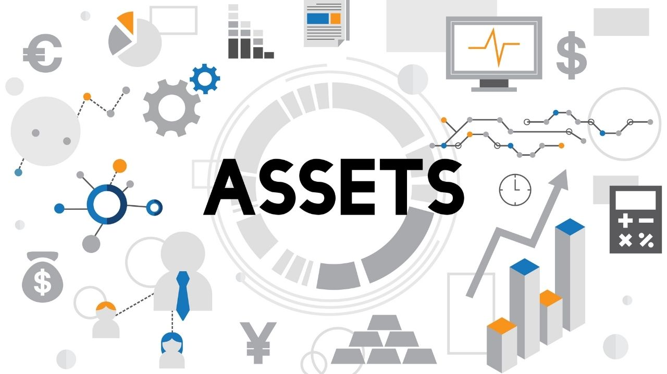
Cost Planning
Cost of Time
Resource Cost
Internal & External
Invoiced or Not
Where are Cost Associated
How to Estimate
How to Track
Travel Expenses
How Travel is Authorized
Where are Cost Associated
Are Cost Marked-Up
How to Estimate
How to Track
Asset Costs
Capital or One-Time
Margin Applied
Where are Cost Associated
How to Estimate
How to Track
Section 4

Slide 63

Scope Planning
Who authorized current scope of work?
How will scope be validated?
Once agreed, how will scope be controlled?
Who approves changes to scope?
How to build the scope of work into a timeline?
Section 4

Slide 64

Risk Planning
How will project disrupters be identified?
Who makes decisions on what to accept?
How will risks be evaluated?
Will this be done at all?
Section 4

Slide 65

Team Exercise: Building the Foundation
Project Planning
What needs to planed?
How accurate will you be?
Who approves the plans?
Team Exercise

Slide 66
Resource
Management
People, Equipment, Technology, etc.
Borrowed or Owned
Section 5

Slide 67








Functions Associated with Projects
People Drive Project Delivery
Provides Oversight & Coordination
Presents Objectives & Feedback
Facilitates & Support
Performs Work & Contributes Insight
Applies Expertise
Provides Business Direction & Insights
Provides Resources & Direction
Maintains Governance
Customer: Individual or group who requested or is funding the project.
End User: Individual or group who experiences the direct use of the project deliverable.
Section 5

Slide 68




Coordinating the Work
Centralized
Decentralized
Functional Team Members
Project Manager
Functional Leaders
Self
Organizing
Functional Team Members
Servant Leader
Facilitator
Leadership and Guidance of a Project Manager
Team Members Self-Organize & Self Manage
Section 5

Slide 69

Stakeholders
Identify
Stakeholder
Individual, group, or organization that touches the project or outcome of the project.
Monitor
Understand
Engagement
Stakeholder Aspects
Power, Impact, Attitude, Beliefs, Expectations, Degree of Influence, Proximity to the Project, Interest in the Project, and Other Interactions
Engage
Analyze
Prioritize
Section 5

Slide 70
Project Team Allocation
Who Owns the Team Resources
Projectized
Matrix
Project
Manager
Project
Manager
Technology
Engineering
Team
Team
Direct Reporting
Finance
Human Resources
Marketing
Team
Team
Team
Borrowed Resources
Section 5

Slide 71
Standard Team Structure Example
Different Projects = Different Resources
Core Business
PROJECT
External Org.
Project
Manager
Sponsor(s)
Project Manager(s)
Legal
Lead
Finance
Lead
Compliance Lead
Technology
Project Manager
Operations
Lead
Human Resource Lead
Marketing Lead
Integration
Lead(s)
Application Lead(s)
Hardware Lead(s)
Tech Security Lead
Section 5

Slide 72



Cross Organizations-Countries-Continents
Distributed Project Teams
Challenges to Resource Management
Working Together
Time Zones
Cultures
Policies
Leadership Direction
Government
Skills & Capabilities
Availability
Desire
Transparency
Respecting Differences
Setting Team Norms
Coordination of Events
Section 5

Slide 73
Adaptive (Agile) Team Structure
Different Value Iterations = Different Resources
OWNER
ARCHITECT
PROJECT LEAD
TEAM MEMBERS
Product/Service
Tech/Ops
Project Specific
Project Specific
Ensures the Right Capability is Built
Ensures the Capability is Built Right
Coordinates the Capability Build
Builds the Capability
Executives
Operations
Technology
External Orgs
Functional Experts
Operational Experts
Technology Experts
External Experts
STAKEHOLDERS
SPECIALISTS
Section 5

Slide 74
Factors that Limit Strategic Results
Vision
Actionable
Strategy
Capabilities
Incentives
Resources
Urgency
Success
Lacking Vision
Lacking Actionable Strategy
Lacking Capabilities
Lacking Incentives
Lacking Resources
Lacking Urgency
Confusion
False Starts
Anxiety
Restraint & Resistance
Frustration
Apathy
Success Factors
Transparency
Stakeholder Engagement
Communications
Involvement
Limiting Factors
Disengagement
Organizational Alignment
Resource Capabilities
Contradicting Priorities
Section 5

Slide 75

Culture
What Makes an Organizational or Team Culture
Behaviors
Beliefs
Culture
Section 5

Slide 76
Culture Should be Visible
Alignment with Stated Values or Beliefs
Sample Stated Values or Beliefs
Innovation
Adaptability
Teamwork
Respect
Experiment
Continuous Learning
Continuous Improvement
Integrity
Innovation
Low Risk Opportunities
Formal Training
Formal CI Programs
Accountability
Diversity
Challenging Opportunities
Learn from Failure
Reports to Sr. Leadership
Leadership
Creativity
Trust
Transparency
Shared Experiences
Section 5

Slide 77

What Comes First, Beliefs or Behaviors?
Changing Culture Requires Changing Both
Behaviors
Actions we take
Decisions we make
Tasks we perform
How we work
How we interact
Developed over Time
This isn’t a chicken or egg problem
Forced Behavioral Changes
Beliefs that Followed
Technology Advances
Working Locations
Global Travel
Climate Change
Scientific Advances
Medical Advances
Leadership Advances
Enhances jobs, not eliminates
Remote work is beneficial
People want the same things in life
Fossil fuels to sustainable solutions
The Earth is a sphere
Cancer doesn’t always kill
People need more than a paycheck
Beliefs
How we think
Input into Decisions
Drives commitments
How we trust
Where we get information
Developed over time
Section 5

Slide 78
Change a Culture to Deliver Value
Understand Why the Change is Needed
Cyber security is a threat to data integrity and ransom demands.
The Behavioral Challenge
People like single login access to a system and believe additional steps are unnecessary.
Culture to Change
How Wide the Change is
All users with access to company email, all applications, and have unique user login credentials.
Belief in the Change Comes Much Later
What Behaviors Need to Change
Password credentials change every 90-days, and double security access required for certain applications.
Plan to Socialize the Change
Development of communications material and lists of people impacted by the change.
Socialize the Change
Open and circular communications, answer all questions, and actively listen to concerns.
Build a Team of Champions
Pilot the changes with people that have the greatest connections to those impacted, get feedback and adjust.
Implement in Phases
Make the changes as quickly as possible, but in manageable group sizes, and apply extra support.
Section 5

Slide 79

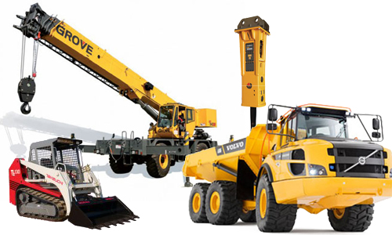
Capital or One-Time Resources
Capital Resources
Depreciable Assets
Facilities
Infrastructure
Office Equip.
Specialty Equip.
Technology
Operating Systems
One-Time Project Resources
Short-Term Needs
Travel
Construction Equip.
Outsourced Experts
Short Term Rentals
Specialty Tools
Short-Term Storage
Section 5

Slide 80

Team Exercise: Resourcing the Project
Resource Planning
Who are the people?
What other resources are needed?
Where are the challenges?
Team Exercise

Slide 81
Communications Management
How, When, Who, and What
Audience Drives Style
Section 6

Slide 82
Forms of Communications
Content
Written or Visual
Physical
Verbal or Audible
Delivery
Push or Pull
E-mails, Memos, Text Messaging, or any form of Written Report
Charts, Graphs, Status Lights, or any Visual Indicator
Face-to-Face, Phone, Video Conferencing, or any form of Direct Connections
Video Content, Recorded Messaging, or any form of Recorded Communications
PUSH
E-mail Reports, Status Meetings, Auto Generated Reports, and other forms of Distributed Communications
PULL
Report Repositories, Portfolio Tools, and other forms of Communications Storage and Retrieval
Formal
Presentations, Project Reviews, Briefings . . .
Informal
General Conversations, Brief Notes, Text . . .
Section 6

Slide 83




Communications Loop
Message Encoding
Message Decoding
Message
Electronic Communications
Audio Communications
Direct Communications
Sender
Noise
Receiver
Feedback
Response
Section 6

Slide 84



Project Engagement of New People
Getting Them Up-To Speed
Project Team
Leadership
Sponsors
Stakeholders
Project Charter
Team Meetings
Status Reports
Document Access
Detailed Reviews
Project Briefings
Status Reports
Project Charter
Executive Summary
Project Briefings
Status Reports
Project Charter
Sponsor Summary
Project Briefings
Status Reports
Narrow Focused Report
Section 6

Slide 85

Communications Channels
Why Planning and Controlling Communications is Important
Project Team Members = N
N(N-1)/2 = Communications Channels
N=10 People
10(10-1)/2 = 45 Channels
Watch Outs
Quiet Team Members
Overbearing Team Members
Focus on Issues, not People
Focus on Present & Future, not Past
Section 6

Slide 86
Status Reporting
What-When-Who-How
Type of Status Reports
Type of Report Content
Frequency
(Weeks)
Executives / Sponsors
Key Milestones, Risks, Cost, & Exec. Decisions Needed
4-5
External Partners
Integrated Activity Status, Issues, Action Items, & Risk Review
1-3
Internal Functional Leaders
Milestones Review, Resource, Risks, Issues, and Needs
1-3
Project Team Members
Activity Status, Milestones Review, Issues, Risks, & Constraints
1-2
Note: Project complexity, organizational importance, levels of risk, and other factors will change audiences, content, and frequencies.
Section 6

Slide 87
Example Status Report
Executives / Sponsors / External / Internal (Modified for Needs)
Project: Project #15976
Project Manager
Stephanie Rodrigues
Tech Project Manager
Kendrick Emanual
Project Status
Status Indicators
Tracking Direction
Report Date: 15 JAN 25
Comp:
25%
Tracking
Challenges
Critical
Holding
Improved
Decreased
Key Milestones / Key Schedule Dates
Scope:
Cost:
Schedule:
Risks:
Resources:
Milestone
Planned Date
Status
Challenge / Issue / Actions
Resolve Date
Status
Contracting for Services Completed
08 OCT 24
100%
Scope Approval Delaying Development
20 JAN 25
Scope of Services/Business Requirements Completed
10 DEC 24
75%
TBD
TBD
TBD
TBD
0%
TBD
TBD
TBD
TBD
0%
TBD
TBD
TBD
TBD
0%
TBD
TBD
TBD
TBD
0%
TBD
TBD
TBD
TBD
0%
Support Needed / Decision to be Made
From / Owner
Status
TBD
TBD
0%
Scope Approval Authorities – Who?
Exec Sponsors
Pending
TBD
TBD
0%
TBD
TBD
TBD
TBD
0%
TBD
TBD
TBD
TBD
0%
TBD
TBD
TBD
TBD
0%
TBD
TBD
What’s the greatest value in creating this report?
Section 6

Slide 88
Scope
Management
Understanding it & Controlling it
Not all Change is Bad
Section 7

Slide 89
Scope: The Delivery of Value
Requirement: “A condition or capability that is necessary to be present in a product, service, or result to satisfy the business need.”
PMBOK® 7th Edition
Project Scope
Scope Decomposition
Functionality
User Experience
Requirements
Requirements
How things work
How they respond
Information provided
How users interact
Value provided
Ease of use
Look & Feel
Requirements
Overall appearance
Quality of materials
Navigation
Section 7

Slide 90
Requirement Attributes
Functional vs. Nonfunctional
Clear
Only one interpretation
Functional
Action Words Describing Functionality Required to Meet Needs
Nonfunctional
Quality Words Describing the Look & Feel, the Appearance
Concise
Use as few words possible
Verifiable
A way to verify completion
Consistent
No contradicting requirements
Complete
Combined requirements represent all project needs
Traceable
They can be identified and followed through the projects
Section 7

Slide 91


Capturing Requirements
Requests for . . .
Information
Quotes
Proposals
Methods
Use Cases
Observations
Interviews
Prototyping
Participants
Functional Stakeholders
Operational Stakeholders
Leadership
End Users
Section 7

Slide 92







The Life Cycle of a Requirement
Requirement Traceability
Requirement
Defined
Added to Scope & WBS
Design
Develop
Test
Train
Execute
Support
Section 7

Slide 93
Scope Decomposition
Breaking Requirements Down – Work Breakdown Structure
Project Scope (Delivery Expectation)
1.0 Requirement
2.0 Requirement
3.0 Requirement
Product Scope
1.1 Task / Work Package
2.1 Task / Work Package
3.1 Task / Work Package
1.2 Task / Work Package
2.1.1 Sub Work Package
3.2 Task / Work Package
2.1.2 Sub Work Package
1.3 Task / Work Package
3.2.1 Sub Work Package
2.1.3 Sub Work Package
3.2.2 Sub Work Package
1.3.1 Sub Work Package
2.2 Task / Work Package
3.3 Task / Work Package
1.3.2 Sub Work Package
2.3 Task / Work Package
1.3.3 Sub Work Package
Project Scope
The work performed to deliver a product, service, or result with the specified features and functions
1.4 Task / Work Package
Section 7

Slide 94
Work Breakdown Structures (WBS)
WBS Benefits
Prevents work slipping through the cracks
Helps the team understand where they fit
Helps prevent changes
Basis for estimating cost, resources and time
Helps with team buy-in
2.1.0 Systems Testing
2.1.1 Unit Testing
2.1.1.1 Write Test Scripts
Use Verbs, Action Words, and be Clear in Description
Work Packages Should be in Manageable Chunks, Not To-Do List Size
2.1.1.2 Create Test Data
WBS is Not
Schedule
Responsibility Matrix
Time Oriented
No Durations
No Dependencies
2.1.1.3 Perform Tests
2.1.1.4 Validate Results
2.1.1.5 Adjust & Correct
2.1.1.6 Retest & Adjust
2.1.1.7 Accept Testing
2.1.2 Integration Testing
2.1.3 User Testing
Section 7

Slide 95


Approving Scope
Scope Planning
Requirements are Defined
Requirements Documented
In Scope & Out of Scope is Clear
Scope Control is Planned
Scope Approvals
Approval Authority Defined
Scope Reviews
Feedback Provided
Adjustments Made
Tentative Approvals Provided
Formal Approvals Given

Slide 96
Controlling Change
“During the life of a project change is inevitable.”
Define the Change
Understand Project Impact
Document the Change
Approve the Change
Schedule the Change
Why the Change
Who Requested
Value Delivered
Cost
Schedule
Resources
Risks
Change Request
Scope Document
Status Reports
Written / Verbal
Documented
Communicated
Build WBS
Add to Schedule
Is the change required for the MVP?
Section 7

Slide 97
Team Exercise: Scope Management
Scope Planning
Work Breakdown Structure (WBS)
How is scope approved?
How are changes to scope managed?
Team Exercise

Slide 98
Schedule / Time Management
Linking the Parts that Deliver Value
Listen to the Experts
Section 8

Slide 99
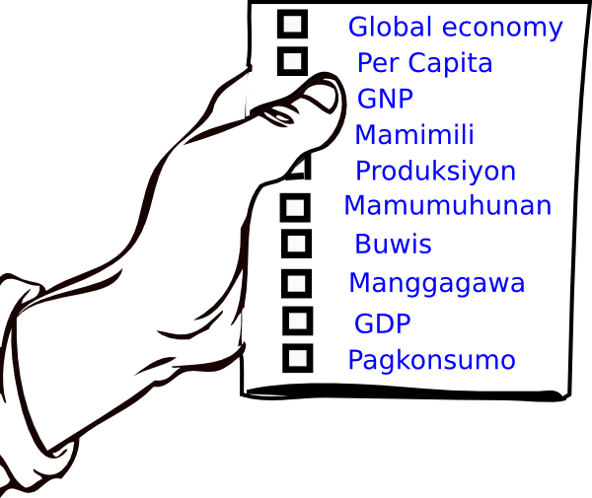
Common Terms in Schedule Management
Constraints
Assumptions
Decomposition
Crash & Fastrack
Work Package
Activities
Milestones
Slack & Lag
Critical Path
Dependencies
Baseline
Section 8

Slide 100


Decomposing the Work Down into Digestible Groups
Work Breakdown Structures
Project
Complexity determines planning tool
  Number of activities, resources, scope, etc.
Activity can represent a few days to a few weeks of effort
  Can be hours or workdays
Logical buckets are good, but not absolute
  Importance is listing the activity somewhere
Summary Level 1.0
Activity 1.1
Activity 1.2
Activity 1.3
Summary Level 2.0
Activity 2.1
Activity 2.2
Activity 2.3
Planning Tools
Summary Level 3.0
Summary Level 3.1
Activity 3.11
Activity 3.12
Activity 3.2
Activity 3.3
Section 8

Slide 101


Estimating Time
Expert Judgement
Analogous Estimating
Quantitatively Based Durations
Bottom Up
Top Down
PERT Estimates
Program Evaluation Review Technique
$\frac{Optomistic + 4\left(Most Likly\right) + Pesimistic}{6}$ = Estimate
Section 8

Slide 102
Applying Time to Activities
WKS
WK 1
WK 2
WK 3
WK 4
WK 5
WK 6
WK 7
Project
3
Durations
Summary Level 1.0
3
Summary Level Time
Activity 1.1
3
WK 1
WK 2
WK 3
Activity 1.2
2
WK 1
WK 2
Apply best estimate of time to complete activities
Order & sequence does not matter
  That comes next
Activity 1.3
2
WK 1
WK 2
Summary Level 2.0
3
Summary Level Time
Activity 2.1
1
WK 1
Activity 2.2
3
WK 1
WK 2
WK 3
Activity 2.3
2
WK 1
WK 2
Summary Level 3.0
3
Summary Level Time
Summary Level 3.1
2
Summary Level
Activity 3.11
2
WK 1
WK 2
Activity 3.12
1
WK 1
Activity 3.2
3
WK 1
WK 2
WK 3
Activity 3.3
1
WK 1
Section 8

Slide 103
Dependencies
Create Logic and Order Trough Linkage
Finish to Start
Mandatory
Nature of the work drives the dependency
Activity
F
When One Finishes the Other Can Start
S
Activity
Finish to Finish
Discretionary
Project preferences drive the dependency
Activity
F
They Both Need to Finish Together
Activity
F
External
Outside, uncontrolled activities drive the dependency
Start to Start
S
Activity
They Both Need to Start Together
S
Activity
Internal
Organizationally controlled activities drive the dependency
Start to Finish
Activity
F
When One is Starting the Other Must be Finishing
S
Activity
Section 8

Slide 104
Critical Path & Milestones
“A critical path is the shortest time from start to finish”
A
B
6 Days
5 Days
Start
Finish
F
7 Days
33 Days
D
E
G
H
C
4 Days
8 Days
5 Days
7 Days
8 Days
“A milestone marks the beginning or end of something”
Milestones Have Zero Duration
Section 8

Slide 105
Linking the Activities Builds the Schedule
WKS
WK 1
WK 2
WK 3
WK 4
WK 5
WK 6
WK 7
Project
7
Project Level Time
Summary Level 1.0
6
Summary Level Time
Activity 1.1
3
FS
WK 1
WK 2
WK 3
Dependencies
Activity 1.2
2
WK 1
WK 2
FS
FS
Finish-Start
Activity 1.3
2
WK 1
WK 2
SS
Start-Start
Summary Level 2.0
4
Summary Level Time
SS +1wk
FF
Finish-Finish
Activity 2.1
1
WK 1
SF
Start-Finish
Activity 2.2
3
FS
WK 1
WK 2
WK 3
SS
Activity 2.3
2
WK 1
WK 2
Summary Level 3.0
5
Summary Level Time
Summary Level 3.1
3
Summary Level Time
FS -1wk
Activity 3.11
2
WK 1
WK 2
Activity 3.12
1
FS -1wk
WK 1
FS
Activity 3.2
3
Critical Path
WK 1
WK 2
WK 3
Activity 3.3
1
Float/Slack
WK 1
FF
Section 8

Slide 106
Crashing & Fast Tracking
Crashing a Timeline
Adding resources to complete the work in a shorter period
Standard Task Duration
Added Resource Duration
Fast Tracking a Timeline
Starting work before completely ready to start
Standard Dependency
Fast Tracked Dependency
F
F
S
S – 10days
Section 8

Slide 107

Schedule Performance
Earned Value or Best Guess
Schedule Performance Index (SPI)
SPI < 1.0 = Behind Schedule
Estimated Cost
100 Hrs @ $10 per Hr
BAC = $1,000
Budget at Completion
Rough Guess Estimates
00% = Not Started
25% = Activity Started
50% = Half-Way Through
75% = Getting Close to Finish
100% = Finished, No Additional Work
COMPLICATED
Planned to be 75% Completed
NOT COMPLICATED
Actual Work is 50% Completed
BCWP = $500
Budgeted Cost of Work Performed
BCWS = $750
Budgeted Cost of Work Scheduled
SPI = 67%
Schedule Performance
Section 8

Slide 108
Update Activities with Owners Input
WKS
WK 1
WK 2
WK 3
WK 4
WK 5
WK 6
WK 7
Project
7
Project Level Time
Summary Level 1.0
6
Summary Level Time
Activity 1.1
3
WK 1
WK 2
WK 3
75%
% Complete
Activity 1.2
2
WK 1
WK 2
100%
0%
Not Started
Activity 1.3
2
WK 1
WK 2
25%
Started
Summary Level 2.0
4
Summary Level Time
50%
About ½ Way
Activity 2.1
1
WK 1
100%
75%
Almost Done
Activity 2.2
3
WK 1
WK 2
WK 3
25%
100%
Finished
Activity 2.3
2
WK 1
WK 2
75%
Summary Level 3.0
5
Summary Level Time
Summary Level 3.1
3
Summary Level Time
Activity 3.11
2
WK 1
WK 2
Activity 3.12
1
WK 1
Activity 3.2
3
Critical Path
WK 1
WK 2
WK 3
25%
Activity 3.3
1
Float/Slack
WK 1
Current Date
Section 8

Slide 109
Narrowing the Knowledge Gap
Moving From Planning to Doing the Work
Prj. Approvals
Getting it Going
Doing the Work
Transferring
Project Intensity
Solution Design / Core Development / Unit Testing
User Acceptance Testing, End User Training
1st Level Cost Estimates, Schedule, Scope, Resourcing, Risk
Integration & End-to-End Testing / Training Data Setup
Go-Live Support / Hypercare
Requirements / Discovery / Revised Cost / Updated Timelines
Steady State
Knowledge Gap
Acceptance of Baseline Schedule, Cost, Scope, Risk, Etc.
Project Team Engagement
Ideation / Commercial Notification
Project Approved & kick-off Sessions
Transition to
Run the Business
Scope, Schedule, Cost Controls
Ideation & Approvals
Initiation & Planning
Design/ Develop / Test / Train
Support
Close
Time
Lifecycle
Section 8

Slide 110



Doing the Work, Controlling the Project
Activity Updates
Status Reporting
Updates to durations & dependencies
Updates to activities % complete
Update activity owners
A critical path that makes logical sense
Audience appropriate reporting
  Executive sponsor reporting
  External organization reporting
  Stakeholder reporting
  Team reporting
Scope Control
Issues Mgt
Understand impact of change
  Cost, schedule, resources, etc.
Approvals of change
Build change into the plan/schedule
Tracking and updating issues
  These are issues happening, not risks
Understanding impact to project
  Cost, schedule, quality, etc.
Risk Control
Resource Mgt
Monitor and adjust identified risks
  Only those with planned responses
Update project plan as needed
Low risks without planned responses let ride but still monitor
Changing functional resources need updated
Adjust deliverables where needed
  Get buy-in from new resources
Section 8
*Others Not Shown and Not Every Project Requires Everything

Slide 111
Team Exercise: Time Management
Schedule Planning
Applying Time to WBS
Linking Activities
What’s the critical path?
When is the project is ready to go?
Team Exercise

Slide 112
Cost
Management
Initial versus Reality
Estimating and Adjusting
Section 9

Slide 113

Estimating Cost
No Different Than Estimating Time
Expert Judgement
Analogous Estimating
Quantitatively Based Estimates
Bottom Up
Top Down
PERT Estimates
Program Evaluation Review Technique
$\frac{Optomistic + 4\left(Most Likly\right) + Pesimistic}{6}$ = Estimate
Section 9

Slide 114
Configuring for Cost of Resources
Quantitatively Based but with Best Guess Assumptions
Travel Cost Est. Configuration
Cost of Resource Configuration
Category | Cost
Airfare (per Trip) | $700
Lodging (per Day) | $250
Rental Car (per Day) | $80
Meals (per Day) | $100
Misc. Travel (per Day) | $10
# | Resource | Role | Existing $ (per Hour) | Incremental $ (per Hour)
1 | Senior Project Manager | Project Management | $125
2 | Business Analyst | Business Requirements | $70
3 | Training Manager | Testing & Training | $0 | $100
4 | Engineer | Operations Design | $125
5 | Operations | Operations Design | $95
6 | IT Project Manager | Project Management | $115
7 | IT Development Lead | Technology Design | $95
8 | Integration Lead | Systems Integration | $95
9 | Applications Lead | Applications Development | $95
10 | Infrastructure Lead | Equipment & Network | $0 | $125
Project Duration Est.
(By Project Phase)
Project Phase | Wks | Est. Start | Est. Finish
Project Initiation | 4 | Mar 03, 2025 | Mar 31, 2025
Discovery & Design | 10 | Mar 31, 2025 | Jun 09, 2025
Development & Testing | 12 | Jun 09, 2025 | Sep 01, 2025
Training, Go-Live, & Close | 10 | Sep 01, 2025 | Nov 10, 2025
Total Est. Project Duration | 36 | Mar 03, 2025 | Nov 10, 2025
Section 9

Slide 115
Applying Next Level Assumptions to Resource Estimates
Tools help in estimates, but they’re still best educated guesses.
Section 8

Slide 116
Cost Performance
Not Easy
Cost Performance Index (SPI)
CPI < 1.0 = Behind Schedule
Cost Performance: For Every $ Spent, There’s $0.83 of Budgeted Value
Challenges to Cost Management
Access to Data
Accuracy in Data
Timeliness of Data
Cross Functional Data Integration
Project Mgt. Resource Support
Cost Variance = $10,000
COMPLICATED
Actual Spend
$60,000
Budgeted to Spend
$50,000
BC = $50,000
Budgeted Cost
AC = $60,000
Actual Cost
CPI = 83%
Cost Performance
Evaluates by work package overall cost value
If the CPI < 1.0 The activity is running over budget
Section 9

Slide 117
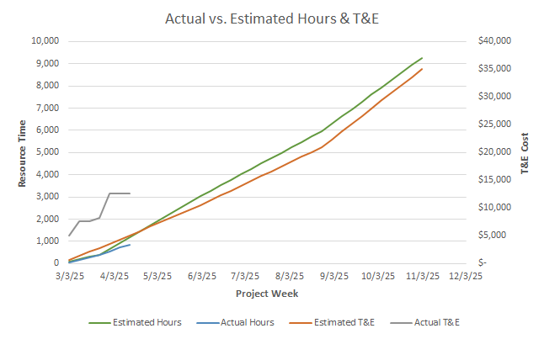
Tracking Resource Actual Cost
Many Methods for Capturing Resource Cost, None are Easy
Section 9

Slide 118

Estimating Non-Resource Cost
Section 9

Slide 119
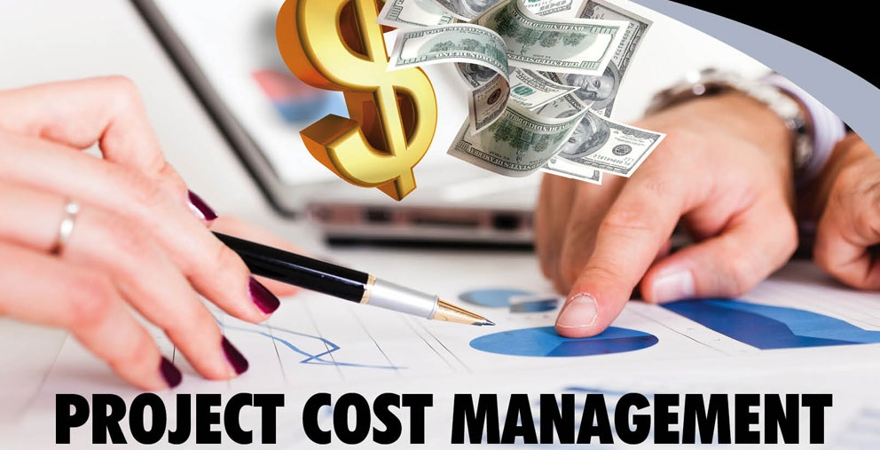
Team Exercise: Cost Management
Cost Planning
What are the cost elements?
What’s the estimated budget?
What’s the level of confidence?
How will cost be tracked?
Team Exercise

Slide 120
Risk
Management
Threats & Opportunities
Probabilities & Impact
Section 10

Slide 121


What is Risk
“A risk is an uncertain event or condition that, if it occurs, can have a positive or negative effect on one or more objectives”
PMI® PMBOK® 7th Edition
Things that may derail the project
Negative impact to time, cost, scope, etc.
Response plans for actions
Things that may improve the project
Positive impact to time, cost, scope, etc.
Response plans for actions
Section 10

Slide 122

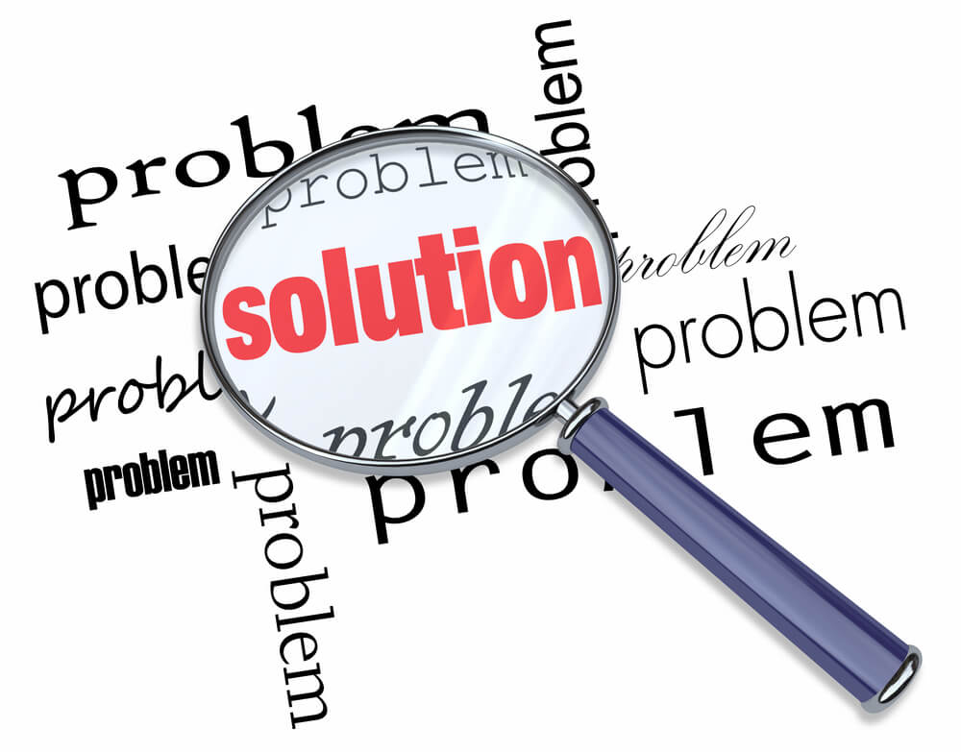
Risks or Issues
Risks
They May Happen
Possibility of a Disruption
Possibility of an Opportunity
Mitigation Responses
Input into Project Activities
Response to Probability or Impact
Issues
It’s Happening
Present Challenge
Immediate Response
Managed at Occurrence
Reduce Immediate Impact
Section 10

Slide 123

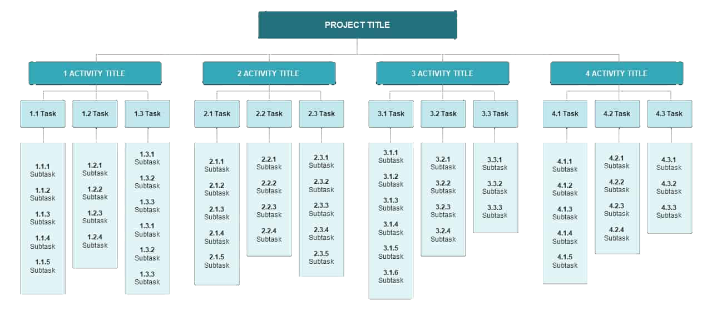

Identifying Risks
Find in the WBS
Use Experience
Look Externally, Internally, Operationally, Technically, Functionally, etc…
Section 10
Brainstorm Considerations

Slide 124



Three Choices Affecting Two Things
Accept It!
How likely is it to happen?
If it happens, what does it effect?
If it happens, when is that expected to be?
Can it happen more than once?
PROBABILITY
Change It!
IMPACT
Leave It!
Section 10

Slide 125




Risk Responses
Accept It, Change It, or Leave It
No response planning
Manage if it happens
Monitor until action needed
Response Should Be
Appropriate for the significance of the risk
Cost effective
Realistic within the project context
Agreed to by relevant stakeholders
Owned by a responsible person
Remove scope from project
Plan actions to remove
Get approvals for removal
Actions to change probability
Actions to change impact
Plan mitigation actions
Risk ownership transferred
Monitor & control as needed
Formal agreements if needed
Section 10

Slide 126
Breaking Down Risk Management
Qualitative or Quantitative
Identification
Naming the risk
Description of Results
What happens and what does it cause
Understanding Impact
The level of disruption or advantage
Calculating Probability
The likelihood that it will occur
Decisions on Response
How we deal with it
Response Application
Putting actions into play
Monitor & Control
Watching it and adjusting strategy
Section 10

Slide 127
Planning & Controlling Risk
Risk Rating Simple Tool
“Risks are at a specific event, not at the project level.”
Very Low: Acceptance is a normal response.
Low: Acceptance or small actions are a normal response.
Moderate: Actions to lower probability or impact is a normal response.
High: Actions are needed to lower probability or impact.
Section 10

Slide 128
Issues Are Not Risks
Issues are happening; response plans aren’t prepared.
They’ll show in every project and need to be managed.
Use simple or complicated tools but use something.
Section 10

Slide 129
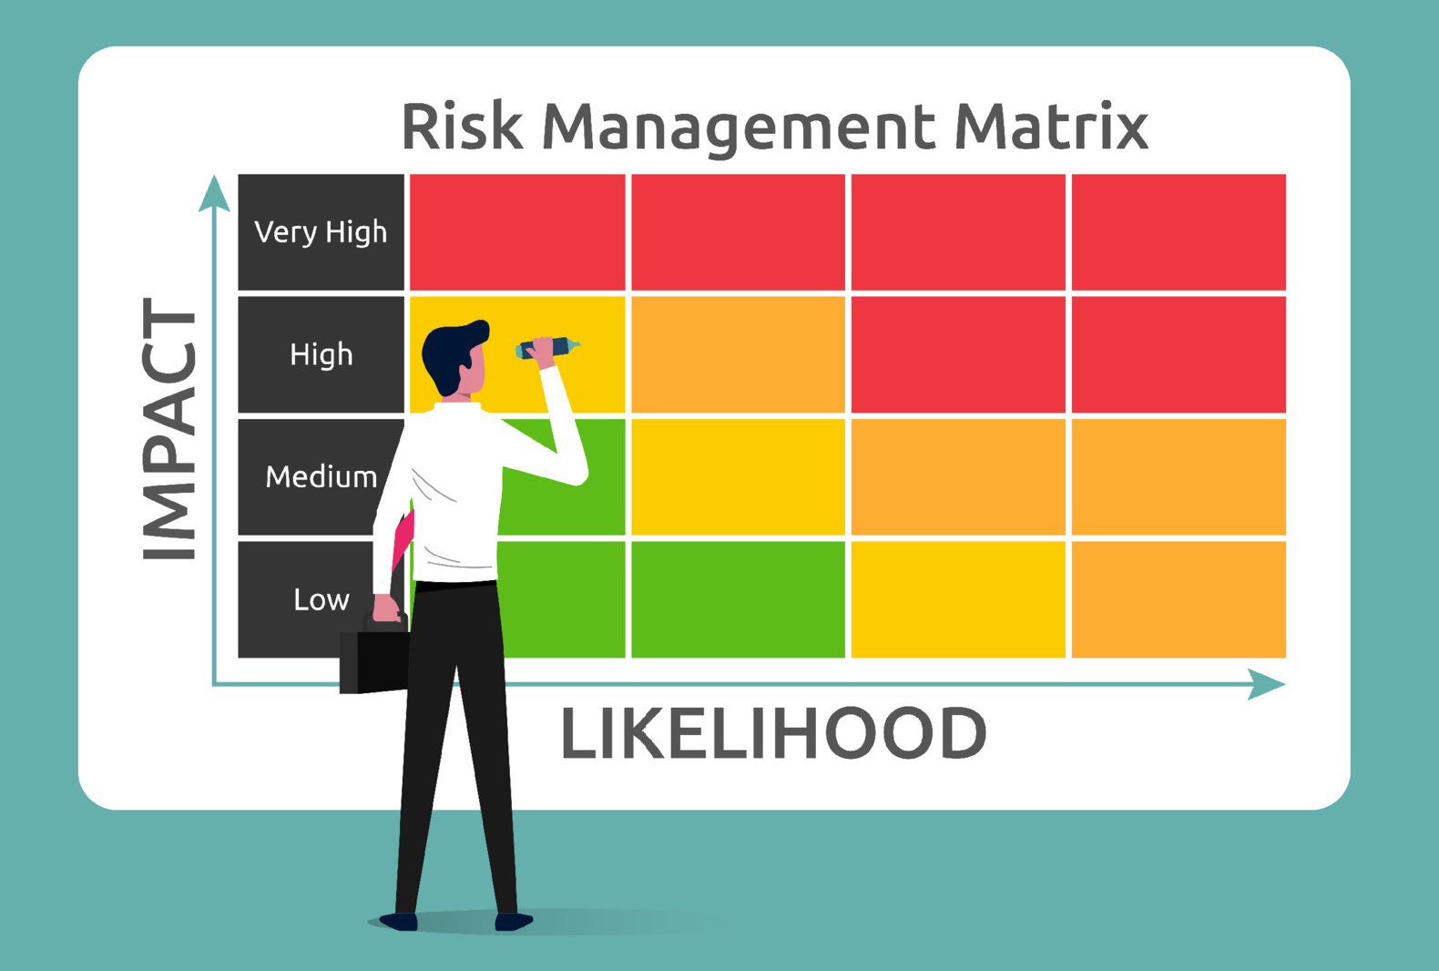
Team Exercise: Risk Management
Risk Planning
What are some key risks?
How will they be managed?
What are some risks you’re accepting?
Team Exercise

Slide 130
Transitioning / Closing
Transitioning to Run-the-Business
Moving into Continuous Improvement
Section 11

Slide 131
Narrowing the Knowledge Gap
Moving From Doing the Work To Transitioning
Prj. Approvals
Getting it Going
Doing the Work
Transferring
Solution Design / Core Development / Unit Testing
User Acceptance Testing, End User Training
1st Level Cost Estimates, Schedule, Scope, Resourcing, Risk
Integration & End-to-End Testing / Training Data Setup
Go-Live Support / Hypercare
Requirements / Discovery / Revised Cost / Updated Timelines
Steady State
Knowledge Gap
Acceptance of Baseline Schedule, Cost, Scope, Risk, Etc.
Project Team Engagement
Ideation / Commercial Notification
Project Approved & kick-off Sessions
Transition to
Run the Business
Scope, Schedule, Cost Controls
Ideation & Approvals
Initiation & Planning
Design/ Develop / Test / Train
Support
Close
Time
Lifecycle
Section 11

Slide 132




Transitioning to Run-the-Business
What, How, and Why we Close Projects
Inputs
Learnings
Archives
Outputs
Stakeholders
External Partners
Internal Partners
Went Well
Had Struggles
Just Went Wrong
Schedules
Resources
Costs
Risk Tools
Action Items
Performance KPIs
Run-the-Business
People
Roadmap
Escalations
Future Call Outs
Section 11

Slide 133


Closing
How it Actually Works
Project Manager
Team Members
Question Examples
Prepares for Closing
Builds the Structure
Populates Project Info
Gathers Input from Team
Finalize Closing Documents
Presents Closing Material
Formally Closes the Project
Provides Support Material
Provides Constructive Input
Participates in Closing Sessions
How did the organizations work together?
How could they do better?
What should be repeated?
Were expectations met?
Section 11

Slide 134

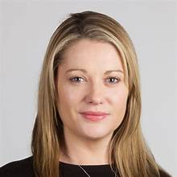



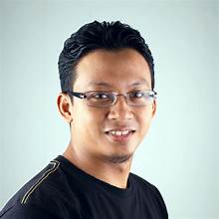

Transfer of Ownership
Operations Owner
Project Manager
Open Issues
Enhancements
Product/Service Owner
Adaptive
Project Management
Project Documentation
Section 11

Slide 135
Team Exercise: Wrapping up the Project
Final Presentation
Make an executive-level presentation
What is the project about?
Why should it be approved?
What will be the cost?
When can it be ready to go?
Team Exercise

Slide 136
Project Management into Strategy Management
Strategy Management Tools
Building Teams & Capabilities
Section 13

Slide 137
Organizationally Deep Strategy, Culture, Mission, Vision, & Values
Highest-Level Organizational Strategy
Highest-Level Mission, Vision, and Values
Highest
Culture
Business Units / Regional Area Strategy
Mission, Vision, and Values
Alignment
Culture
Culture
Culture
Culture
Functional Area Strategy
Mission, Vision, and Values
Lowest
Culture
Culture
Culture
Culture
Culture
Culture
Culture
Culture
Personal Strategy
Mission, Vision, and Values
Culture
Culture
Culture
Culture
Culture
Culture
Culture
Culture
Culture
Culture
Culture
Culture
Section 13

Slide 138
What is Strategy?
…Value for Shareholders…
Kaplan, R. S., & Norton, D. P. (2004). Strategy Maps. Harvard Business School Press.
…Competitive Advantage…
Pearce II, J. A., & de Kluyver, C. A. (2015). Strategic Management. Business Expert Press.
…Superior Performance Relative to Competitors…
Rothaermel, F. T. (2017). Strategic Management. McGraw Hill.
…How a Business is Going to Compete…
Porter, M. (1980). Competitive Strategy. The Free Press.
…Plan for Achieving Goals and Objectives…
Nickols, F. (2008). Strategy, Strategic Management, Strategic Planning, and Strategic Thinking.
…Building Capabilities & Competencies…
Gerald Jeffs, Strategy & Project Management Professional
Section 13

Slide 139


What it is and What it’s not
It’s Not
It Is
What you say you’re going to do
What your plans say you’ll do
What you are doing
What plans are being implemented
Section 13

Slide 140
What is Strategy Management?
Management, Planning, Controlling, and Adjusting
Markets Served
Value Proposition to Market
Market Potential
Entry into Market
Resources
Capabilities & Competencies
Bandwidth & Incentives
People, Capital, Financial, etc.
Organization Alignment
Impacted Stakeholders
Organizational Capability
Organizational Motivation
Pivoting
Sunk Work & Cost Acceptance
Risk Analysis
Executive Feedback Loop
Prioritizations
Strategic Portfolio Pipeline
Competing Forces
Decision Making Authorities
Business Modeling
Writing the Story
What, Who, and How
Financial Flows
Measurements
Success Factors
Leading & Lagging Indicators
Quantitative vs. Qualitative
Strategic Mapping
Projects Driving Strategy
Impacts of Strategy
Value Returned from Strategy
Section 13

Slide 141




Mission, Vision, and Values
What, How, and Guiding Beliefs
MISSION
What an organization does
Different People have Different Definitions
VISION
How an organization delivers on its mission
VALUES
Beliefs of an organization
Leadership
Sets Vision & Strategy
Section 13

Slide 142
Mission, Vision, Values, and Why
What, How, and Guiding Beliefs
MISSION
Delivering Strategic Project Portfolio Management Expertise
VISION
Make Strategy Management Accessible to People, Teams, and Smaller Organizations
VALUES
Trust and Continuous Development
WHY
In helping people, teams, and organizations Improve, we improve ourselves.
Section 13

Slide 143




Mission Statements
Examples: There is no one set of rules.
General Guiding Principles
Concise description of a company’s general purpose.
  10 to 25 words, keep it simple
Be aspirational & memorable.
  If those close can’t remember it, it isn’t working
  This is for the organization, not the World
Written with multiple audiences in mind.
  Primarily employees
  Public, stakeholders, and customers
Don’t compare yours to others.
  A respected organization doesn’t mean they have a great mission statement
“To bring the best user experience to customers through innovative hardware, software and services.”
“To provide branded products and services of superior quality and value that improve the lives of the world’s consumers, now and for generations to come.”
“To bring inspiration and innovation to every athlete in the world. If you have a body, you are an athlete.”
“Delivering Strategic Project Portfolio Management Expertise.”
Section 13

Slide 144




Vision Statements
Examples: There is no one set of rules.
General Guiding Principles
Specific but concise, and not overly detailed.
  5 to 15 words, keep it simple
  One or two key points
  Not a catchy phrase, aim for clarity
Inspirational, memorable, and simple
  Easy to focus on and fulfill
  No technical terms or jargon
This is organizational not a World vision
Don’t compare yours to others.
  A respected organization doesn’t mean they have a great vision statement
“Our vision is to be the most trusted and agile partner for meeting diverse educational needs.”
“To make people happy.”
“Spread ideas.”
“We ignite opportunity by setting the world in motion.”
“Make Strategy Management Accessible to People, Teams, and Smaller Organizations
Section 13

Slide 145




Values, Beliefs, or Behaviors
Examples: There is no one set of rules.
General Guiding Principles
Serve as a guide for behavior
Can shape the culture and public perception
Contain words like: Integrity, Diversity, Innovation, Community, Customer Satisfaction, and Sustainability
A statement may follow the descriptive noun.
  “Striving for innovation in all we do.”
  “Promoting diversity & inclusion”
  “We are one team.”
More words are not always better.
  These should be memorable to employees.
  Decisions must reflect values.
Leadership, Collaboration, Integrity, Accountability, Passion, Diversity, and Quality
Diversity, Equity, Inclusion, Sustainability
People First, Customer Driven, One Team, Act as Owners, Raise the Bar, Value Different Perspectives
Entrepreneurial Spirit and Employee Focus
Trust and Continuous Development
Section 13

Slide 146



Types of Strategic Projects & Portfolios
Business Models
People & Culture
Vision & Mission
Value Proposition
Customer Experience
Technology
Distribution Structure
Technology
Internal Skills
Mergers & Acquisitions
Operational
Customer Management
Product Development
Market Strategies
Product Strategies
Diversification Strategies
Branding
Innovation
Quality
TRANSFORMATION
CAPABILITIES
GROWTH
Section 13

Slide 147









Business Modeling
Telling the Story
Value Propositions
What problems are being solved by your solution?
Is the solution different and durable?
Customer Segments
Who has the problem, what’s the market size?
Is it measurable and accessible?
Will the solution impact a substantial piece of the market?
Relationship Management
How are relationships conducted?
Email, voice, video technology, face-to-face, seminars, etc.
Frequency of contact
Delivery Channels
How are solutions delivered?
Personal delivery, supply chains, technology delivery, brick & mortar, etc.
Key Activities
Activities performed on a regular basis.
Manufacturing, application development, purchasing, marketing, etc.
Key Resources
People, skills, or competencies required to deliver the solution.
Capital and financial resources
Key Partners
External partners that assist in delivering the solution, or support of the organization.
Can be functional teams that support other functional teams.
Revenue Streams
Where does the financial support come from?
Can be internal and external sources.
Sales, contributions, in-kind donations, reallocation of profits, etc.
Cost Structure
What costs are needed to support the model?
Payroll, 3rd Party costs, technology, capital expenses and overhead, cost of goods, etc.
Section 13

Slide 148
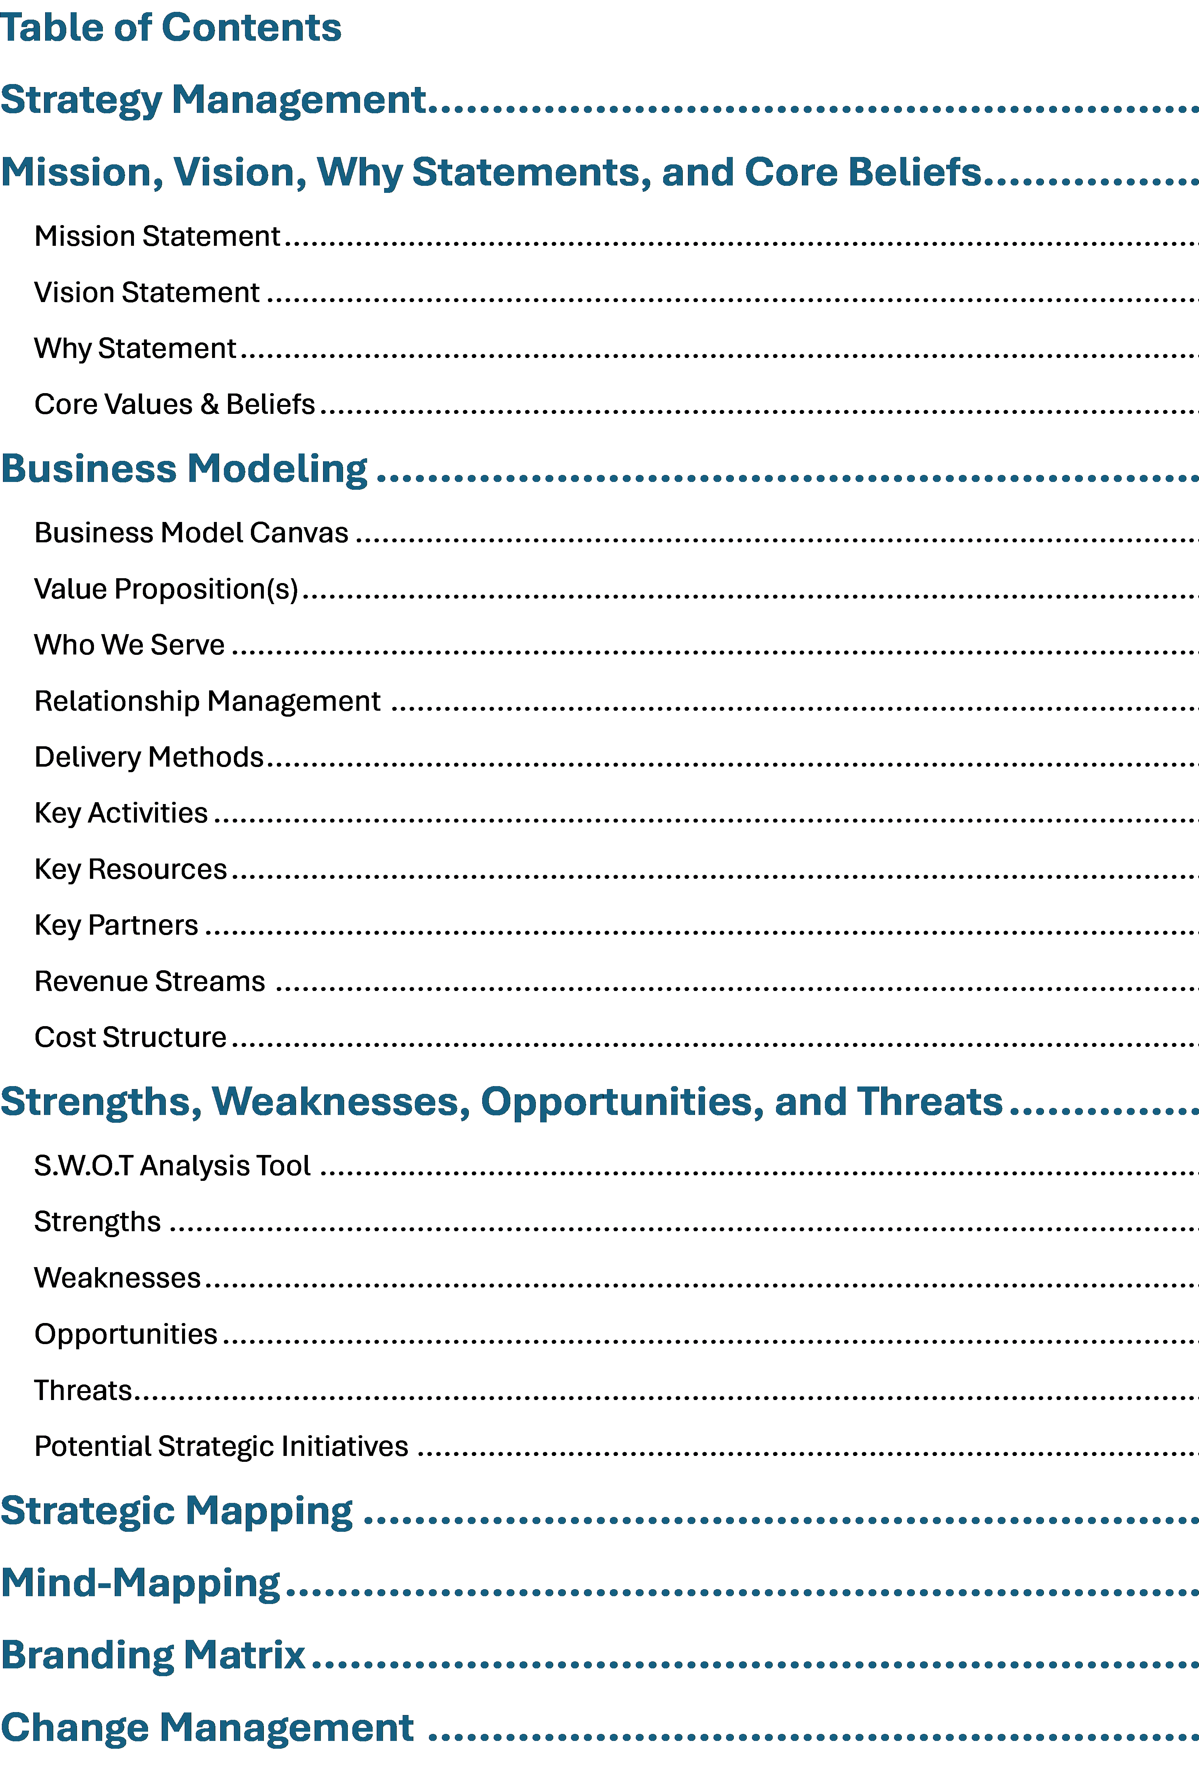
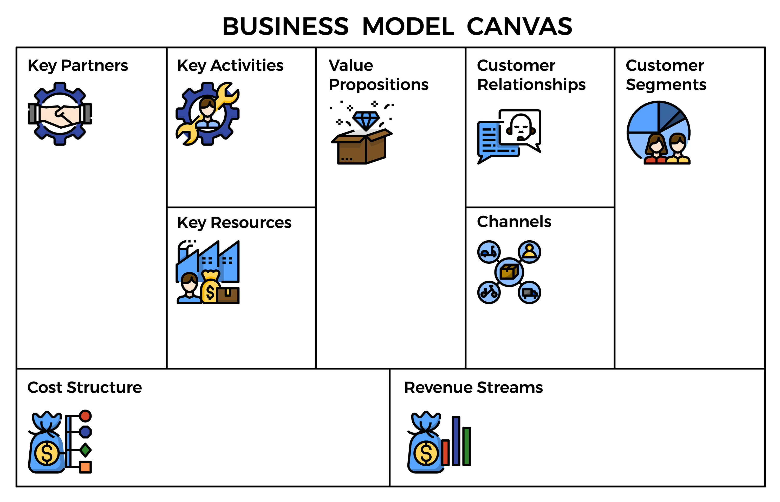
Detailed and High-Level Models
Different Documents for Same Model but Different Audiences
Detailed: Part of a strategic plan that allows for details too deep for a quick presentation
High-Level: Great for presentations, brief overview of who an organization is, who they support, problems they solve, and how they work.
Note: Every organization may require different elements and formats for approvals / support.
Section 13

Slide 149









Business Modeling
Designed For: Clarity Execution, LLC
Designed By: Gerald Jeffs
Year: 2025
Education Providers
  Administrators
  Program Owners
Contracting Firms
  Third-Party Service Providers
Nonprofit Organizations
  Executive Directors
  Board Members
Providing Educational Services
Providing Strategy/Project Mgt. Services
Networking with Partners & Market for Services
Development of Tools & Content
Turning team and organizational strategies into outcomes that deliver value.
Developing capabilities of people, teams, and organizations in project, portfolio, and strategy management.
Face-to-Face
Video/Mobile Conferencing
Electronic Mail & Text
For-Profit Organizations
  Contract Consulting
Nonprofit Organizations
  Local
  Regional
  State
Educational Providers
  Colleges & Universities
  High School Career Programs
  Professional Organizations
Key Partners
Key Activities
Value Propositions
Relationships Mgt.
Who We Serve
Strategy/Project Mgt. Professional
Social Media Platforms
Tool and Content Development Capabilities
Business Accounting/Finance
Small Business Mgt.
Onsite
Remote/Hybrid
Key Resources / Skills
Delivery Methods
Tools and Applications for Content Development
Networking Applications
Cost of Networking
Unrecoverable Travel
Social Media and Internet Presence
For-Profit Organization Invoicing for Strategy/Project Mgt. Services
Full Training Programs in Strategy/Project Mgt. to Education Providers
Cost Structure
Revenue Streams

Slide 150
S.W.O.T. Analysis
Strengths, Weaknesses, Opportunity's, and Threats
Internal Factors
External Factors
Strengths
Forces unique to the organization
Core competencies Skills, operating capabilities & differentiators
Resources: People & Capital
Weaknesses
Forces limiting an organizations value proposition
Lacking capabilities, skills, capital investments, etc.
Opportunities
Forces that can be capitalized
Factors: Political, Economic, Social-Cultural, Technology, Environmental, Legal, etc.
Threats
Forces that can cause disruptions
Factors: Political, Economic, Social-Cultural, Technology, Environmental, Legal, etc.
Factors that are internal to the organization
The organization has control over these
They can be changed within the organization
Factors that are external to the organization
The organization has no control over these
They can’t be changed by the organization
Section 13

Slide 151
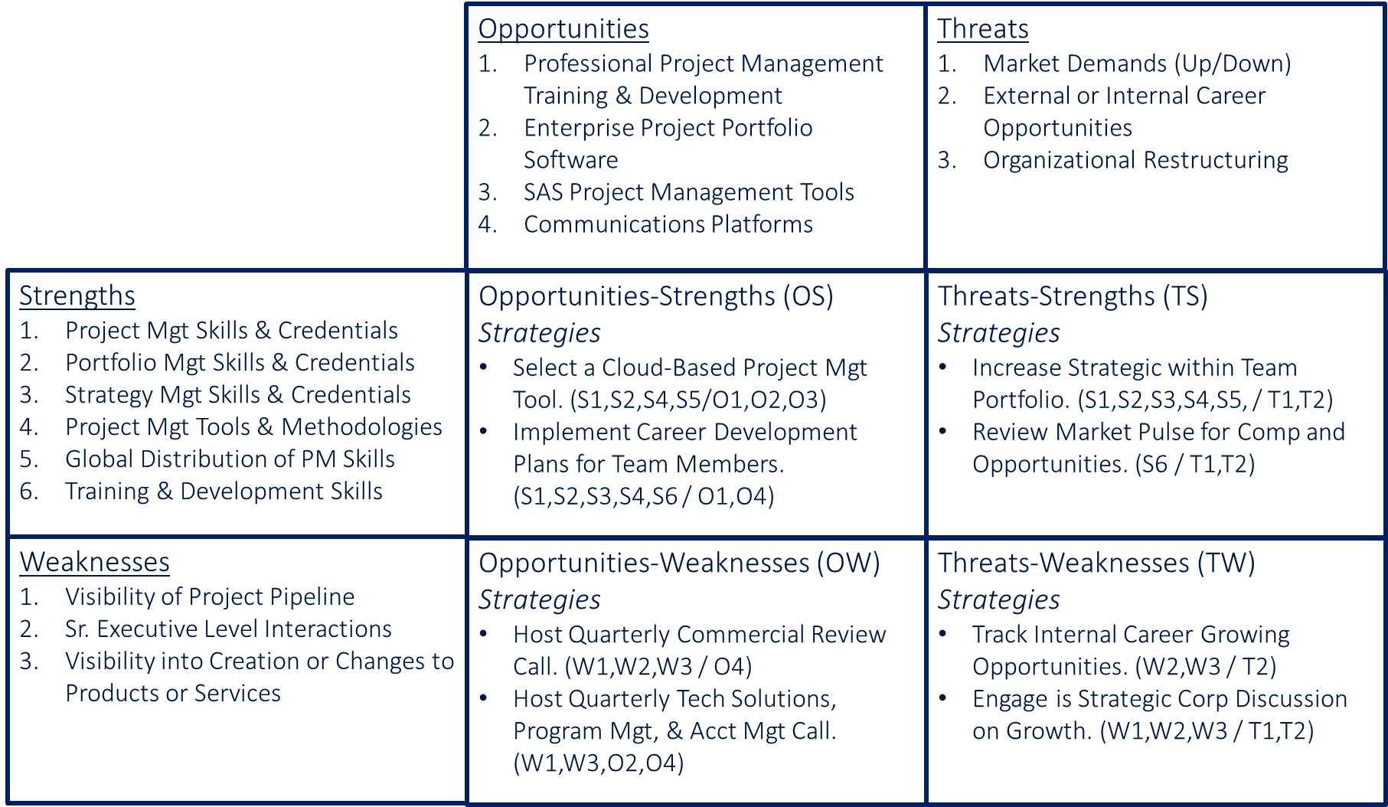
S.W.O.T.’s Done, Now What?
Start Strategic Planning
Value of Work: It creates actionable strategies to strengthen a team or organization. A leader should create a draft and then get team input for buy in. Not all initiatives need to be done, pick one or two to start with.
Opportunities - Strengths (OS)
(Strategies)
What strengths can be used to capitalize on opportunities
Define strategic initiatives by identifying the strength and the opportunity (S1, S3, O4)
Threats - Strengths (TS)
(Strategies)
What strengths can be used to limit a threats impact
Define strategic initiatives by identifying the strength and the threat (S2, T2, T3)
Example
Opportunities - Weaknesses (OW)
(Strategies)
What weaknesses if improved can be used to capitalize on opportunities
Define strategic initiatives by identifying the weakness and the opportunity (W2, O1, O3)
Threats - Weaknesses (TW)
(Strategies)
What weaknesses if improved can be used to limit a threats impact
Define strategic initiatives by identifying the weakness and the threat (W2, W4, T1, T4)
Section 13

Slide 152
Strengths-Weaknesses-Opportunities-Threats
External Forces
Opportunities
Education Provider Networking Events
Nonprofit Organization Public Events
Professional Organization Networking Events
Internet Platforms
Threats
Demand of For-Fee Contract Services
Demand for Guest Speakers in Strategy/Project Mgt
Strengths
Project Mgt Skills & Credentials
Portfolio Mgt Skills & Credentials
Strategy Mgt Skills & Credentials
Training & Development Skills
Strategy/Project Mgt Content & Tools
Professional Credentials & Documents
Opportunities-Strengths (OS)
Strategic Theme(s)
Guest Speaking at Professional Events
  (S1,S2,S3,S4,S5,S6/O1,O2,O3,O4)
Website Creation
  (S5,S6/O4)
Threats-Strengths (TS)
Strategic Theme(s)
Build 3rd Party for Fee Service Provider Relationships
  (S5,S6,T1)
Create Training Content for Education Providers
  (S4,S5,S6/T2)
Internal Forces
Weaknesses
Education Provider Relationships
Nonprofit Ex. Dir. Relationships
3rd Party For-Fee Service Provider Relationships
Network of Decision Makers
Internet Presence
Opportunities-Weaknesses (OW)
Strategic Theme(s)
Guest Attendance at Professional Networking Events
  (W1,W2,W3,W4/O1,O2,O3)
Website and LinkedIn Business Site
  (W5/O3,O4)
Threats-Weaknesses (TW)
Strategic Theme(s)
Widen Networks of Professionals Decision Makers
  (W1,W2,W3,W4/T1,T2)
Section 13

Slide 153
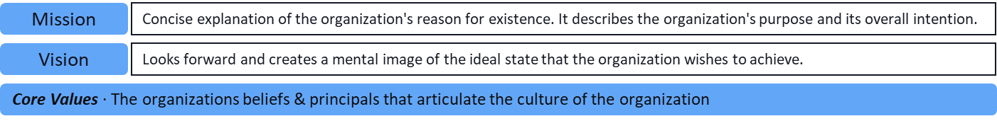
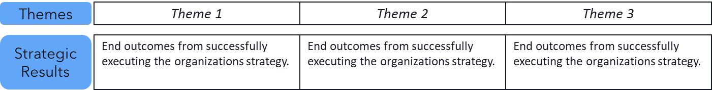
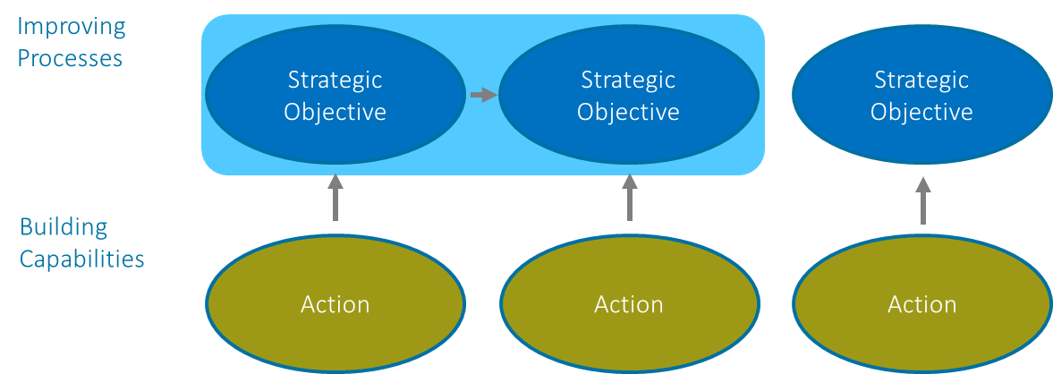
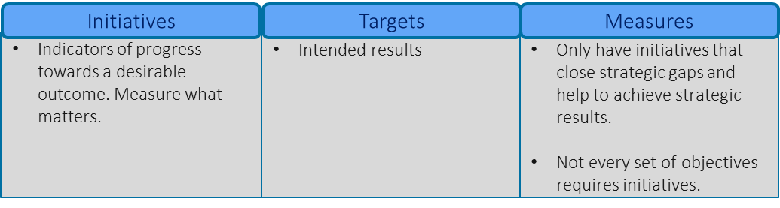
Strategic Mapping
Turning Previous Work into a Visual Strategic Plan
This will be some of the hardest work
Mission, Vision, & Values
These drive all strategies, so they need to be front, and center and alignment must be visible.
S.W.O.T. into
Strategic Themes
A theme will come out of the S.W.O.T. work, there can be as little as one, there shouldn’t be more than four.
Mapping Connections Upward
The categories can change, there should be three to four levels that are connected by a level below, but the below work can jump up more than one level.
Initiatives, Targets, & Measures
Define specific strategic initiatives with targeted objectives, and measurement that present what success looks like
Section 13

Slide 154
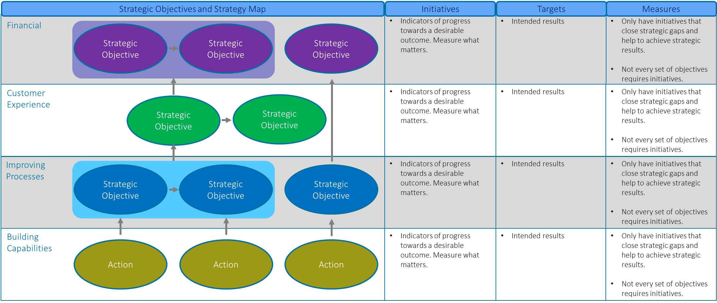
Building the Connections Up
Simplicity & Conciseness is King, but Never Easy
The picture will tell the story of a team’s or organization’s direction, what they’re going to do and how they do it. This may appear simple, but that’s only because a lot of work will go into doing it.
Section 13

Slide 155
Strategic Mapping
Mission
Delivering Strategic Project Portfolio Management Expertise
Vision
Make Strategy Management Accessible to People, Teams, and Smaller Organizations
Themes
Building Relationships
Speaking Engagements
Internet Presence
Strategic
Objectives
Increase the number of professional decision makers with education providers, 3rd Party For-Fee Service Providers, and Nonprofit Executive Directors.
Increase the frequency of guest speaking engagements with education providers, and professional events.
Creation of internet presence and accessibility to Clarity Execution, LLC.
Strategic Objectives and Strategy Map
Initiatives
Objectives
Measures
Incentives
Request of For-Fee Services
Increase Engagements
Provides Self Satisfaction
Engagement Tracking
Growth of Engagements in all Services
Tracking of Engagement by Services Provided
Customer Experience
Case Studies or Testimonials
Track and Report Past Experiences
Number of People, Teams, & Orgs Supported
Professional
Experience
Understanding of Organization
Improving
Engagement of Professional Networks
Website Content 
Increase Access to Decision Makers
Maintain Quality and Current Content
Measure Growth until Plateau
Frequency of Content Updates
Connections to Services
Opportunity Management
Internet Presence



Capabilities / Competencies
Professional Networks
Engagement Mgt Tool
Website
Build Network Management Capability
Build Website 
Tracking & Reporting of Network Portfolio
Control Internet Presence, Content, and Access
Number of Accessible Contacts
Web Pages with Informative Content



Tracking
Needs Work
Off Track or Not Started
Core Values ∙ Trust ◊ Continuous Development




Slide 156


Branding & Mind Mapping
How We Present Ourselves & How We are Perceived by Others
Branding Matrix
Mind Mapping
Aligns Core Brand with Values and Culture Internally and Externally.
What’s the organization’s personality and how does it express itself.
What do relationships and market position look like to others.
The competencies in the organization with the offered value proposition.
What does an organization want to be in the hearts and minds of people.
How does the organization see itself and how does it present externally?
Mapping can go as deep as needed.
Section 13

Slide 157
Branding Matrix
How Does the Organization or Team Align Internally & Externally
INTERACTION
STRATEGY
EXTERNAL
Value Proposition
What problem is being solved & how?
Relationships
The nature of relationships with key stakeholders.
Position
The market position and what’s in the hearts & minds of key stakeholders?
Alignment
There needs to be clear alignment on the diagonal paths (Strategy & Competition), the vertical path (Interaction), and the horizontal path (communications).
Expression
The way an organization communicates and expresses itself
Brand Core
What’s the promise and what are the core values that sum up what the brand stands for?
Personality
What combination of human characteristics or qualities forms the character?
EXTERNAL / INTERNAL
COMMUNICATIONS
Usage
Internal & external communications about how the organization defines itself and how it functions; also helps drive what’s being established at the core.
Vision & Mission
Vision: How does the organization or team accomplish objectives
Mission: What is the core function of the organization or team
Culture
What are the organization’s or team’s attitude and how do they work & behave?
Competences
What the organization or team are good at, and what makes them better than most?
INTERNAL
Section 13
COMPETITION

Slide 158
Branding Matrix
How the Organization Aligns Internally & Externally
INTERACTION
STRATEGY
EXTERNAL
Value Proposition
Turns Strategy into Beneficial Outcomes
Building Sustainable Competences in Strategic Project Portfolio Management
Relationships
Personal Focus with Stakeholders
Consistent and Accurate Communications
Position
Concierge Level Service
Professional Discipline Service Provider
Educator of Strategic Proj. Portfolio Skills
Alignment
There needs to be clear alignment on the diagonal paths (Strategy & Competition), the vertical path (Interaction), and the horizontal path (communications).
Expression
Guest Speaking
LinkedIn Content
Website Content
Brand Core
Strategic Project Portfolio Management Expertise
Personality
Focuses on Mission
Curiosity in Others
Driven to Improve
Community Service
EXTERNAL / INTERNAL
COMMUNICATIONS
Usage
Internal & external communications about how the organization defines itself and how it functions; also helps drive what’s being established at the core.
Vision & Mission
Mission: Delivering Strategic Project Portfolio Management Expertise
Vision: Make Strategy Mgt Accessible . . .
Culture
Building Trust Based Relationships
Continuously Learning and Improving
Competences
Strategy, Portfolio, and Project Management Expertise
INTERNAL
Section 13
COMPETITION

Slide 159
Hearts & Minds of Others
Careers in Project Mgt.
Example: Clarity Execution
Project/Program/Strategy Mgt.
Contract Assignments
For Profits
Nonprofits
501c3 / c4 Corps.
Guest Speaker
Product Mgt.
Remote & Onsite
Local & Regional
Change Mgt. / Changing Culture
Under & Graduate Prgms.
Educator
Project/Program/Strategy Mgt.
H.S. Business Prgms.
Education Providers
Customers
Courses / Programs
Project Mgt. Organizations
8 to 40 Hours Course Work
Individuals & Teams
Professional Conferences
Professional Organizations
Mentor
Career Development
Project Mgt. Organizations
Mid-Level to Sr. Leaders
Individuals & Groups
Project/Program Prioritization
PM Organization Structure
Team Development
Portfolio Management
Resource Management
Build Sustainable Org & Teams
Schedules, Cost, Risk, Communications
Repository of Tools & Processes
Market Analysis
Application of Tools
Project Management
Strategy Management
Business Planning
Solution Viability
Tools & Methods
Standard & Agile Methods
Organization Alignment
Project & Program Mgt.
S.W.O.T. Analysis / Identify Initiatives
Applied Project & Program Mgt.
Project Leader
Change Management
Strategy Execution
Strategic Planning
Strategic Road Mapping
Proj. Portfolio Management
Stakeholder Mgt.
Organization Socialization
Section 13

Slide 160
Project Management Careers
Lifelong Learning & Experimenting
It Never Get’s Easier
Section 13

Slide 161











Industries
All Industries Have Project Managers
International Logistics
Technology
Health Care
Consumer Products
Nonprofit
Construction
Domestic Logistics
Automotive
Legal
Media
Government
Transportation
The Depth of Project Management Changes
Section 13

Slide 162

Organizational Structure
Where Does Project Management Fit?
Finance
Legal
Human Resources
Information
Technology
Operations
Payables
Contracting
HR Policies
Applications
Services
Receivables
Litigation
Training
Data Storage
Manufacturing
Tax
Compliance
Benefits
Hardware
Supply Chain
Payroll
Recruiting
Security
Engineering
General Accts
Performance
Integration
Safety
Section 13

Slide 163



Building a Competency
LEARN
APPLY KNOWLEDGE
ADJUST /EXPERIENCE
TEACH OTHERS
WHY?
In helping people, teams, and organizations Improve, we improve ourselves.
Section 13

Slide 164
Possible Steps
C-Level / Educator / Board Member
Changing Organizations & Giving Back
Strategy Manager / Leader
Step 6
Strategic Planning & Execution
Portfolio Manager / PMO
Step 5
Balancing Work, Team Development, Strategic Leadership
Complexity of Knowledge & Skills
Sr. Project Manager
Step 4
Applied Leadership
Project Manager
Experiential Learning
Step 3
Project Coordinator
Building the Foundation
Step 2
Step 1
Section 13

Slide 165
Roles, Functions, and Credentials
VP Project-Strategy Management
Organizational Project Portfolios
Project/Strategy Managers Development
Project/Strategy Management Tool-Box
Align Corporate Strategies & PMO
Corporate Project Implementations
Support PM Education & Experiences
Advanced Degree & Certifications
Dir. Project-Strategy Management
Business Unit/Functional Project Portfolios
Operations & Corporate Projects
Project Managers Development
Alignment with Organizational PMO
Creation of Tools & Methodologies
Support PM Education & Experiences
Advanced Certifications
Sr. Project / Portfolio Manager
Functional Area Project Portfolio
Operations & Corporate Projects
Creation of Tools & Methodologies
Project Manager(s) Development
Support PM Education & Experiences
Advanced Certifications
Sr. Project Manager
Functional & Corporate Projects
Creation of Tools & Methodologies
Support PM Education & Experiences
Obtaining PMP®
Fundamental Courses
Project Coordinator & Project Manager
Internal Functional Projects
Development of PM Skills & Experiences
Support Tracking & Reporting Activities
Fundamental Development
Section 13

Slide 166
Portfolio Management
Corporate Portfolio
Operations
Portfolios
Strategic
Portfolios
PRT 1.1
PRT 1.2
PRT 2.1
PRT 2.2
PRJ 1.11
PRJ 1.12
PRJ 1.13
PRJ 1.21
PRJ 1.22
PRJ 2.11
PRJ 2.12
PRJ 2.21
PRJ 2.22
PRJ 2.23
Resource Allocation
Prioritization
Governance
Tools & Templates
Organization Development
Team Member Development
Methodologies
Financial Management
Section 12

Slide 167


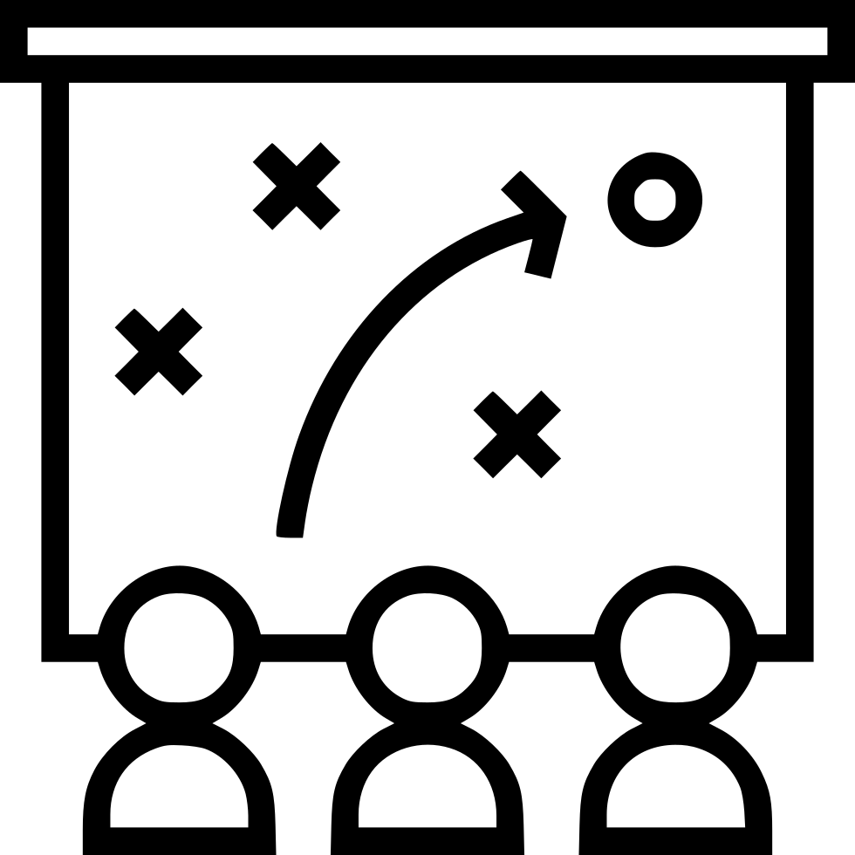
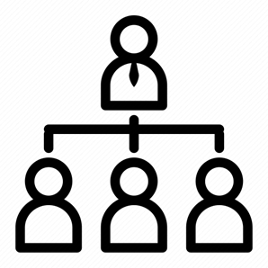




Needed Skills & Experiences
Communications
Leadership
Project Management
Portfolio Management
Strategy Management
Organizational Development
Industry Specific Knowledge
Product Management
Market Analysis
Cross Cultural Management
Section 13

Slide 168
A Career of Knowledge & Experience
VP Project-Strategy Management
Highest Level of Industry Knowledge
Highest Organizational Development Skills
Highest Org. Wide Functional Knowledge
10+ Years Project Portfolio Leadership
10+ Years Strategic Portfolio Leadership
10+ Years Leading & Developing Teams
Dir. Project-Strategy Management
Strong Industry Knowledge
Strong Organizational Development Skills
Strong Functional Area(s) Knowledge
5+ Years Project Portfolio Leadership
5+ Years Strategic Project Portfolio
5+ Years Leading & Developing Teams
Industry
Knowledge
Sr. Project / Portfolio Manager
Wide Industry Knowledge
Wide Team Development Skills
Wide Functional Area(s) Knowledge
5+ Years Project Management Leadership
5+ Years Leading Strategic Projects
5+ Years Developing People
Sr. Project Manager
Good Industry Knowledge
Good Leadership Skills
Good Functional Area Knowledge
5+ Years Project Management
5+ Years Cross Functional Area Projects
5+ Years Matrix Resource Integration
Change
Project Coordinator & Project Manager
Developing Industry Knowledge
Developing People Skills
Developing Functional Area Knowledge
Section 13

Slide 169
Project Management Professional (PMP®)
Requirements
  High school diploma or GED
    60 Months/5 Years Experience within Past 8 Years
  ≥ 4 Year Degree
    36 Months/3 Years Experience within Past 8 Years
  ≥35 hours of project management education/training
  60 Professional Development Units (PDU) every three years
Certification Exam
  180 Questions in 3:50 Hours
  Price: $425 PMI Member/$675 nonmembers
PMP Stats
  Average U.S. Median Salary ≈ $120k
  Current Holders ≈ 1.5m Worldwide
    >500,000 in North America (November 2024)
  Top Countries: U.S., Canada, China
Section 13

Slide 170
Certified Associate in Project Management (CAPM®)
Requirements
  High school diploma or GED
  No experience requirements
  ≥23 hours of project management education/training
  15 Professional Development Units (PDU) every three years
Certification Exam
  150 Questions in 3:00 Hours
  Price: $225 PMI Member/$300 nonmembers
CAPM Stats
Average U.S. Median Salary ≈ $72k
Current Holders ≈ 1.7m Worldwide
Types of Positions
  Assistant Project Manager
  Project Administrator
  Project Analyst
  Project Coordinator
  Project Manager
  Technical Project Manager
Section 13

Slide 171
Other Project Management Credentials
Undergraduate, Graduate, or University Certifications/Degrees
Program Management Professional (PgMP®)
Disciplined Agile Scrum Master (DASM®)
Portfolio Management Professional (PfMP®)
Disciplined Agile Senior Scrum Master (DASSM®)
PMI Agile Certified Practitioner (PMI-ACP®)
Prince2 Foundation
PMI Professional in Business Analysis (PMI-PBA®)
Prince2 Practitioner
PMI Risk Management Professional (PMI-RMP®)
Prince2 Agile Foundation
PMI Scheduling Professional (PMI-SP®)
Prince2 Agile Practitioner
https://www.pmi.org
https://www.prince2.com
Section 13

Slide 172

Thank You
Gerald Jeffs
clarityexecution.com
www.linkedin.com/in/gerryjeffs
jeffsgerry@gmail.com
925-487-5982
Tracy, CA

Slide 173
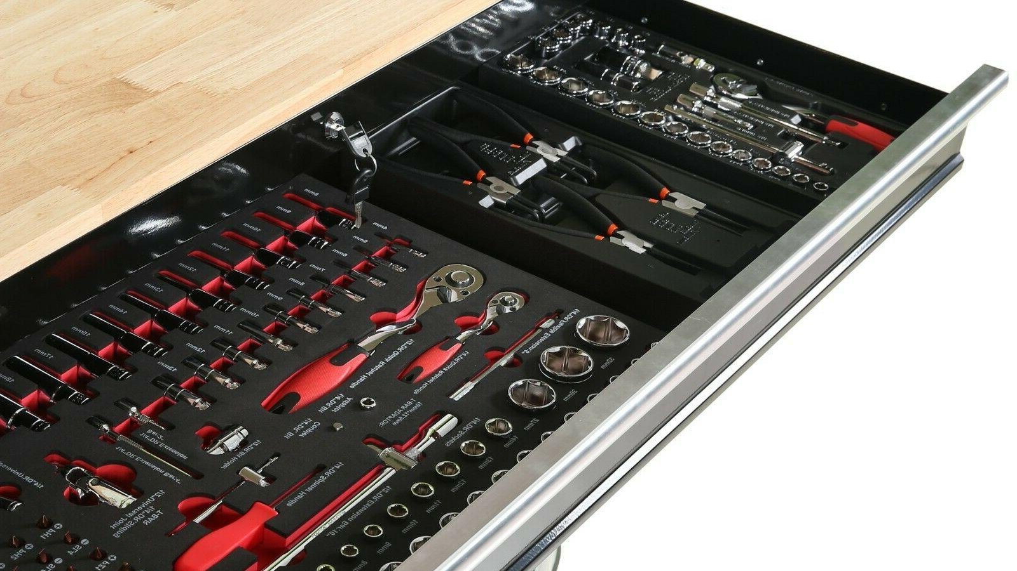
Tool Chest
Excel File &
MS Project Format

Slide 174
Value Iteration/Sprint Management
#
Prioritized Iteration/Sprint
Service/Area
Resources Needed
Expected Outcome
1
Iteration/Sprint
Service/Area
Resources
Outcome
2
Iteration/Sprint
Service/Area
Resources
Outcome
3
Iteration/Sprint
Service/Area
Resources
Outcome
Pipeline/Backlog of Iterations/Sprints
Iteration/Sprint
Iteration/Sprint
Iteration/Sprint
Iteration/Sprint
Iteration/Sprint
Iteration/Sprint
Iteration/Sprint
Iteration/Sprint
Iteration/Sprint
Iteration/Sprint
Iteration/Sprint
Iteration/Sprint
Iteration/Sprint
Iteration/Sprint
Iteration/Sprint

Slide 175
Status Report Template
Project: TBD
Project Manager
TBD
Tech Project Manager
TBD
Project Status
Status Indicators
Tracking Direction
Report Date: TBD
Comp:
00%
Tracking
Challenges
Critical
Holding
Improved
Decreased
Key Milestones / Key Schedule Dates
Scope:
Cost:
Schedule:
Risks:
Resources:
Milestone
Planned Date
Status
Challenge / Issue / Actions
Resolve Date
Status
TBD
TBD
0%
TBD
TBD
TBD
TBD
0%
TBD
TBD
TBD
TBD
0%
TBD
TBD
TBD
TBD
0%
TBD
TBD
TBD
TBD
0%
TBD
TBD
TBD
TBD
0%
TBD
TBD
TBD
TBD
0%
Support Needed / Decision to be Made
From / Owner
Status
TBD
TBD
0%
Scope Approval Authorities – Who?
Exec Sponsors
Pending
TBD
TBD
0%
TBD
TBD
TBD
TBD
0%
TBD
TBD
TBD
TBD
0%
TBD
TBD
TBD
TBD
0%
TBD
TBD

Slide 176
Strengths-Weaknesses-Opportunities-Threats
External Forces
Opportunities
TBD
Threats
TBD
Strengths
TBD
Opportunities-Strengths (OS)
Strategic Theme(s)
TBD
Threats-Strengths (TS)
Strategic Theme(s)
TBD
Internal Forces
Weaknesses
TBD
Opportunities-Weaknesses (OW)
Strategic Theme(s)
TBD
Threats-Weaknesses (TW)
Strategic Theme(s)
TBD

Slide 177
Business Modeling
Designed For: TBD
Designed By: TBD
Year: TBD
TBD
TBD
TBD
TBD
TBD
Key Partners
Key Activities
Value Propositions
Relationships Mgt.
Who We Serve
TBD
TBD
Key Resources / Skills
Delivery Methods
TBD
TBD
Cost Structure
Revenue Streams

Slide 178
Strategic Mapping
Mission
Looks forward and creates a mental image of the ideal state that the organization wishes to achieve.
Vision
Concise explanation of the organization's reason for existence. It describes the organization's purpose and its overall intention.
Themes
Highest Level Description
Highest Level Description
Highest Level Description
Strategic
Objectives
End outcomes from successfully executing the strategy.
End outcomes from successfully executing the strategy.
End outcomes from successfully executing the strategy.
Strategic Objectives and Strategy Map
Initiatives
Objectives
Measures
Financial
Strategic Objective
Strategic Objective
Strategic Objective
Expected Outcomes
Intended Results
Indicators of progress towards a desirable outcome.
Customer Experience
Expected Outcomes
Intended Results
Indicators of progress towards a desirable outcome.
Strategic Objective
Strategic Objective
Improving
Expected Outcomes
Intended Results
Indicators of progress towards a desirable outcome.
Strategic Objective
Strategic Objective
Strategic Objective
Capabilities / Competencies
Action
Action
Action
End outcomes from successfully executing the strategy.
Intended Results
Indicators of progress towards a desirable outcome.
Core Values ∙ The beliefs & principals that articulate culture

Slide 179
Hearts & Minds of Others
TBD
TBD
TBD
TBD
TBD
TBD
TBD
TBD
TBD
TBD
TBD
TBD
TBD
TBD
TBD
TBD
TBD
TBD
TBD
TBD
TBD
TBD
TBD
TBD
TBD
TBD
INSERT LOGO
TBD
TBD
TBD
TBD
TBD
TBD
TBD
TBD
TBD
TBD
TBD
TBD
TBD
TBD
TBD
TBD
TBD
TBD
TBD
TBD
TBD
TBD
TBD
TBD
TBD
TBD
TBD
TBD
TBD
TBD

Slide 180
Branding
INTERACTION
STRATEGY
EXTERNAL
Value Proposition
What problem is being solved & how?
Relationships
The nature of relationships with key stakeholders.
Position
The market position and what’s in the hearts & minds of key stakeholders?
Alignment
There needs to be clear alignment on the diagonal paths (Strategy & Competition), the vertical path (Interaction), and the horizontal path (communications).
Expression
The way an organization communicates and expresses itself
Brand Core
What’s the promise and what are the core values that sum up what the brand stands for?
Personality
What combination of human characteristics or qualities forms the character?
EXTERNAL / INTERNAL
COMMUNICATIONS
Usage
Internal & external communications about how the organization defines itself and how it functions; also helps drive what’s being established at the core.
Vision & Mission
Vision: How does the organization or team accomplish objectives
Mission: What is the core function of the organization or team
Culture
What are the organization’s or team’s attitude and how do they work & behave?
Competences
What the organization or team are good at, and what makes them better than most?
INTERNAL
COMPETITION

