Slide 1



Agile in Real World Applications
Small Incremental Pragmatic Value

Slide 2
What is Agile?
Does it Really Matter
80’s & 90’s Tech Advancement Took too Long
Manifesto was Developed
Principles Established
Focused on Consistent Delivery
Short Iterations
People Working Together Daily
Changing Requirements
Uncertainty in Demand
Cultural Change Required
Deepen User Connections
Team Structure Changes
Language Developed
Tools & Methodologies
And Then
Migrated from IT centric into Business Opportunities
We’ve talked text-book, now do you get Agile and how to apply it?

Slide 3












Industries
Pick an Industry and Subset
International Logistics
Technology
Health Care
Consumer Products
Nonprofit
Construction
Domestic Logistics
Automotive
Legal
Media
Government
Transportation
Cultural Change

Slide 4

Organizational Structure
Again, Where Can Agile Fit?
Finance
Legal
Human Resources
Information
Technology
Operations
Payables
Contracting
HR Policies
Applications
Services
Receivables
Litigation
Training
Data Storage
Manufacturing
Tax
Compliance
Benefits
Hardware
Supply Chain
Payroll
TBD
Recruiting
Security
Engineering
General Accts
TBD
Performance
Integration
Safety
Cultural Change

Slide 5




Project Success
What Defines Success?
SCOPE
COST
SCHEDULE
VALUE

Slide 6




What is Value?
User Experience
Market Expansion
Cost Reduction
Quality Gains
What does an incremental gain do in these areas?
What other categories define value?

Slide 7
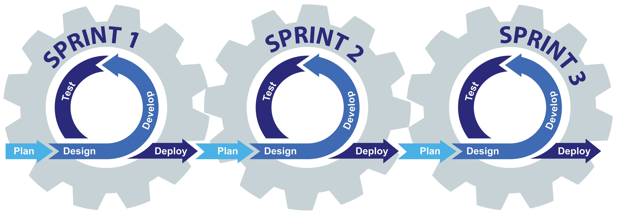
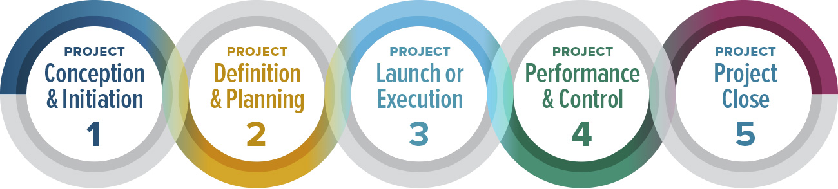
Two Methodologies with Different Approach's
Standard/Waterfall Project or Agile
Standard Project Method
Agile Method
Starts from Nothing
Delivers a Minimum Viable Product (MVP)
Clearly Defined Objectives
Experienced Resources
Longer Durations
Larger Project Teams
Dispersed Resources (Possible Time Zones)
Agile comes from Lean Methodologies
Minimum Viable Product (MVP) Exists
Short Iterations to Deliver Value
A Pipeline of Ideas Ready to Go
  User Stories
Smaller Consistently Changing Teams
Teams are Closer, if not Collocated

Slide 8
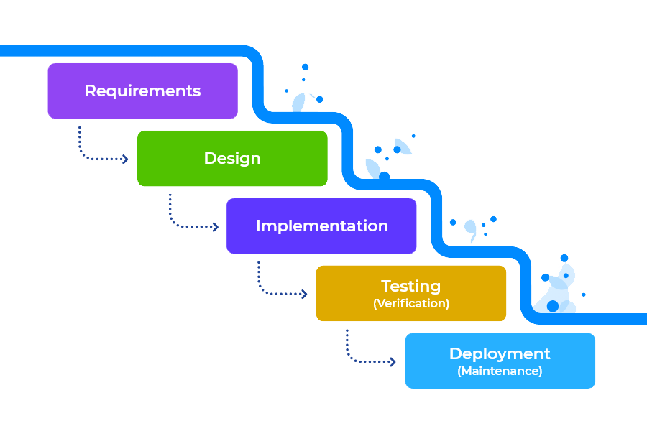
Narrowing the Knowledge Gap
Waterfall > Standard > Regular Project Management
Solution Design / Core Development / Unit Testing
User Acceptance Testing, End User Training
1st Level Cost Estimates, Schedule, Scope, Resourcing, Risk
Integration & End-to-End Testing / Training Data Setup
Go-Live Support / Hypercare
Requirements / Discovery / Revised Cost / Updated Timelines
Steady State
Knowledge Gap
Acceptance of Baseline Schedule, Cost, Scope, Risk, Etc.
Project Team Engagement
Ideation / Commercial Notification
Project Approved & kick-off Sessions
Transition to
Run the Business
Scope, Schedule, Cost Controls
Ideation & Approvals
Initiation & Planning
Design/ Develop / Test / Train
Support
Close
Time

Slide 9

First a Minimum Viable Product (MVP)
Start with Basics & Grow
Minium Viable Product
VALUE ITERATIONS
VALUE
VALUE
VALUE
VALUE
Market Growth / Sustainable Products & Services
VALUE
VALUE
VALUE
VALUE
VALUE
VALUE
VALUE
VALUE
VALUE
VALUE
VALUE
VALUE
VALUE
VALUE
VALUE
VALUE
VALUE
VALUE
VALUE
VALUE

Slide 10

Standard Team Structure Example
Different Projects = Different Resources
Core Business
PROJECT
External Org.
Project
Manager
Sponsor(s)
Project Manager(s)
Legal
Lead
Finance
Lead
Compliance Lead
Technology
Project Manager
Operations
Lead
Human Resource Lead
Marketing Lead
Integration
Lead(s)
Application Lead(s)
Hardware Lead(s)
Tech Security Lead

Slide 11






Agile Team Structure
Different Value Iterations = Different Resources
OWNER
ARCHITECT
PROJECT LEAD
TEAM MEMBERS
Product/Service
Tech/Ops
Project Specific
Project Specific
Ensures the Right Capability is Built
Ensures the Capability is Built Right
Coordinates the Capability Build
Builds the Capability
Executives
Operations
Technology
External Orgs
Functional Experts
Operational Experts
Technology Experts
External Experts
STAKEHOLDERS
SPECIALISTS

Slide 12
Agile Team Roles & Responsibilities
OWNER
ARCHITECT
PROJECT LEAD
TEAM MEMBERS
Ensures the Right Capability is Built
Ensures the Capability is Built Right
Coordinates the Capability Build
Builds the Capability
Defines capabilities to be built
Prioritizes iterations.
Updates Sr. Stakeholders
Consolidates input from Architect & Project Lead
Brings technical expertise
Oversees solution testing
Validates design
Provides input to Owner for approvals
Coordinates activities
Integrates functional teams
Plans & controls the iteration
Provides status to Owner.
Facilitates team meetings.
Provides Lead with activities, durations, and dependencies
Performs the work
Provides updates to Lead
Coordinates change of scope
Performs testing and deployment of solution.

Slide 13
Minimum Viable Product into Agile
YEAR - 1
YEAR - 2
ITERATIONS
Mth1
Mth2
Mth3
Mth4
Mth5
Mth6
Mth7
Mth8
Mth9
Mth10
Mth11
Mth12
Mth1
Mth2
Mth3
Mth4
Mth5
Mth6
Mth7
Mth8
Mth9
Mth10
Mth11
Mth12
MVP
Iteration A
Iteration B
Iteration C
Iteration D
Iteration E
Iteration F
Planning
Building/Testing
Review/Feedback
Approve
Adjust/Track
Why is eight-weeks a base duration?
Should it allows apply?

Slide 14
Normal Project Planning
Yes, Agile May Also Require
WKS
WK 1
WK 2
WK 3
WK 4
WK 5
WK 6
WK 7
Project
7
Project Level Time
Summary Level 1.0
6
Summary Level Time
Activity 1.1
3
FS
WK 1
WK 2
WK 3
Dependencies
Activity 1.2
2
WK 1
WK 2
FS
FS
Finish-Start
Activity 1.3
2
WK 1
WK 2
SS
Start-Start
Summary Level 2.0
4
Summary Level Time
SS +1wk
FF
Finish-Finish
Activity 2.1
1
WK 1
SF
Start-Finish
Activity 2.2
3
FS
WK 1
WK 2
WK 3
SS
Activity 2.3
2
WK 1
WK 2
Summary Level 3.0
5
Summary Level Time
Summary Level 3.1
3
Summary Level Time
FS -1wk
Activity 3.11
2
WK 1
WK 2
Activity 3.12
1
FS -1wk
WK 1
Critical Path
FS
Activity 3.2
3
Float/Slack
WK 1
WK 2
WK 3
Activity 3.3
1
WK 1
FF

Slide 15
Generating a Pipeline (Backlog) of Value Iterations/Sprints
Call Them Whatever You Like
What is the Market/Community/Customers Saying?
Internal Controls
External Controls
Community Access
Cost of Service
Mission Alignment
Staff Engagement
Use of Service
Community Feedback
Communications
Technology
Funding
Paid Staffing
Investment in Growth
Transparency
Facilities/Locations
Tracking/Report Outcomes
Impact Analysis
Service Planning & Design
Leadership Support
Learning & Adjusting
Partner Relationships
Equipment
Volunteers
Sustainable Solution
Backup Support
Service Needs
Government Policies
Local 501 c3 Organizations
Volunteer Engagement
Funding Sources
Community Perception
Charity Rating Platforms
Partner Access/Support
Political Affiliations

Slide 16
Strengths-Weaknesses-Threats-Opportunities
External Forces
Value Propositions from a SWOT
Opportunities
Forces that can be capitalized
Factors
Political, Economic, Social-Cultural, Technological, Environmental, Legal, etc…
Threats
Forces that can cause disruptions
Factors
Political, Economic, Social-Cultural, Technological, Environmental, Legal, etc…
Strengths
Forces that are unique to the organization
Core competencies: Skills, operating capabilities & differentiators
Resources: People & Capital
Opportunities-Strengths (OS)
Strategic Thyme(s)
Using strengths to exploit opportunities
Strategy
(O1, S2, S3)
Threats-Strengths (TS)
Strategic Thyme(s)
Using strengths to combat threats
Strategy
(T3, S1, S3)
Internal Forces
Weaknesses
Forces that limit an organizations value proposition
Capabilities, skills, capital investments, etc.
Opportunities-Weaknesses (OW)
Strategic Thyme(s)
Correcting weaknesses to exploit opportunities
Strategy
(O2, W1)
Threats-Weaknesses (TW)
Strategic Thyme(s)
Correcting weaknesses to combat threats
Strategy
(T4, W3)

Slide 17


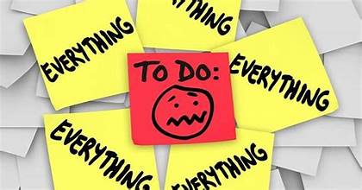

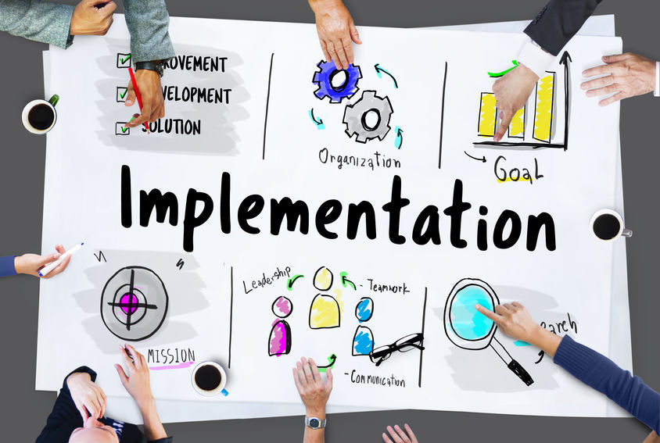

Managing a Pipeline of Value Driven Ideas
Develop Initial list of Value Propositions
Review How the Implementation Went
Prioritize the Top 3-5 Initiatives
Reprioritize the Pipeline and Rethink Approach
Implementation of first Value Iteration
Get in A Rhythm

Slide 18
Value Iteration/Sprint Management
#
Prioritized Iteration/Sprint
Service/Area
Resources Needed
Expected Outcome
1
Iteration/Sprint
Service/Area
Resources
Outcome
2
Iteration/Sprint
Service/Area
Resources
Outcome
3
Iteration/Sprint
Service/Area
Resources
Outcome
Pipeline/Backlog of Iterations/Sprints
Iteration/Sprint
Iteration/Sprint
Iteration/Sprint
Iteration/Sprint
Iteration/Sprint
Iteration/Sprint
Iteration/Sprint
Iteration/Sprint
Iteration/Sprint
Iteration/Sprint
Iteration/Sprint
Iteration/Sprint
Iteration/Sprint
Iteration/Sprint
Iteration/Sprint

Slide 19


Thank You
Gerald Jeffs
clarityexecution.com
www.linkedin.com/in/gerryjeffs
jeffsgerry@gmail.com
925-487-5982
Tracy, CA

