Slide 1


Step-One to . . .
A Career from Project Mgt. into Strategy Mgt.

Slide 2


Gerald Jeffs
Strategy & Project Management
Executive MBA
Saint Mary’s College of CA
Stanford Advanced Project Mgt.
Stanford Center for Professional Develop.
Master’s Certificate in Project Mgt.
George Washington University
Project Management Professional
PMP Certification
Disciplined Agile Scrum Master
DASM Certification
Quantitative Methods
Harvard Business Publishing

Slide 3





Building a Competency
LEARN
APPLY KNOWLEDGE
ADJUST /EXPERIENCE
TEACH OTHERS
WHY?
In helping people, teams, and organizations Improve, we improve ourselves.

Slide 4
C-Level / Educator / Board Member
Possible Steps
Changing Organizations & Giving Back
Strategy Manager / Leader
Step 6
Strategic Planning & Execution
Portfolio Manager / PMO
Step 5
Balancing Work, Team Development, Strategic Leadership
Complexity of Knowledge & Skills
Sr. Project Manager
Step 4
Applied Leadership
Project Manager
Experiential Learning
Step 3
Project Coordinator
Building the Foundation
Step 2
Step 1

Slide 5
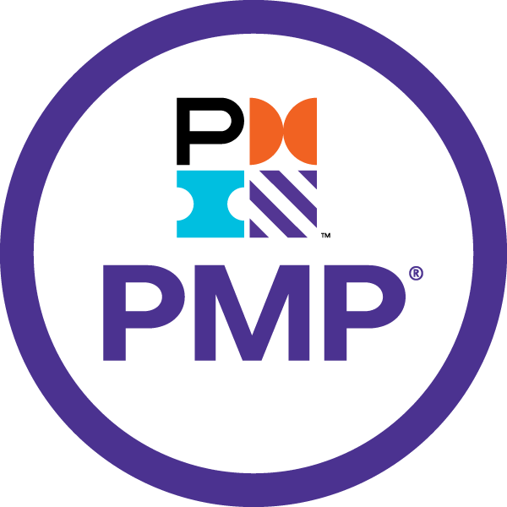
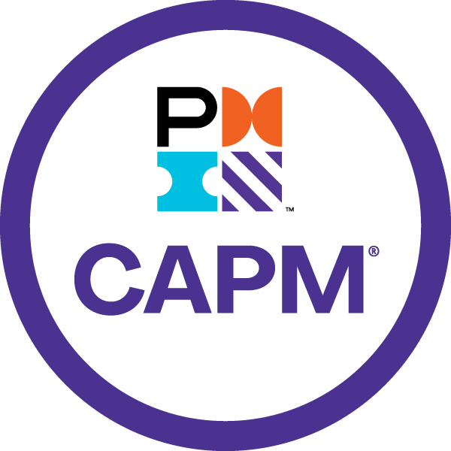
Roles, Functions, and Credentials
VP Project-Strategy Management
Organizational Project Portfolios
Project/Strategy Managers Development
Project/Strategy Management Tool-Box
Align Corporate Strategies & PMO
Corporate Project Implementations
Support PM Education & Experiences
Advanced Degree & Certifications
Dir. Project-Strategy Management
Business Unit/Functional Project Portfolios
Operations & Corporate Projects
Project Managers Development
Alignment with Organizational PMO
Creation of Tools & Methodologies
Support PM Education & Experiences
Advanced Certifications
Sr. Project / Portfolio Manager
Functional Area Project Portfolio
Operations & Corporate Projects
Creation of Tools & Methodologies
Project Manager(s) Development
Support PM Education & Experiences
Advanced Certifications
Sr. Project Manager
Functional & Corporate Projects
Creation of Tools & Methodologies
Support PM Education & Experiences
Obtaining PMP®
Fundamental Courses
Project Coordinator & Project Manager
Internal Functional Projects
Development of PM Skills & Experiences
Support Tracking & Reporting Activities
Fundamental Development

Slide 6
What is Project Management?
Project Life Cycle
Starting
Organizing/Plan
Doing the Work / Implementation
Ending
Process Groups
Initiation
Planning
Executing
Monitor & Control
Closing
Knowledge Areas
Integration
Scope
Schedule
Cost
Quality
Resource
Communications
Risk
Procurement
Stakeholder
Key:
Gate / Milestone
Project Phase
Potential Use
Timeline

Slide 7
What is Portfolio Management?
Corporate Portfolio
Operations
Portfolios
Strategic
Portfolios
PRT 1.1
PRT 1.2
PRT 2.1
PRT 2.2
PRJ 1.11
PRJ 1.12
PRJ 1.13
PRJ 1.21
PRJ 1.22
PRJ 2.11
PRJ 2.12
PRJ 2.21
PRJ 2.22
PRJ 2.23
Resource Allocation
Prioritization
Governance
Tools & Templates
Organization Development
Team Member Development
Methodologies
Financial Management

Slide 8
What is Strategy?
…Value for Shareholders…
Kaplan, R. S., & Norton, D. P. (2004). Strategy Maps. Harvard Business School Press.
…Competitive Advantage…
Pearce II, J. A., & de Kluyver, C. A. (2015). Strategic Management. Business Expert Press.
…Superior Performance Relative to Competitors…
Rothaermel, F. T. (2017). Strategic Management. McGraw Hill.
…How a Business is Going to Compete…
Porter, M. (1980). Competitive Strategy. The Free Press.
…Plan for Achieving Goals and Objectives…
Nickols, F. (2008). Strategy, Strategic Management, Strategic Planning, and Strategic Thinking.
…Building Capabilities & Competencies…
Gerald Jeffs, Strategy & Project Management Professional

Slide 9
What is Strategy Management?
Management, Planning, Controlling, and Adjusting
Markets Served
Value Proposition to Market
Market Potential
Entry into Market
Resources
Capabilities & Competencies
Bandwidth & Incentives
People, Capital, Financial, etc.
Organization Alignment
Impacted Stakeholders
Organizational Capability
Organizational Motivation
Pivoting
Sunk Work & Cost Acceptance
Risk Analysis
Executive Feedback Loop
Prioritizations
Strategic Portfolio Pipeline
Competing Forces
Decision Making Authorities
Business Modeling
Writing the Story
What, Who, and How
Financial Flows
Measurements
Success Factors
Leading & Lagging Indicators
Quantitative vs. Qualitative
Strategic Mapping
Projects Driving Strategy
Impacts of Strategy
Value Returned from Strategy

Slide 10



Types of Strategic Projects & Portfolios
Business Models
People & Culture
Vision & Mission
Value Proposition
Customer Experience
Technology
Distribution Structure
Technology
Internal Skills
Mergers & Acquisitions
Operational
Customer Management
Product Development
Market Strategies
Product Strategies
Diversification Strategies
Branding
Innovation
Quality
TRANSFORMATION
CAPABILITIES
GROWTH

Slide 11




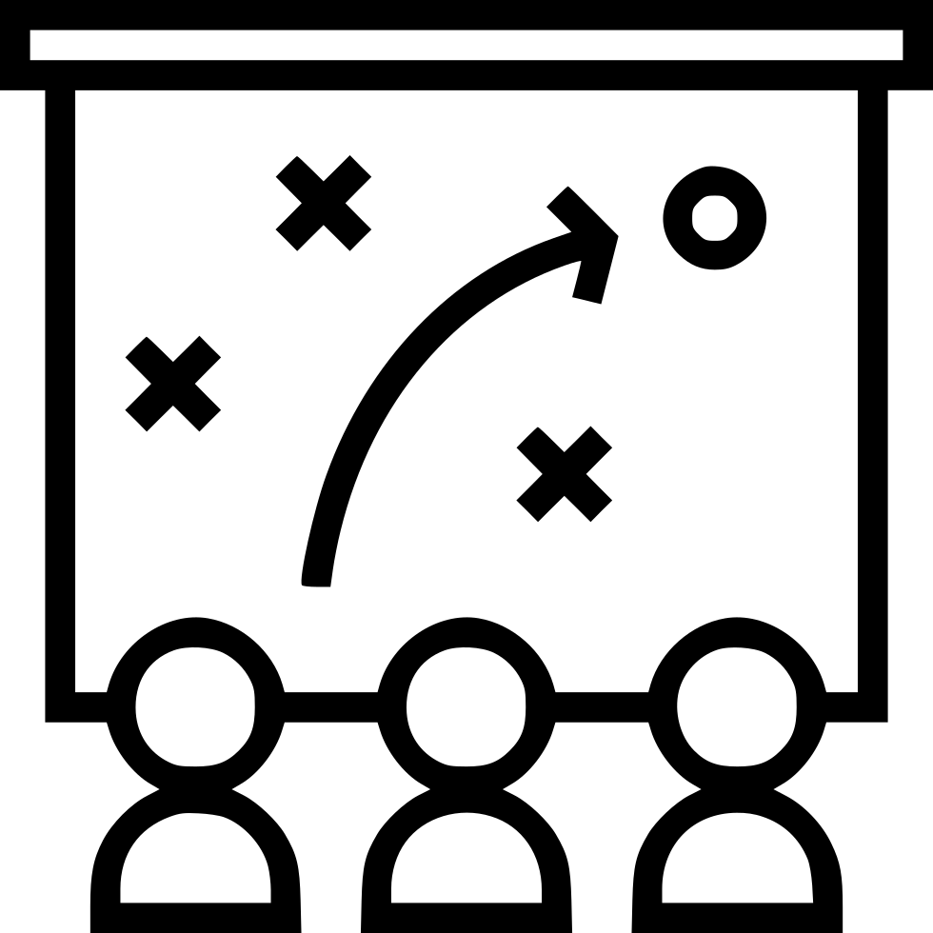





Needed Skills & Experiences
Communications
Leadership
Project Management
Portfolio Management
Strategy Management
Organizational Development
Industry Specific Knowledge
Product Management
Market Analysis
Cross Cultural Management

Slide 12
A Career of Knowledge and Experience
VP Project-Strategy Management
Highest Level of Industry Knowledge
Highest Organizational Development Skills
Highest Org. Wide Functional Knowledge
10+ Years Project Portfolio Leadership
10+ Years Strategic Portfolio Leadership
10+ Years Leading & Developing Teams
Dir. Project-Strategy Management
Strong Industry Knowledge
Strong Organizational Development Skills
Strong Functional Area(s) Knowledge
5+ Years Project Portfolio Leadership
5+ Years Strategic Project Portfolio
5+ Years Leading & Developing Teams
Industry
Knowledge
Sr. Project / Portfolio Manager
Wide Industry Knowledge
Wide Team Development Skills
Wide Functional Area(s) Knowledge
5+ Years Project Management Leadership
5+ Years Leading Strategic Projects
5+ Years Developing People
Sr. Project Manager
Good Industry Knowledge
Good Leadership Skills
Good Functional Area Knowledge
5+ Years Project Management
5+ Years Cross Functional Area Projects
5+ Years Matrix Resource Integration
Change
Project Coordinator & Project Manager
Developing Industry Knowledge
Developing People Skills
Developing Functional Area Knowledge
2+ Years Project Management Skills
2+ Years Assisting Sr. Project Manager(s)
2+ Years Project Mgt Tools Experience

Slide 13
PMP® Certification Requirements
High school diploma
60 months experience leading projects within the past eight years
35 hours of project management education/training or CAPM®
60 Professional Development Units (PDU) every three years
Four-year degree
36 months experience leading projects within the past eight years
35 hours of project management education/training or CAPM®
60 Professional Development Units (PDU) every three years
or

Slide 14



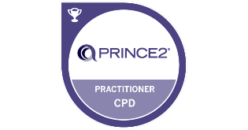
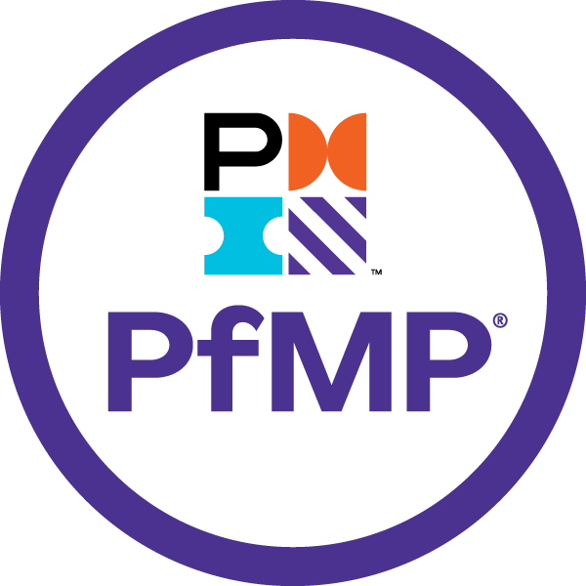


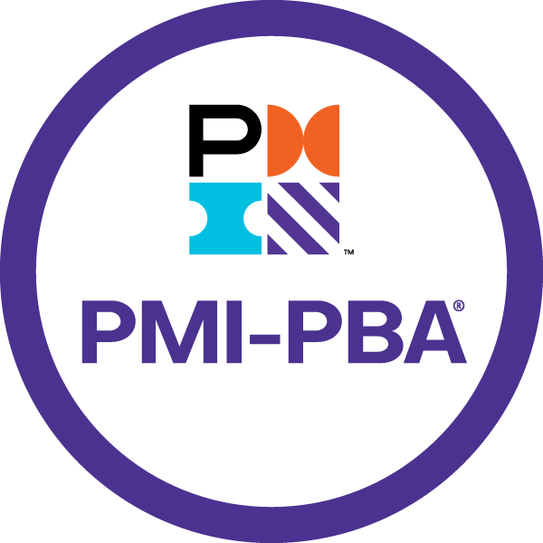
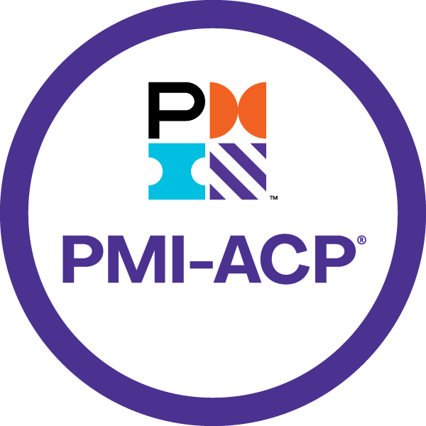


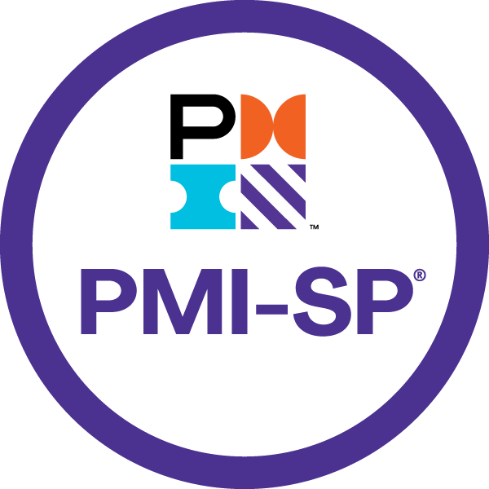



Other Project Management Credentials
Undergraduate, Graduate, or University Certifications/Degrees
Prince2 Foundation
Program Management Professional (PgMP®)
Prince2 Practitioner
Portfolio Management Professional (PfMP®)
Prince2 Agile Foundation
Certified Associate in Project Management (CAPM®)
Prince2 Agile Practitioner
PMI Professional in Business Analysis (PMI-PBA®)
PMI Agile Certified Practitioner (PMI-ACP®)
PMI Risk Management Professional (PMI-RMP®)
Disciplined Agile Scrum Master (DASM®)
PMI Scheduling Professional (PMI-SP®)
Disciplined Agile Senior Scrum Master (DASSM®)
https://www.pmi.org
https://www.prince2.com

Slide 15


Thank You
Gerald Jeffs
clarityexecution.com
www.linkedin.com/in/gerryjeffs
jeffsgerry@gmail.com
925-487-5982
Tracy, CA

