Slide 1



Introduction to Strategy Management
Building Capabilities and Competencies

Slide 2
Agenda / Topics
(All topics can be a 1-4 hour classroom session, depending on depth)
01
What is Strategy & Strategy Mgt.
05
Business Modeling
02
Mission, Vision, and Values
06
S.W.O.T. Analysis
03
Culture Based Strategies
07
Strategic Mapping
04
Strategic Project Portfolio Mgt.
08
Branding & Mind Mapping

Slide 3

What is
Strategy?

Slide 4
01
What is Strategy & Strategy Mgt.
How Others Define Strategy
Value for Shareholders
Kaplan, R. S., & Norton, D. P. (2004). Strategy Maps. Harvard Business School Press.
Competitive Advantage
Pearce II, J. A., & de Kluyver, C. A. (2015). Strategic Management. Business Expert Press.
There is no one right answer, only opinions
Superior Performance Relative to Competitors
Rothaermel, F. T. (2017). Strategic Management. McGraw Hill.
How a Business is Going to Compete
Porter, M. (1980). Competitive Strategy. The Free Press.
Plan for Achieving Goals and Objectives
Nickols, F. (2008). Strategy, Strategic Management, Strategic Planning, and Strategic Thinking.
Building Capabilities & Competencies for Differentiation
Gerald Jeffs (2019), Strategy & Project Management Professional

Slide 5



Types of Strategies
Strategic Projects or Portfolios
  Business Model
  People & Culture
  Vision & Mission
  Value Proposition
  Customer Experience
  Technology
  Distribution Structure
  Technology
  Internal Skills
  Mergers & Acquisitions
  Operational
  Customer Management
  Product Development
  Market Strategies
  Product Strategies
  Diversification Strategies
  Branding
  Innovation
  Quality
Transformation
Capabilities
Growth
But there can be so much more

Slide 6
What is Strategy Management?
Management, Planning, Controlling, and Adjusting
Markets Served
Value Proposition to Market
Market Potential
Entry into Market
Resources
Capabilities & Competencies
Bandwidth & Incentives
People, Capital, Financial, etc.
Organization Alignment
Impacted Stakeholders
Organizational Capability
Organizational Motivation
Pivoting
Sunk Work & Cost Acceptance
Risk Analysis
Executive Feedback Loop
Prioritizations
Strategic Portfolio Pipeline
Competing Forces
Decision Making Authorities
Business Modeling
Writing the Story
What, Who, and How
Financial Flows
Measurements
Success Factors
Leading & Lagging Indicators
Quantitative vs. Qualitative
Strategic Mapping
Projects Driving Strategy
Impacts of Strategy
Value Returned from Strategy

Slide 7
Factors that Limit Strategic Results
Vision
Actionable
Strategy
Capabilities
Incentives
Resources
Urgency
Success
Lacking Vision
Lacking Actionable Strategy
Lacking Capabilities
Lacking Incentives
Lacking Resources
Lacking Urgency
Confusion
False Starts
Anxiety
Restraint & Resistance
Frustration
Apathy
Success Factors
Transparency
Stakeholder Engagement
Communications
Involvement
Limiting Factors
Disengagement
Organizational Alignment
Resource Capabilities
Contradicting Priorities

Slide 8




02
Mission, Vision, and Values
What, How, and Guiding Beliefs
MISSION
What an organization does
Different People have Different Definitions
VISION
How an organization delivers on its mission
VALUES
Beliefs of an organization
Leadership
Sets Vision & Strategy

Slide 9




Mission Statements
Examples: There is no one set of rules.
General Guiding Principles
Concise description of a company’s general purpose.
  10 to 25 words, keep it simple
Be aspirational & memorable.
  If those close can’t remember it, it isn’t working
  This is for the organization, not the World
Written with multiple audiences in mind.
  Primarily employees
  Public, stakeholders, and customers
Don’t compare yours to others.
  A respected organization doesn’t mean they have a great mission statement
“To bring the best user experience to customers through innovative hardware, software and services.”
“To provide branded products and services of superior quality and value that improve the lives of the world’s consumers, now and for generations to come.”
“To bring inspiration and innovation to every athlete in the world. If you have a body, you are an athlete.”
“Delivering Strategic Project Portfolio Management Expertise.”

Slide 10




Vision Statements
Examples: There is no one set of rules.
General Guiding Principles
Specific but concise, and not overly detailed.
  5 to 15 words, keep it simple
  One or two key points
  Not a catchy phrase, aim for clarity
Inspirational, memorable, and simple
  Easy to focus on and fulfill
  No technical terms or jargon
This is organizational not a World vision
Don’t compare yours to others.
  A respected organization doesn’t mean they have a great vision statement
“Our vision is to be the most trusted and agile partner for meeting diverse educational needs.”
“To make people happy.”
“Spread ideas.”
“We ignite opportunity by setting the world in motion.”
“Trusted Expert in Strategic Project Portfolio Management.”

Slide 11




What Altitude Provides the Best Viewpoint?
Mission & Vision Represent
The Right Level of Focus
The Impacted Level
Global
Region
Industry
Organization

Slide 12




Values, Beliefs, or Behaviors
Examples: There is no one set of rules.
General Guiding Principles
Serve as a guide for behavior
Can shape the culture and public perception
Contain words like: Integrity, Diversity, Innovation, Community, Customer Satisfaction, and Sustainability
A statement may follow the descriptive noun.
  “Striving for innovation in all we do.”
  “Promoting diversity & inclusion”
  “We are one team.”
More words are not always better.
  These should be memorable to employees.
  Decisions must reflect values.
Leadership, Collaboration, Integrity, Accountability, Passion, Diversity, and Quality
Diversity, Equity, Inclusion, Sustainability
People First, Customer Driven, One Team, Act as Owners, Raise the Bar, Value Different Perspectives
Entrepreneurial Spirit and Employee Focus
Trust and Continuous Development

Slide 13
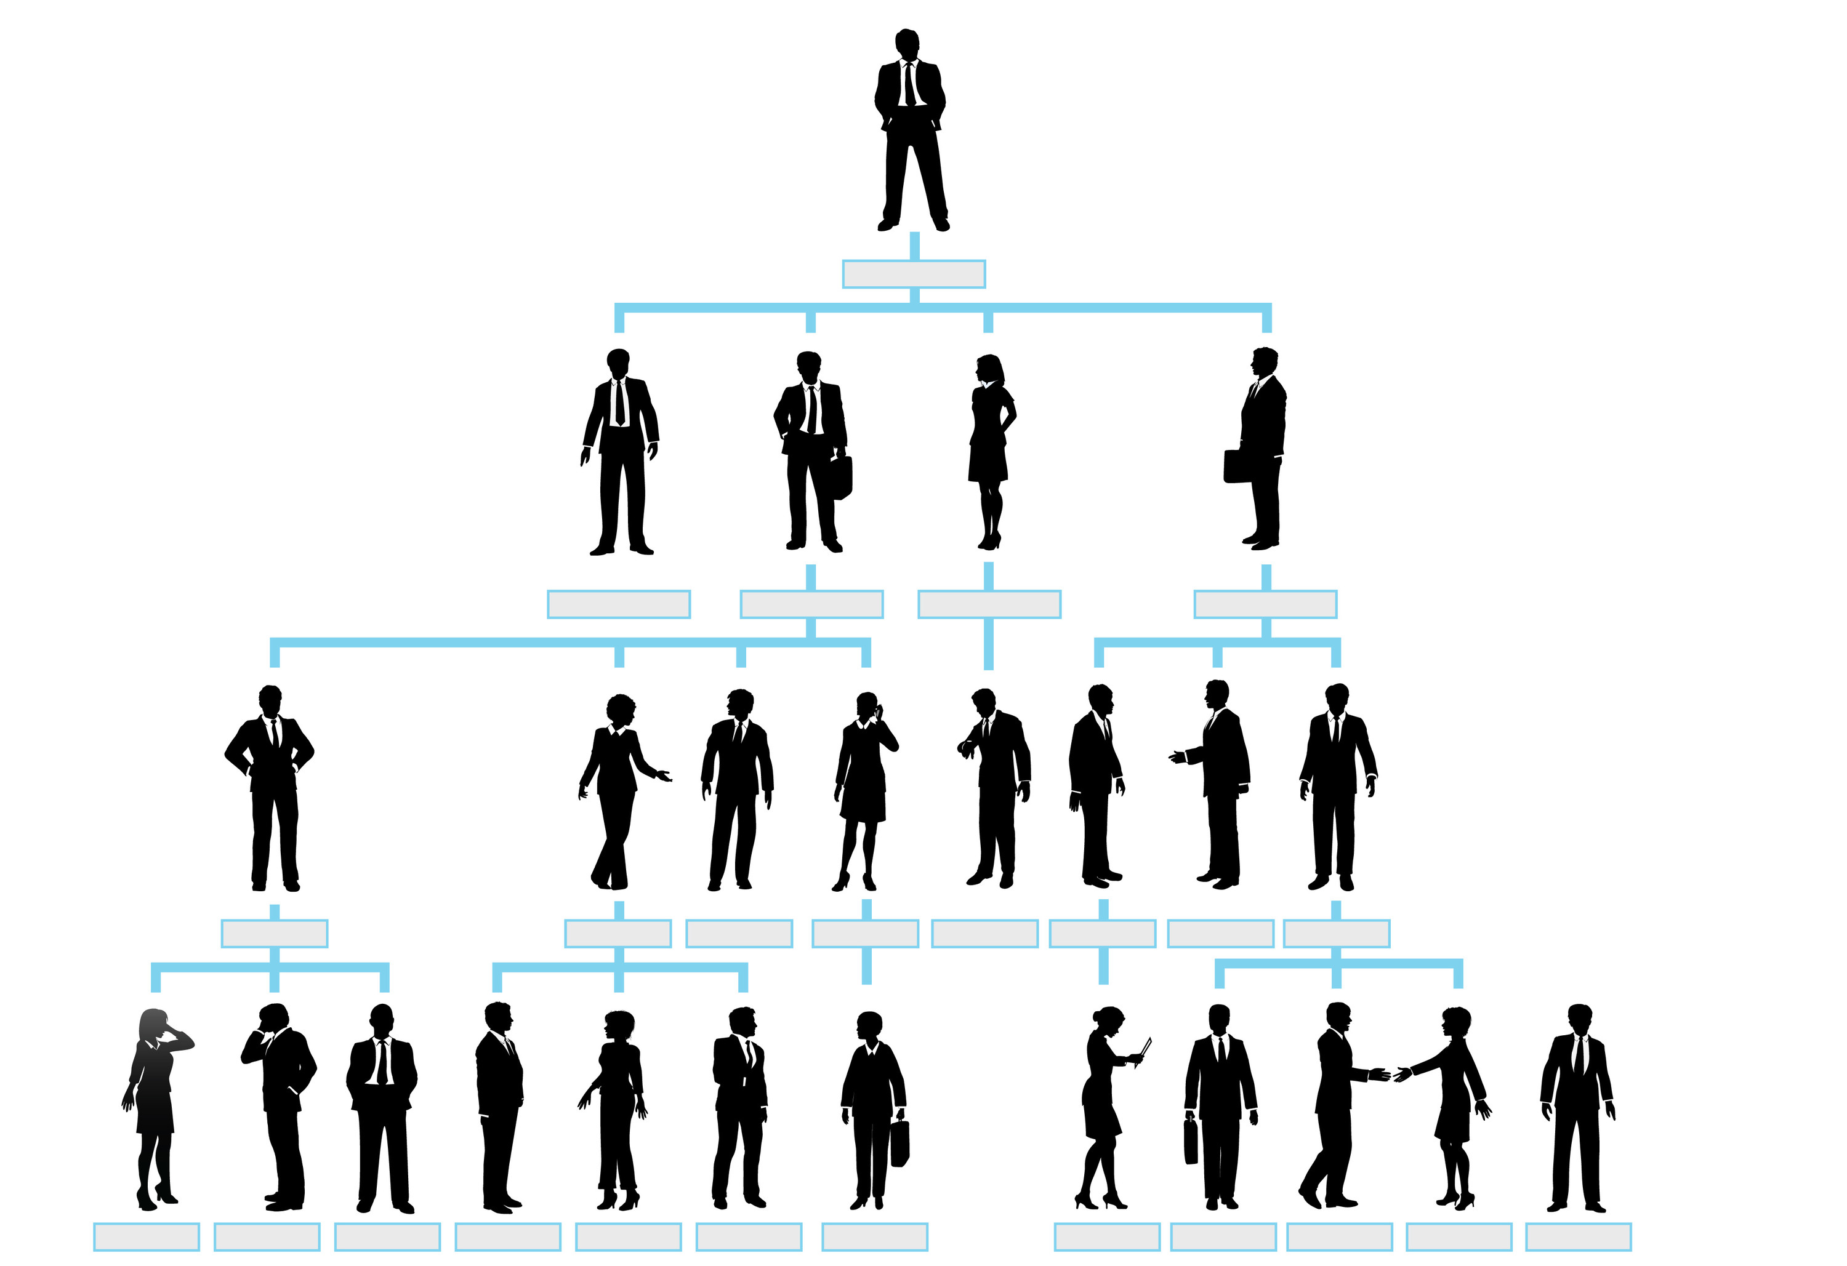
Organizationally Deep Strategy, Culture, Mission, Vision, & Values
Highest-Level Organizational Strategy
Highest-Level Mission, Vision, and Values
Highest
Culture
Business Units / Regional Area Strategy
Mission, Vision, and Values
Alignment
Culture
Culture
Culture
Culture
Functional Area / Team Strategy
Mission, Vision, and Values
Lowest
Culture
Culture
Culture
Culture
Culture
Culture
Culture
Culture
Personal Strategy
Mission, Vision, and Values
Culture
Culture
Culture
Culture
Culture
Culture
Culture
Culture
Culture
Culture
Culture
Culture

Slide 14
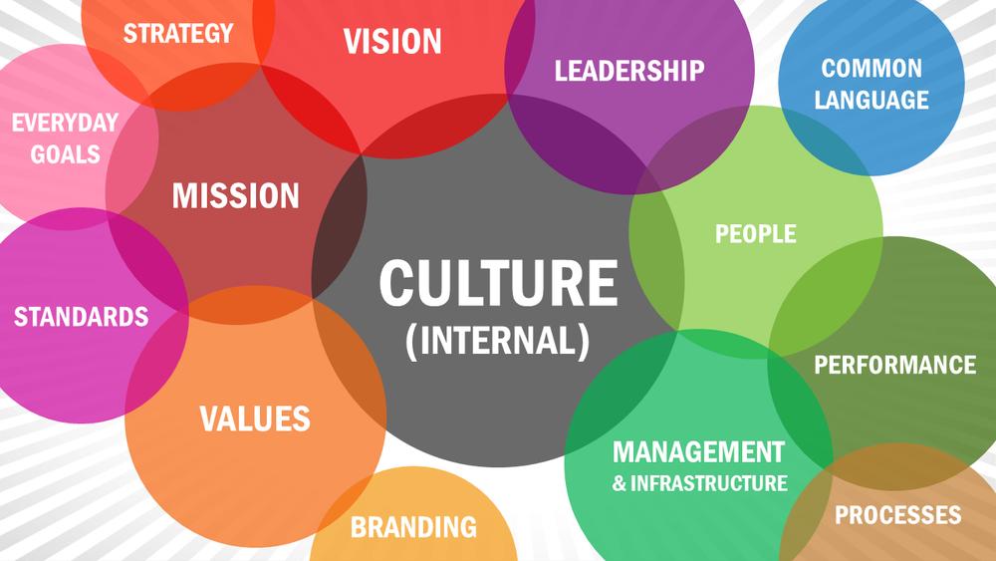
03
Culture Based Strategies
What Makes an Organizational or Team Culture
Behaviors
Beliefs
Culture

Slide 15

What Comes First, Beliefs or Behaviors?
Changing Culture Requires Changing Both
Behaviors
Actions we take
Decisions we make
Tasks we perform
How we work
How we interact
Developed over Time
This isn’t a chicken or egg problem
Forced Behavioral Changes
Beliefs that Followed
Technology Advances
Working Locations
Global Travel
Climate Change
Scientific Advances
Medical Advances
Leadership Advances
Enhances jobs, not eliminates
Remote work is beneficial
People want the same things in life
Fossil fuels to sustainable solutions
The Earth is a sphere
Cancer doesn’t always kill
People need more than a paycheck
Beliefs
How we think
Input into Decisions
Drives commitments
How we trust
Where we get information
Developed over time

Slide 16
Change a Culture to Deliver Value
Understand Why the Change is Needed
Cyber security is a threat to data integrity and ransom demands.
The Behavioral Challenge
People are used to the simplicity of logging into a system and will not like the additional steps.
Culture to Change
How Wide the Change is
All users with access to company email, all applications, and have unique user login credentials.
Belief in the Change Comes Much Later
What Behaviors Need to Change
Password credentials change every 90-days, and double security access required for certain applications.
Plan to Socialize the Change
Development of communications material and lists of people impacted by the change.
Socialize the Change
Open and circular communications, answer all questions, and actively listen to concerns.
Build a Team of Champions
Pilot the changes with people that have the greatest connections to those impacted, get feedback and adjust.
Implement in Phases
Make the changes as quickly as possible, but in manageable group sizes, and apply extra support.

Slide 17


04
Strategic Project Portfolio Mgt.
What is a Portfolio and Portfolio Management in the Project Management World?
Grouping of Projects & Programs Under Single Owner
Individual Projects or Programs of Multiple Projects.
Representing Strategic Projects, Customer Projects, Continuous Improvement Projects, etc.
Supporting Resources can be Direct Reporting or Matrix
REPORT
PRIORITIZE
Portfolio
MGT
VALIDATE
EXECUTE
Prioritization of Projects, Programs, and Resources.
Status Reporting of Projects, Programs, and Portfolio.
Leadership & Development of Project Managers.
Monitoring and Controlling the Implementation of Portfolio Projects & Programs.
CONTROL

Slide 18





Portfolio Structure
Portfolio Structure isn’t Leadership/Ownership Structure
Owner 1
Strategic Portfolio
Owner 2
Sub-Portfolio or Domain 1
Owner 3
Domain 1a
Projects & Programs
Resources
Budgets & Measurements
Domain 1b
Projects & Programs
Resources
Budgets & Measurements
Domain 1c
Projects & Programs
Resources
Budgets & Measurements
Owner 4
Owner 5
Domain Examples
Human Resources
Technology
  Hardware
  Software
  Security
Operations
Finance
  Payroll
  Tax
Sub-Portfolio or Domain 2
Projects & Programs
Resources
Budgets & Measurements
Sub-Portfolio or Domain 3
Domain 3a
Projects & Programs
Resources
Budgets & Measurements
Domain 3b
Projects & Programs
Resources
Budgets & Measurements
Note: Every Organization Structures Domains and Resources Differently

Slide 19

Strategic Project Portfolio
STRATEGIC PORTFOLIO
STRATEGIC PORTFOLIO
STRATEGIC PORTFOLIO
PROGRAM
PROGRAM
PROGRAM

Slide 20



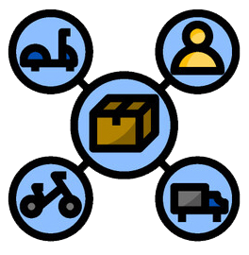





05
Business Modeling
Telling the Story
Value Propositions
What problems are being solved by your solution?
Is the solution different and durable?
Customer Segments
Who has the problem, what’s the market size?
Is it measurable and accessible?
Will the solution impact a substantial piece of the market?
Relationship Management
How are relationships conducted?
Email, voice, video technology, face-to-face, seminars, etc.
Frequency of contact
Delivery Channels
How are solutions delivered?
Personal delivery, supply chains, technology delivery, brick & mortar, etc.
Key Activities
Activities performed on a regular basis.
Manufacturing, application development, purchasing, marketing, etc.
Key Resources
People, skills, or competencies required to deliver the solution.
Capital and financial resources
Key Partners
External partners that assist in delivering the solution, or support of the organization.
Can be functional teams that support other functional teams.
Revenue Streams
Where does the financial support come from?
Can be internal and external sources.
Sales, contributions, in-kind donations, reallocation of profits, etc.
Cost Structure
What costs are needed to support the model?
Payroll, 3rd Party costs, technology, capital expenses and overhead, cost of goods, etc.

Slide 21
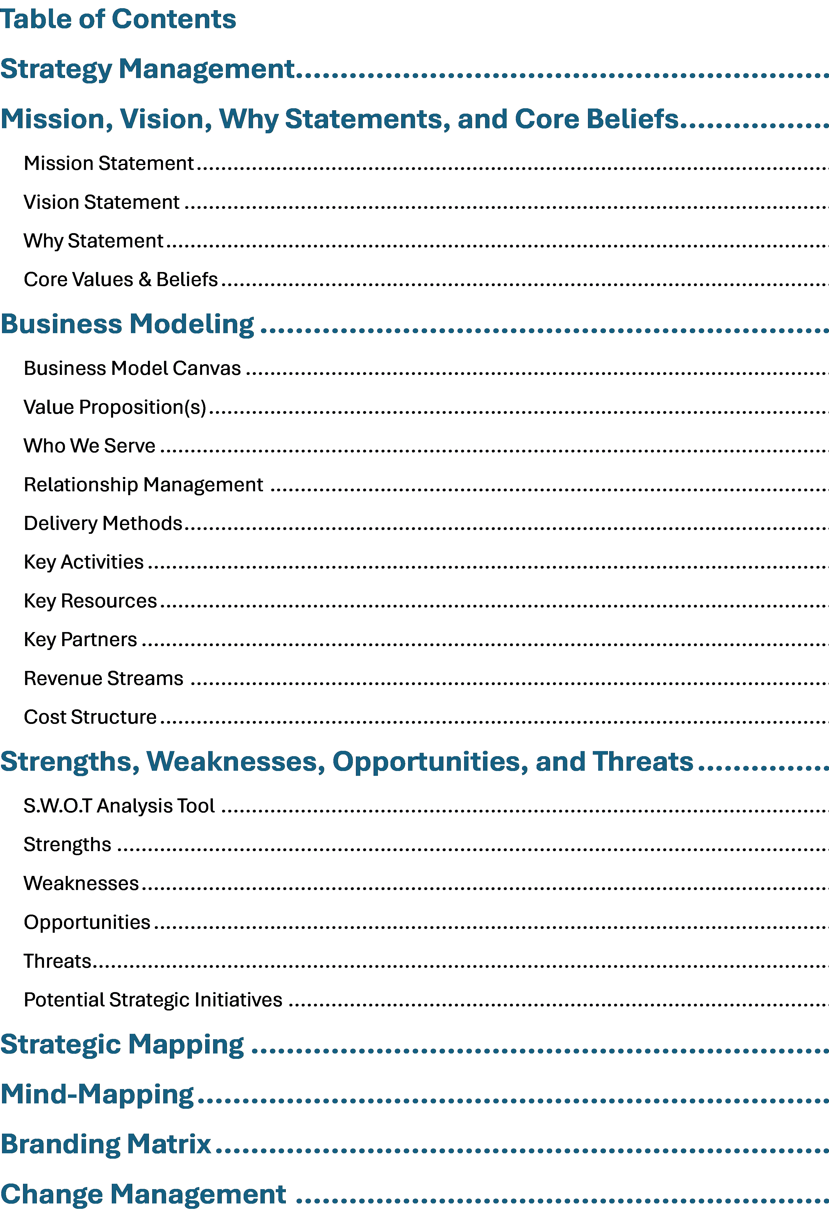
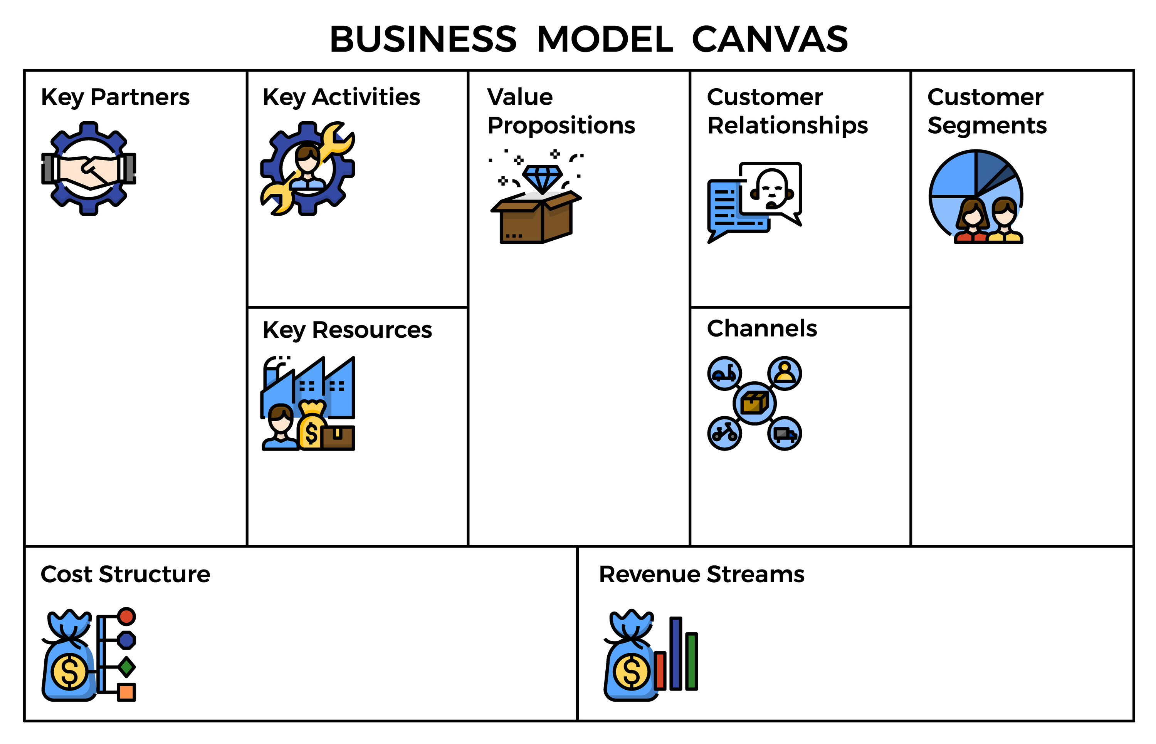
Detailed and High-Level Models
Different Documents for Same Model but Different Audiences
Detailed: Part of a strategic plan that allows for details too deep for a quick presentation
High-Level: Great for presentations, brief overview of who an organization is, who they support, problems they solve, and how they work.
Note: Every organization may require different elements and formats for approvals / support.

Slide 22









Business Model Example
Global Project Management Organization
Designed For: Global Project Management
Designed By: Gerald Jeffs
Year: 2024
APLL Customers
Customs Brokerage Organizations
External Software Providers
Customer Manufactures and Suppliers
Ocean & Air Carriers
All APLL Internal Functional Teams
Implementing customer global supply chain strategies
Implementing internal strategic initiatives
Development of knowledge, skills, and experiences
Implementation of customer supply chain strategies.
Delivery of APLL products & services to the markets we serve.
Execution of corporate strategies & initiatives.
Face-to-Face
Video/Voice Communications
Electronic Communications
Global Operations
  NAM, LATAM, EMEA, SA, NA, SEA
Corporate Functions
  HR, Finance, Legal, Compliance, Risk, Marketing, etc.
Business Development
  New Accounts
Key Partners
Key Activities
Value Propositions
Relationships Mgt.
Who We Serve
Strategy Managers
Portfolio Managers
Project Managers
Commercial Engagements
Planning Sessions
Remote Execution & Control of Activities
Steering Committee Interactions
Key Resources / Skills
Delivery Methods
Cost of Resources: Salaries, Fringe, Misc.
Travel Expenses
Training and Development
Technology Equip: PCs, Laptops, Printers
Software: Portfolio Management, MS Project, Visio, etc.
Customer Agreements for Implementation Cost
Cost Center Allocation
Cost Structure
Revenue Streams

Slide 23
06
S.W.O.T. Analysis
Strengths, Weaknesses, Opportunity's, and Threats
Internal Factors
External Factors
Strengths
Forces unique to the organization
Core competencies Skills, operating capabilities & differentiators
Resources: People & Capital
Weaknesses
Forces limiting an organizations value proposition
Lacking capabilities, skills, capital investments, etc.
Opportunities
Forces that can be capitalized
Factors: Political, Economic, Social-Cultural, Technology, Environmental, Legal, etc.
Threats
Forces that can cause disruptions
Factors: Political, Economic, Social-Cultural, Technology, Environmental, Legal, etc.
Factors that are internal to the organization
The organization has control over these
They can be changed within the organization
Factors that are external to the organization
The organization has no control over these
They can’t be changed by the organization

Slide 24
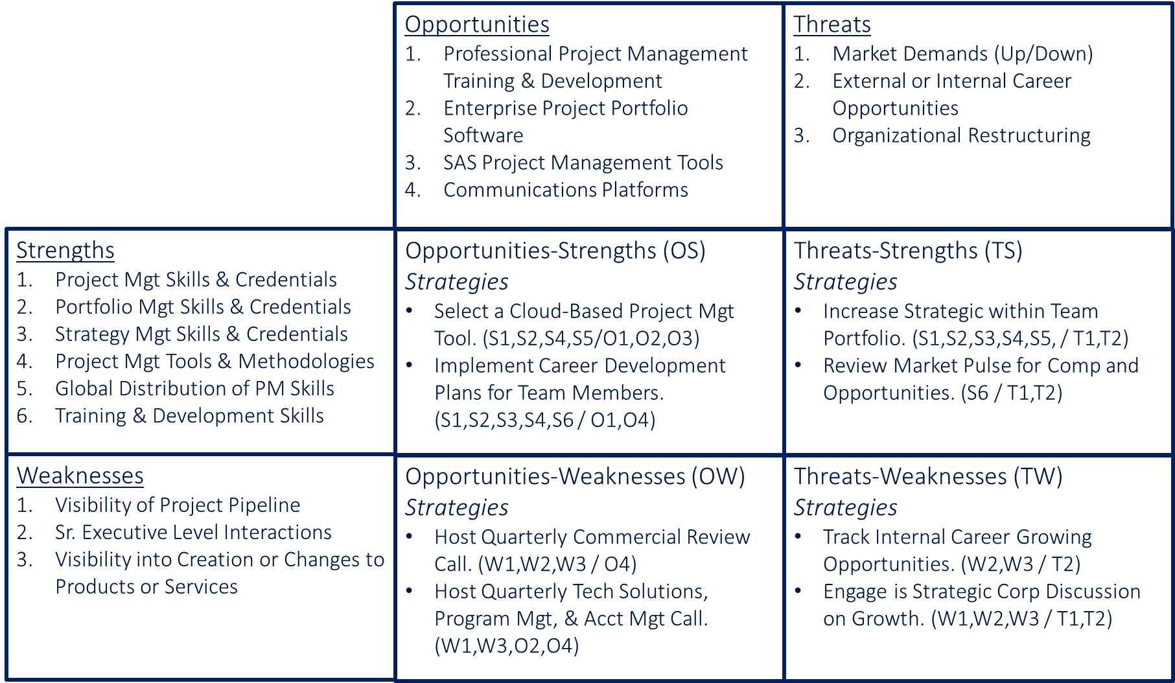
S.W.O.T.’s Done, Now What?
Start Strategic Planning
Value of Work: It creates actionable strategies to strengthen a team or organization. A leader should create a draft and then get team input for buy in. Not all initiatives need to be done, pick one or two to start with.
Opportunities - Strengths (OS)
(Strategies)
What strengths can be used to capitalize on opportunities
Define strategic initiatives by identifying the strength and the opportunity (S1, S3, O4)
Threats - Strengths (TS)
(Strategies)
What strengths can be used to limit a threats impact
Define strategic initiatives by identifying the strength and the threat (S2, T2, T3)
Example
Opportunities - Weaknesses (OW)
(Strategies)
What weaknesses if improved can be used to capitalize on opportunities
Define strategic initiatives by identifying the weakness and the opportunity (W2, O1, O3)
Threats - Weaknesses (TW)
(Strategies)
What weaknesses if improved can be used to limit a threats impact
Define strategic initiatives by identifying the weakness and the threat (W2, W4, T1, T4)

Slide 25
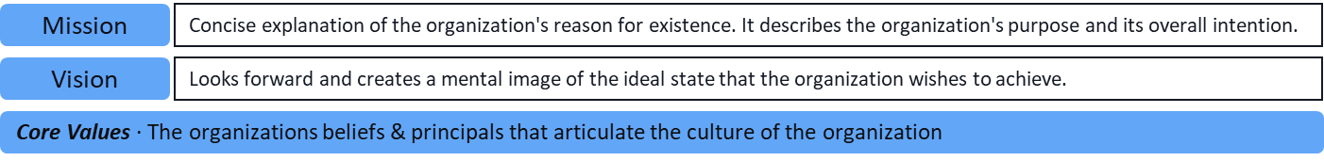
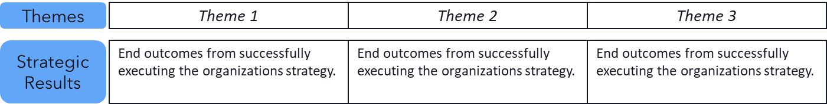
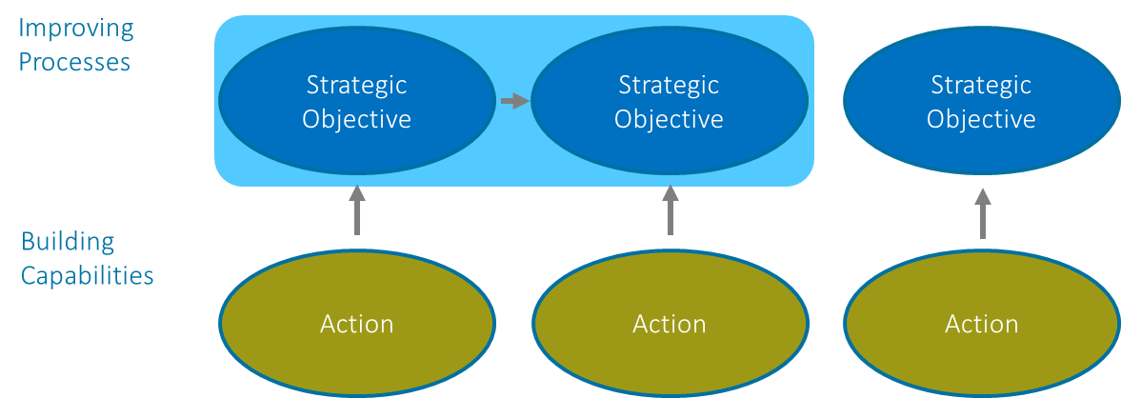
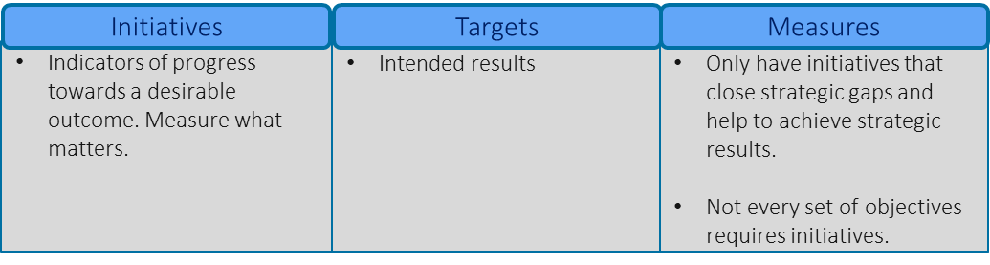
07
Strategic Mapping
Turning Previous Work into a Visual Strategic Plan
This will be some of the hardest work
Mission, Vision, & Values
These drive all strategies, so they need to be front, and center and alignment must be visible.
S.W.O.T. into
Strategic Themes
A theme will come out of the S.W.O.T. work, there can be as little as one, there shouldn’t be more than four.
Mapping Connections Upward
The categories can change, there should be three to four levels that are connected by a level below, but the below work can jump up more than one level.
Initiatives, Targets, & Measures
Define specific strategic initiatives with targeted objectives, and measurement that present what success looks like

Slide 26
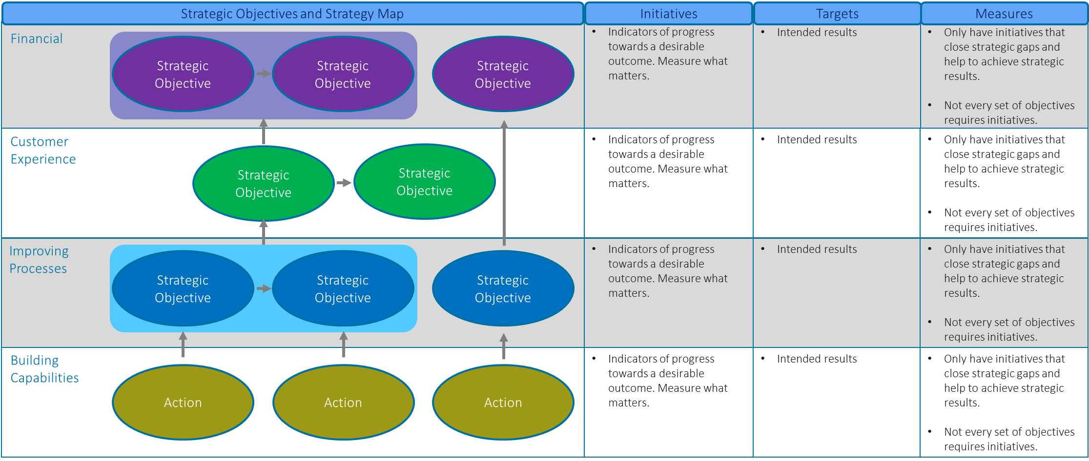
Building the Connections Up
Simplicity & Conciseness is King, but Never Easy
The picture will tell the story of a team’s or organization’s direction, what they’re going to do and how they do it. This may appear simple, but that’s only because a lot of work will go into doing it.

Slide 27
Strategic Mapping Example: Global Project Mgt.
Mission
Execute Customer and Organizational Strategies
Vision
Global Project Management Capable of Delivering Complex Strategies
Themes
Career Development
Tools
Communications
Strategic
Objectives
Individual paths for team members that include education requirements, skill building opportunities, and defined opportunities that encourage professional growth.
Review of cloud-based portfolio management and project management tools and determine if any are a right fit from Global Project Implementations.
Create a rhythm of communications with Commercial, Tech Solutions, Account Management, and Program Management for updates on Pipeline and changes to products or services.
Strategic Objectives and Strategy Map
Initiatives
Objectives
Measures
Financial
Improved Speed to Service
Growth of Services Provided
Increased Financial Strength
Historical Tracking of Project Milestones
Tracking Key Project Dates in Portfolio Tool
Time from “Go” to First Capability, and from Capability to Closure
Customer Experience
None Currently
TBD
TBD
Professional Project Management
Control of Project Risk
Improving
Expanding PM Knowledge
Tool Chest Expansion
Knowledge & Experience Sharing
Increased PM Credentials
Increased PM Tools
Globally Sharing Knowledge & Experiences
# of Credentials Achieved
# of New Tools Added
# of Global Participants in Sharing Sessions
Team Member Engagement
Tool Chest Flexibility
Shared Knowledge / Experience
Capabilities / Competencies
Career Path Discussions
Cloud Based PM Tool Experiences
Cross Functional Virtual Meetings
Career and Performance Development Sessions
PM Tool Evaluations
Facilitated Cross Functional Knowledge Sharing
Two-Three Annual Sessions
Two-Three Tools Evaluated
Quarterly Hosted Sessions
Per Person # of Sessions Performed
# of Tools Evaluated
# of Quarterly Hosted Sessions
Core Values ∙ Trust ◊ Learning

Slide 28
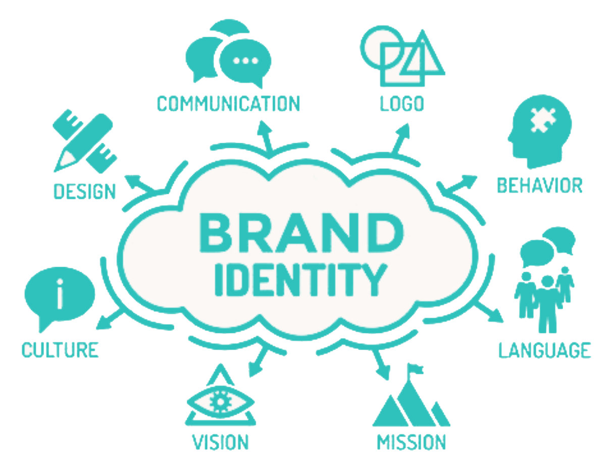

08
Branding & Mind Mapping
How We Present Ourselves & How We are Perceived by Others
Branding Matrix
Mind Mapping
Aligns Core Brand with Values and Culture Internally and Externally.
What’s the organization’s personality and how does it express itself.
What do relationships and market position look like to others.
The competencies in the organization with the offered value proposition.
What does an organization want to be in the hearts and minds of people.
How does the organization see itself and how does it present externally?
Mapping can go as deep as needed.

Slide 29
Branding Matrix
How Does the Organization or Team Align Internally & Externally
INTERACTION
STRATEGY
EXTERNAL
Value Proposition
What problem is being solved & how?
Relationships
The nature of relationships with key stakeholders.
Position
The market position and what’s in the hearts & minds of key stakeholders?
Alignment
There needs to be clear alignment on the diagonal paths (Strategy & Competition), the vertical path (Interaction), and the horizontal path (communications).
Expression
The way an organization communicates and expresses itself
Brand Core
What’s the promise and what are the core values that sum up what the brand stands for?
Personality
What combination of human characteristics or qualities forms the character?
EXTERNAL / INTERNAL
COMMUNICATIONS
Usage
Internal & external communications about how the organization defines itself and how it functions; also helps drive what’s being established at the core.
Vision & Mission
Vision: How does the organization or team accomplish objectives
Mission: What is the core function of the organization or team
Culture
What are the organization’s or team’s attitude and how do they work & behave?
Competences
What the organization or team are good at, and what makes them better than most?
INTERNAL
COMPETITION

Slide 30
Hearts & Minds of Others
Careers in Project Mgt.
Example: Clarity Execution
Project/Program/Strategy Mgt.
Contract Assignments
For Profits
Nonprofits
501c3 / c4 Corps.
Guest Speaker
Product Mgt.
Remote & Onsite
Local & Regional
Change Mgt. / Changing Culture
Under & Graduate Prgms.
Educator
Project/Program/Strategy Mgt.
H.S. Business Prgms.
Education Providers
Customers
Courses / Programs
Project Mgt. Organizations
8 to 40 Hours Course Work
Individuals & Teams
Professional Conferences
Professional Organizations
Mentor
Career Development
Project Mgt. Organizations
Mid-Level to Sr. Leaders
Individuals & Groups
Project/Program Prioritization
PM Organization Structure
Team Development
Portfolio Management
Resource Management
Build Sustainable Org & Teams
Schedules, Cost, Risk, Communications
Repository of Tools & Processes
Market Analysis
Application of Tools
Project Management
Strategy Management
Business Planning
Solution Viability
Tools & Methods
Standard & Agile Methods
Organization Alignment
Project & Program Mgt.
S.W.O.T. Analysis / Identify Initiatives
Applied Project & Program Mgt.
Project Leader
Change Management
Strategy Execution
Strategic Planning
Strategic Road Mapping
Proj. Portfolio Management
Stakeholder Mgt.
Organization Socialization

Slide 31



“The belief in this work comes from the act of doing it.”

Slide 32

Thank You
Gerald Jeffs
clarityexecution.com
www.linkedin.com/in/gerryjeffs
jeffsgerry@gmail.com
925-487-5982
Tracy, CA

